Slide 1
Life or a Knife? The consequences of Knife crime

Slide 2
What is Knife Crime
Knife crime is any crime involving a knife or sharp object. This includes: carrying a knife, owning a banned knife, trying to buy a knife if you are under 18, and/or threatening, injuring or fatally wounding someone with a knife.
An offensive weapon is defined as any item that has been made or adapted for the intention to cause hurt or harm to another person, under the Offences Weapon Act 2019. It is also important to note that pepper spray is illegal to possess in the UK, and is classed as a firearm under Section 5 (1)b of the Firearms Act 1968.
Self-defence or self-protection are not valid reasons for carrying a knife or offensive weapon, and this choice could have serious consequences for that person, including serious or fatal injury to themselves or others, and a criminal record.

Slide 3
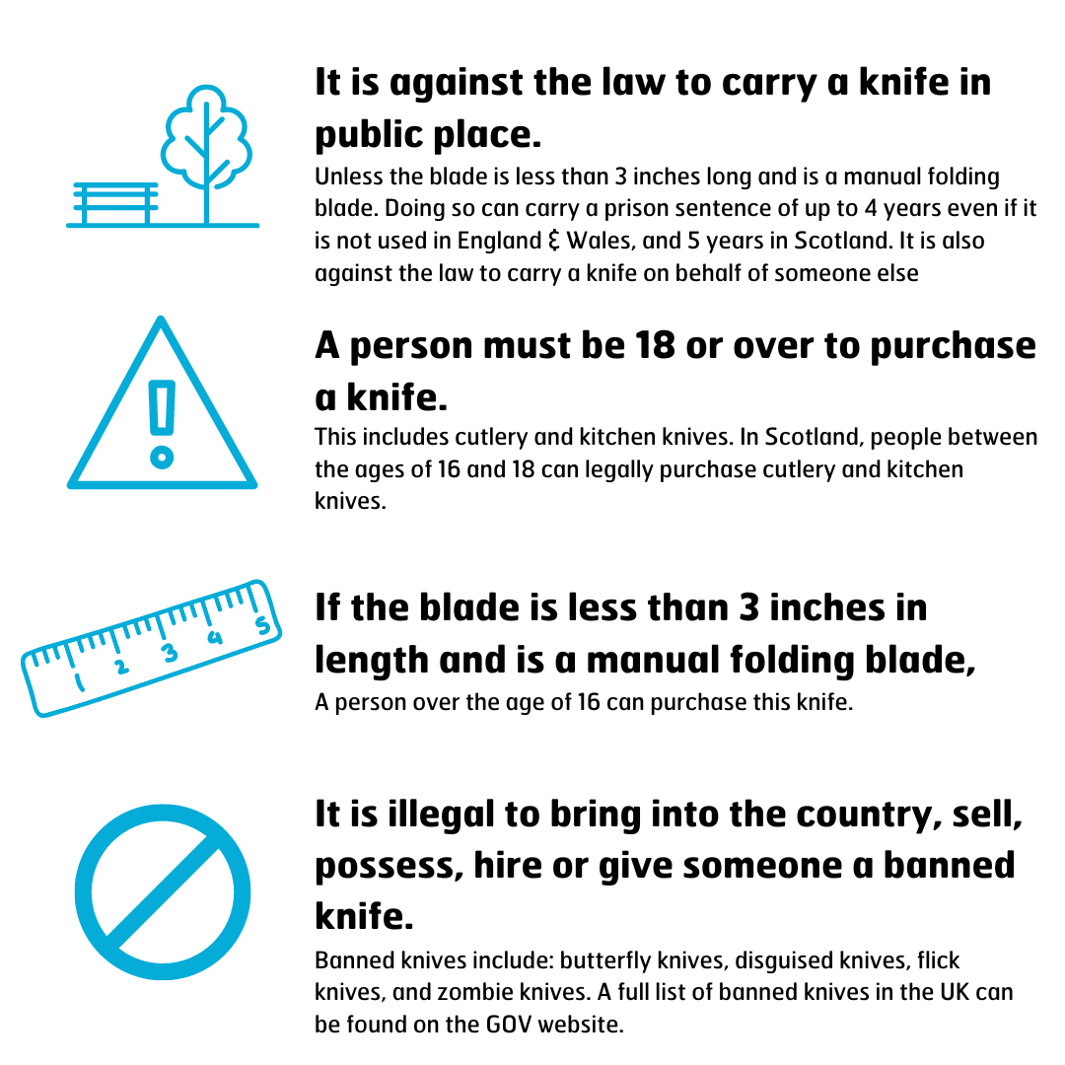
Knife crime laws
Listed below are the knife crime laws for the UK.
Please note there are some variations in the law between England, Wales & Scotland.

Slide 4
Sadam’s story
Please watch this video to find out how carrying a knife can potentially affect your life.
Think about and discuss the effect it would have on you if you were in Sadam’s position.
Who would you have as support ie family, friends?
Would your current friends visit you in prison?
How would you feel stuck in a cell with no TV or music, just the 4 walls for company?

Slide 5
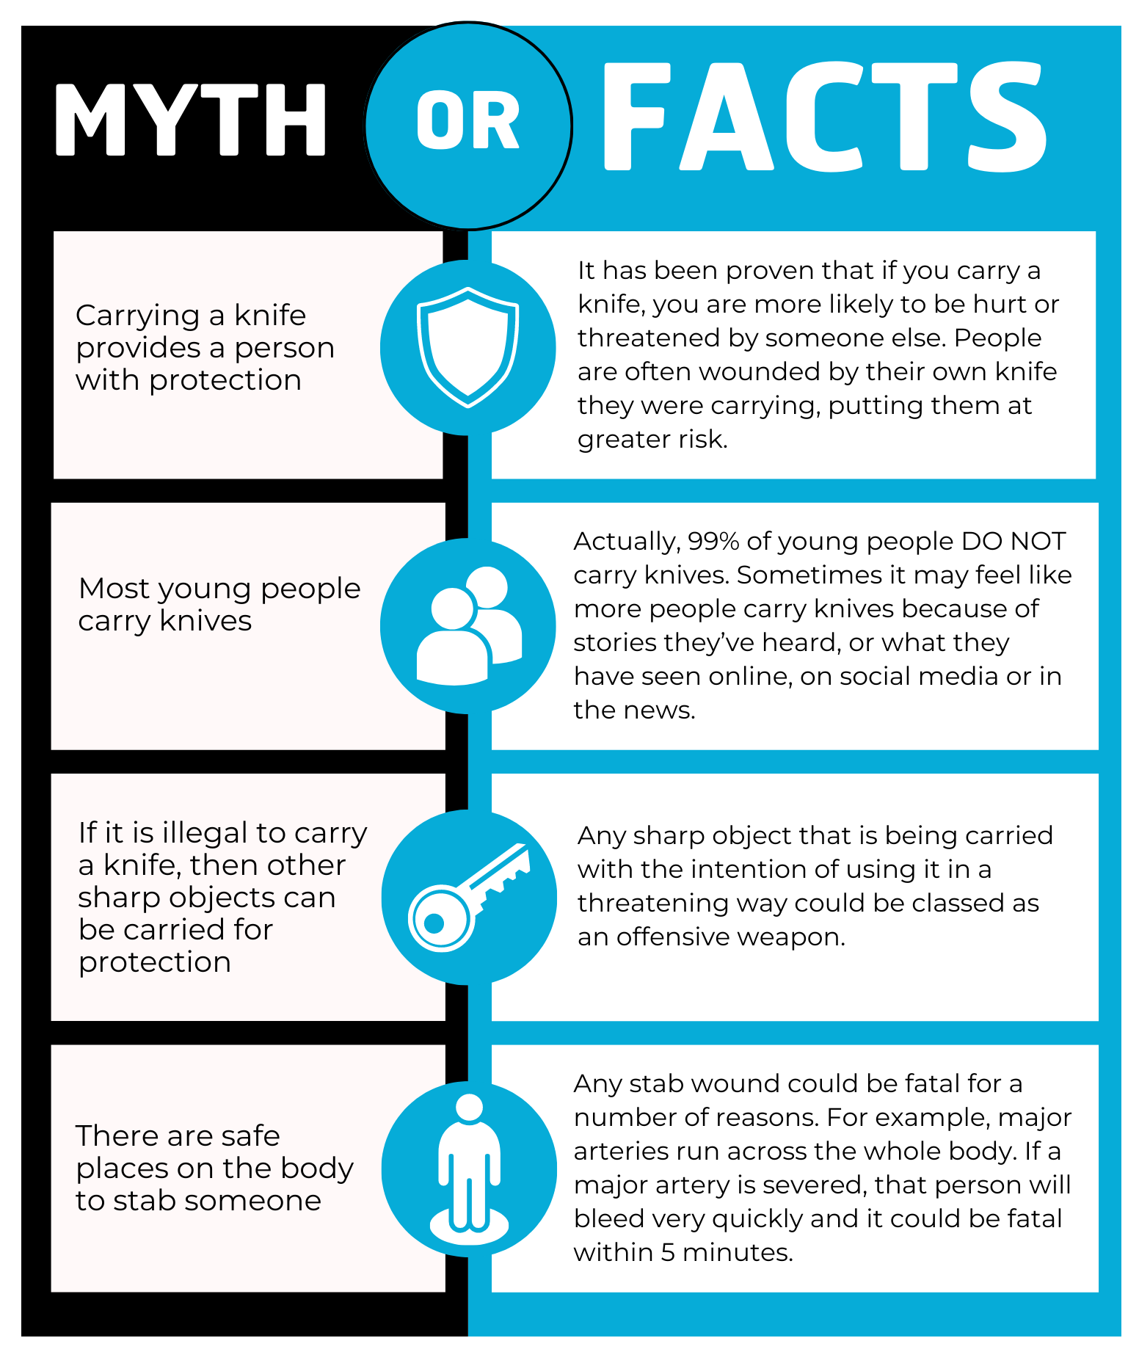
Joint Enterprise
Joint Enterprise is a section of the law which allows two or more people to be convicted of the same crime, potentially receiving the same sentence, even if they had differing levels of involvement.
The Joint Enterprise law is for circumstances where there is evidence to prove a group of people were involved in a crime, but where it is difficult to determine who is the main perpetrator.
For example, if a murder has taken place and there is evidence that 5 people were involved, but it is difficult to determine which of those 5 dealt the fatal blow, they could all be convicted of murder under Joint Enterprise.

Slide 6
Carrying knives or other weapons
Some young people think if you carry a knife then it will provide protection. But statistics show that if you carry a knife or weapon then you are more likely to end up being hurt. You can be seen as threatening. You might also end up being hurt by your own weapon. It is also illegal to carry knives and other weapons.
You might think you'll be respected or even feared for carrying a weapon. But all it really does is put you, your friends and family in danger. Understand the consequences:
Carrying a knife or gun is illegal and increases your risk of being injured. It could ruin your life if you are caught, even if you never use the weapon
Having a criminal record could stop you gaining entry into your chosen college or university, getting a job and could place restrictions on you travelling to some countries like the United States of America.
You could go to jail for up to four years if you’re found in possession of a knife or five years for a gun, even if you’re carrying it for someone else. In the worst case scenario, you could get life imprisonment for murder.
While walking away is often the hardest thing to do it is the safest and could save your life.
You can visit https://crimestoppers-uk.org/fearless for advice, discover real stories about people who turned their lives around after being involved in knife crime as well as places you can go for further help and support.

Slide 7
You are more likely to be hurt or injured if you carry a knife
Research shows 99%of young people don't carry knives
Carrying a knife could mean up to 5 years in prison, even if it is not used
Victim of knife crime?
As Fearless is 100% anonymous, we are unable to take reports from victims of crime.
If you have been a victim of knife crime, it’s really important that you talk to a parent/guardian, an adult you trust or report it to the police.
You can also get more information, support and advice from the organisations listed on our youth support services page.
https://crimestoppers-uk.org/fearless/more-info/crime-types-explained/knife-crime - this link provides you with further information regarding knife crime and its’ dangers

Slide 8
Activity
Imagine the following scenario:
You’re at a friend’s house, just about to leave together. Your friend says something to suggest
there could be trouble where you are going. They quietly removes a kitchen knife from a drawer as
you leave and slips it into their pocket. You ask, “What’s that for?” they say, “Protection.” What do
you do next?
Get into groups and come up with ideas.
What would be the best things to say or do?
Why?
What might be helpful or unhelpful?
Who would you talk to if you were concerned
Discuss with the rest of the class, comparing ideas.
Create a poster with guidance of what to do and who to speak to if you had concerns about someone or a situation.

Slide 9
First aid
If you are ever with someone who is bleeding heavily, you need to act fast. Follow these steps below:
Apply pressure to the wound using your hand, a t-shirt scarf, towel or anything that can be put over the wound. This will stop or slow the flow of blood. This will help the blood clot and stop the bleeding.
Call 999 or ask someone else to do it, ask for an ambulance and tell them what has happened.
While you wait for the ambulance to arrive, continue to apply pressure to the wound as in step 1.

Slide 10
Reporting a concern
If you are concerned that someone has a knife or weapon on them or in college then please:
Tell your teacher or member of staff immediately
Come to Student Services to report what you have seen or heard
Call 01992 707027

