Slide 1
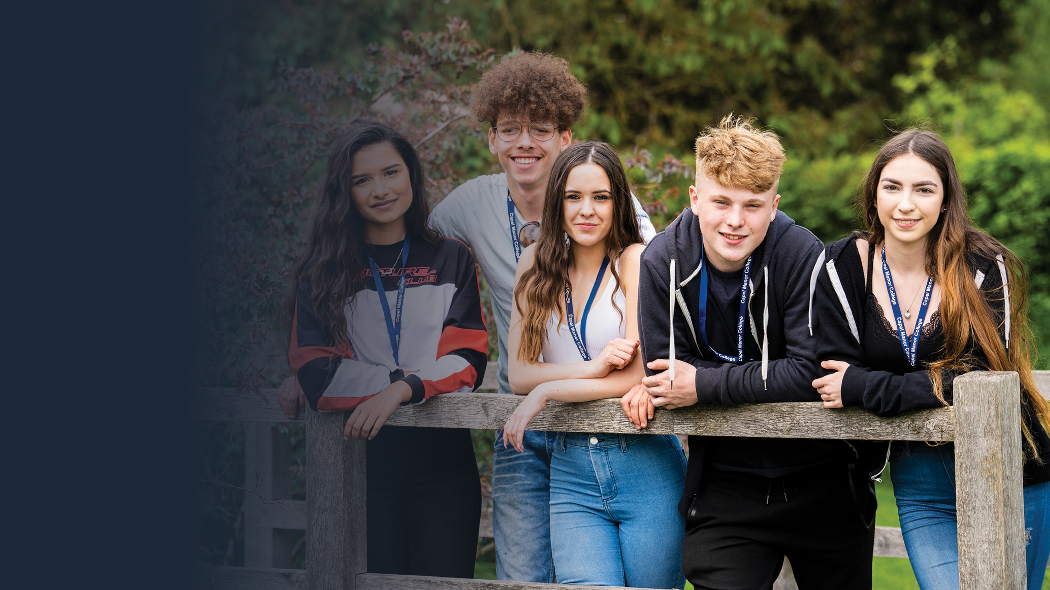
Personal
Safety

Slide 2
Physical Safety
Emotional Safety
Physical safety is the absence of harm or injury that can be experienced by a person from a physical object or practices that include a physical object. It’s about keeping your body safe
Examples of physical safety include:
The use of personal protective equipment such as boots, high viability jackets, ear muffs, gloves.
The following of health & safety regulations and policy
The maintenance of equipment and buildings to ensure a safe learning environment
Emotional safety exists when an individual feels safe to express emotions, views and be themselves without fear of harm.
Examples of emotional safety include:
Being able to express views freely without fear of ridicule or violence
Being able to express sexuality freely without fear of ridicule or violence
Feeling respected and safe at College for who you are
Having someone to talk to in confidence if you feel vulnerable or unsafe and knowing where to go
London’s environmental college capel.ac.uk
Notes:
Explain what physical safety is and give examples.
Explain what emotional safety is and give examples. Remind students of the support available through Student Services

Slide 3
The Importance of Physical and Emotional Safety
Feeling physically and emotionally safe at College allows you to:
Stay safe from harm
Engage in a range of physical activities that promote understanding of your vocational subject
Get involved in group discussions, debates and extra curricula activities that enhance your learning experience
Develop friendships and relationships with students and staff based upon mutual respect, which support confidence, self value and a positive college experience.
London’s environmental college capel.ac.uk
Notes:
Explain why physical and emotional safety at college is important.

Slide 4
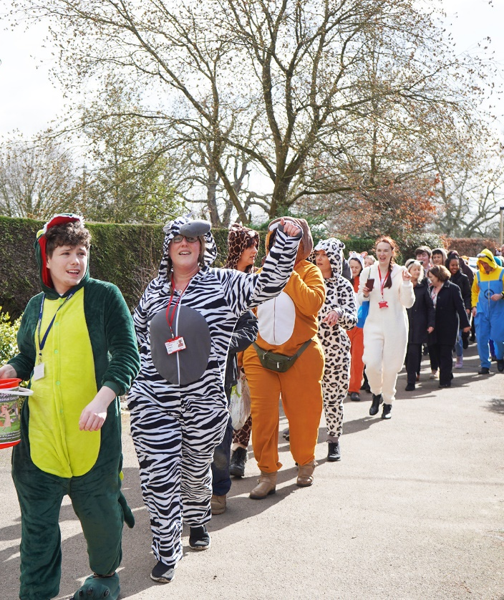
Safeguarding Physical and Emotional Safety at Capel Manor College
Activity
In your small group discuss what Capel Manor College does to safeguard your physical and emotional safety.
When you have finished discussing feedback your answers to the rest of the class.
London’s environmental college capel.ac.uk
Notes:
In small groups students to discuss what the College does to safeguard their physical and emotional safety and feedback to the class. Teacher to list feedback on the board.

Slide 5
Safeguarding Physical and Emotional Safety at Capel Manor College
Capel Manor does the following things to safeguard your physical and emotional safety:
Ensures compliance with the College Health & Safety policy
Qualified and trained teachers, practical instructors and first aiders
Risk assessments in place for all activities that involve a risk
Maintains the safety of all equipment and estate
Ensures compliance with Student Code of Conduct, Safeguarding, Bullying & Discrimination and Equal Opportunities policies
Qualified and trained safeguarding team, counsellors, learning and welfare support
London’s environmental college capel.ac.uk
Notes:
Explain how the college safeguards physical and emotional safety.

Slide 6
Physical Safety at Capel Manor College
When you are on site you may come into contact with external visitors to the gardens or farms:
In groups: please discuss:
Should you talk to the visitors?
How should you talk to the visitors?
Should the visitors take pictures of you and your friends?
What should you do if one of the visitors makes you feel uneasy or unsafe?
London’s environmental college capel.ac.uk
Notes:
Explain how the college safeguards physical and emotional safety.

Slide 7
Physical Safety at Capel Manor College
When you are on site you may come into contact with external visitors to the gardens or farms:
If you feel unsafe or uneasy or have been approached in a way that you are not comfortable with by a visitor to the gardens, farms or anybody else
You must:
Report it to your teacher
Come and talk to student services
Report it to the safeguarding team who will be wearing purple lanyards
Please do this straight away so that we can keep you safe
If the college is closed and you have been threatened please call the police directly by calling 999 if you are in immediate danger
London’s environmental college capel.ac.uk

Slide 8
Physical Safety at Capel Manor College
Stay safe when you leave college by ensuring :
Being careful with your personal information, including contact details and not sharing these with strangers on-line or in person, Not going to places you do not know to meet people you do not know
Not travelling in cars with people you do not know or people who do not have a full driving licence
Always tell somebody where you are going if you go out alone or to meet friends, ensuring that you have a means of contact, e.g. mobile phone
Go straight home after your classes, do not hang around in the cold and the dark outside college
If approached by a threatening group or individual, don’t argue with them, hand over any mobile phone, device they ask for , it is not worth risking your safety, this equipment can be replaced, you can’t!
If possible come back into college and report it to your teacher, safeguarding member of any member of staff as soon as possible, if not call the police if you think you are in immediate danger.
London’s environmental college capel.ac.uk
Notes:
Explain how the college safeguards physical and emotional safety.

