Slide 1



Slide 2



Student Services
Our role is to assist you through your time at Capel Manor and provide support and help when you need it.
You can refer yourself to Student Services or you can be referred by one of your tutors.
Ask at reception for the location of Student Services for your campus
London’s environmental college capel.ac.uk

Slide 3

What we offer
We offer the following services:
Wellbeing Support
Counselling Service
Mentoring Service
Safeguarding Support
Additional Learning Support
Special exam arrangements
Enrichment Programme
Wellbeing support
London’s environmental college capel.ac.uk

Slide 4
Wellbeing support
Mentoring can help support you to:
Make new friends and settle into college
Gain practical advice, encouragement and support
Become more empowered to make positive choices
Develop study skills, organization and academic confidence
Identify goals and establish a positive sense of direction
We can help you with:
Personal Wellbeing
Relationships and Sexual Health
Mental Health
Welfare Concerns
Counselling
Mentoring
Safeguarding Concerns
The Counselling Service offers:
Counselling sessions take place on an individual basis with a fully qualified counsellor
Confidential support to deal with a range of issues including; mental health, self harm, relationships, body image, bullying, anxiety and confidence
Students can self refer to the counselling & mentoring service or be referred by a member of staff
London’s environmental college capel.ac.uk

Slide 5
Safeguarding & Prevent
Safeguarding means protecting the health, wellbeing and human rights of children and vulnerable adults, and supporting them to live free from harm, abuse and neglect.
It is important to the college as we have a legal obligation to ensure that students are safe both inside & outside of college & to report any concerns.
Concerns can be reported to:
A Tutor or Teaching Staff
A member of the Safeguarding Team (purple lanyard)
Any member of staff (red lanyard)
email the safeguarding team on safeguarding@capel.ac.uk
Ring 429 from a college phone
Come to Student Services
London’s environmental college capel.ac.uk

Slide 6

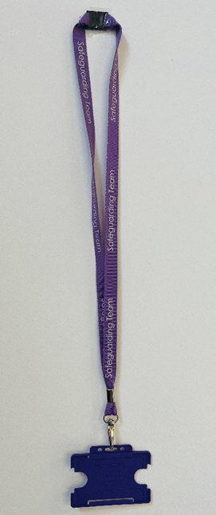
Safeguarding
  The college provides a safe and secure environment by:
  Issuing ID cards to staff & students
  Having a Safeguarding Team
  Class registers
  Ensuring DBS checks and references for staff
  Having a disciplinary policy & procedure for Students & Staff
  Ensuring all staff receive Safeguarding training
Staff Member – Red ID
Safeguarding officer – Purple ID
London’s environmental college capel.ac.uk

Slide 7
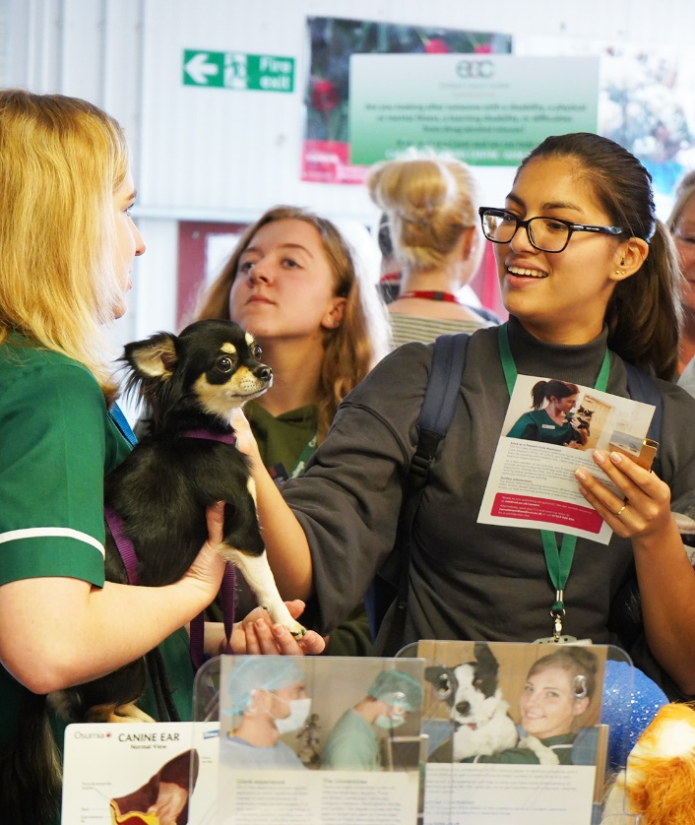
Equity, Diversity and Inclusion
Equity means that we ensure everybody has an equal opportunity and is not treated differently or discriminated against because of their characteristics or needs. It means treating people as individuals and recognising individual difference
Diversity is about taking account of the differences between people and groups of people and placing a positive value on those differences.
Inclusion means placing respect and kindness in the centre of your outlook, recognising that we all have different experiences and situations that have made us who we are today and ensuring that Capel Manor College is an open, safe and welcoming place for everyone.
When we start to appreciate each other, we are really beginning to learn and grow
London’s environmental college capel.ac.uk

Slide 8

What we expect from you
Show consideration and respect for others and for the College environment
Wear Your Lanyard whilst on the College Premises – If not, you will be challenged
Follow College policies and expectations, including those relating to:
Equality and Diversity
Anti - Bullying
Safeguarding
London’s environmental college capel.ac.uk

Slide 9
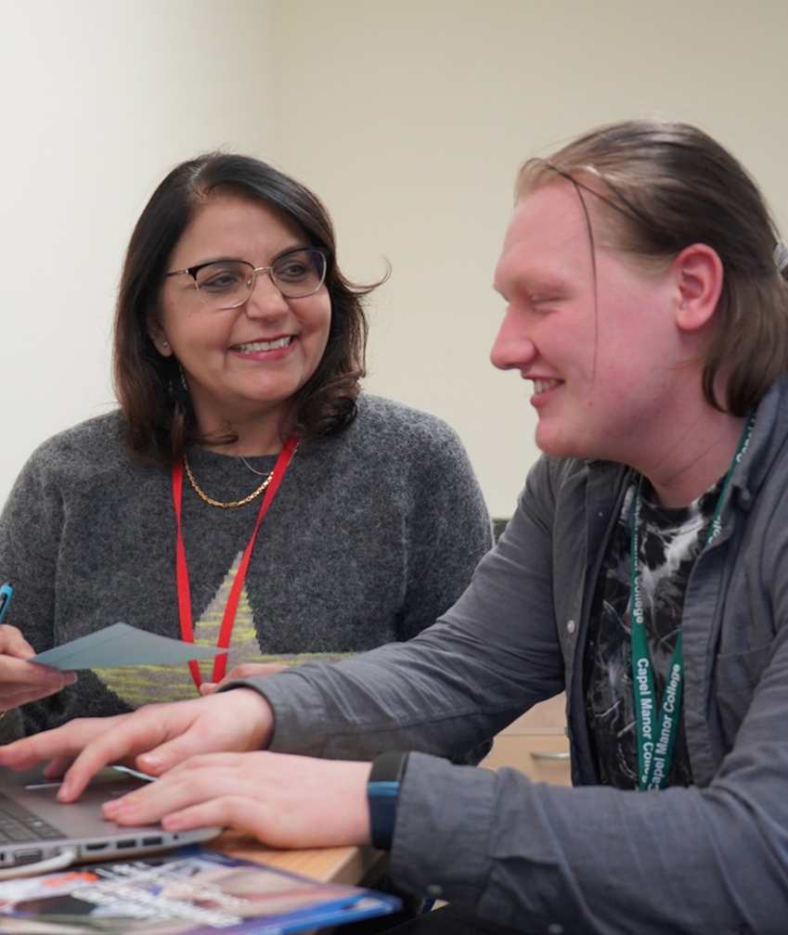
Learning Support
The learning support department are here to offer advice and support to any student that has declared a learning difficulty.
We can offer advice to you on what strategies you may find useful to support your learning.
We can also speak to your tutor about your difficulties or we can signpost you to other services if necessary.
If you would like an interview with the learning support team you can either email us at learningsupport@capel.ac.uk or ask your tutor to refer you to the learning support coordinator for your campus.
London’s environmental college capel.ac.uk

Slide 10

Access Arrangements
You may be entitled to special arrangements for your exams these are called access arrangements and these seek to ensure that some learners are not disadvantaged in their exams due to a learning need or disability. This could include:
Extra time
Rest breaks
Separate room
Scribe or reader.
The decision is based on your individual need and your normal way of working in class.
To speak to someone about whether you qualify for these adjustments, please talk to your teacher who can make a referral or email accessarrangements@capel.ac.uk
London’s environmental college capel.ac.uk

Slide 11

Enrichment
Gives you the opportunity enhance your college life, make new friends beyond your course, and create lasting memories.
Jack Petchey Achievement Award:
Recognises outstanding young people aged 11-25 who have gone that extra mile and in some cases, challenged adversity to succeed. Please look on Moodle and on the college pin boards to find out more information and how to nominate a fellow student
Wellbeing and Health:
Sexual Health Clinic
C Card Scheme
Around You Programme (Sanitary Products)
London’s environmental college capel.ac.uk

Slide 12

We are here to help and support you!

