Slide 1
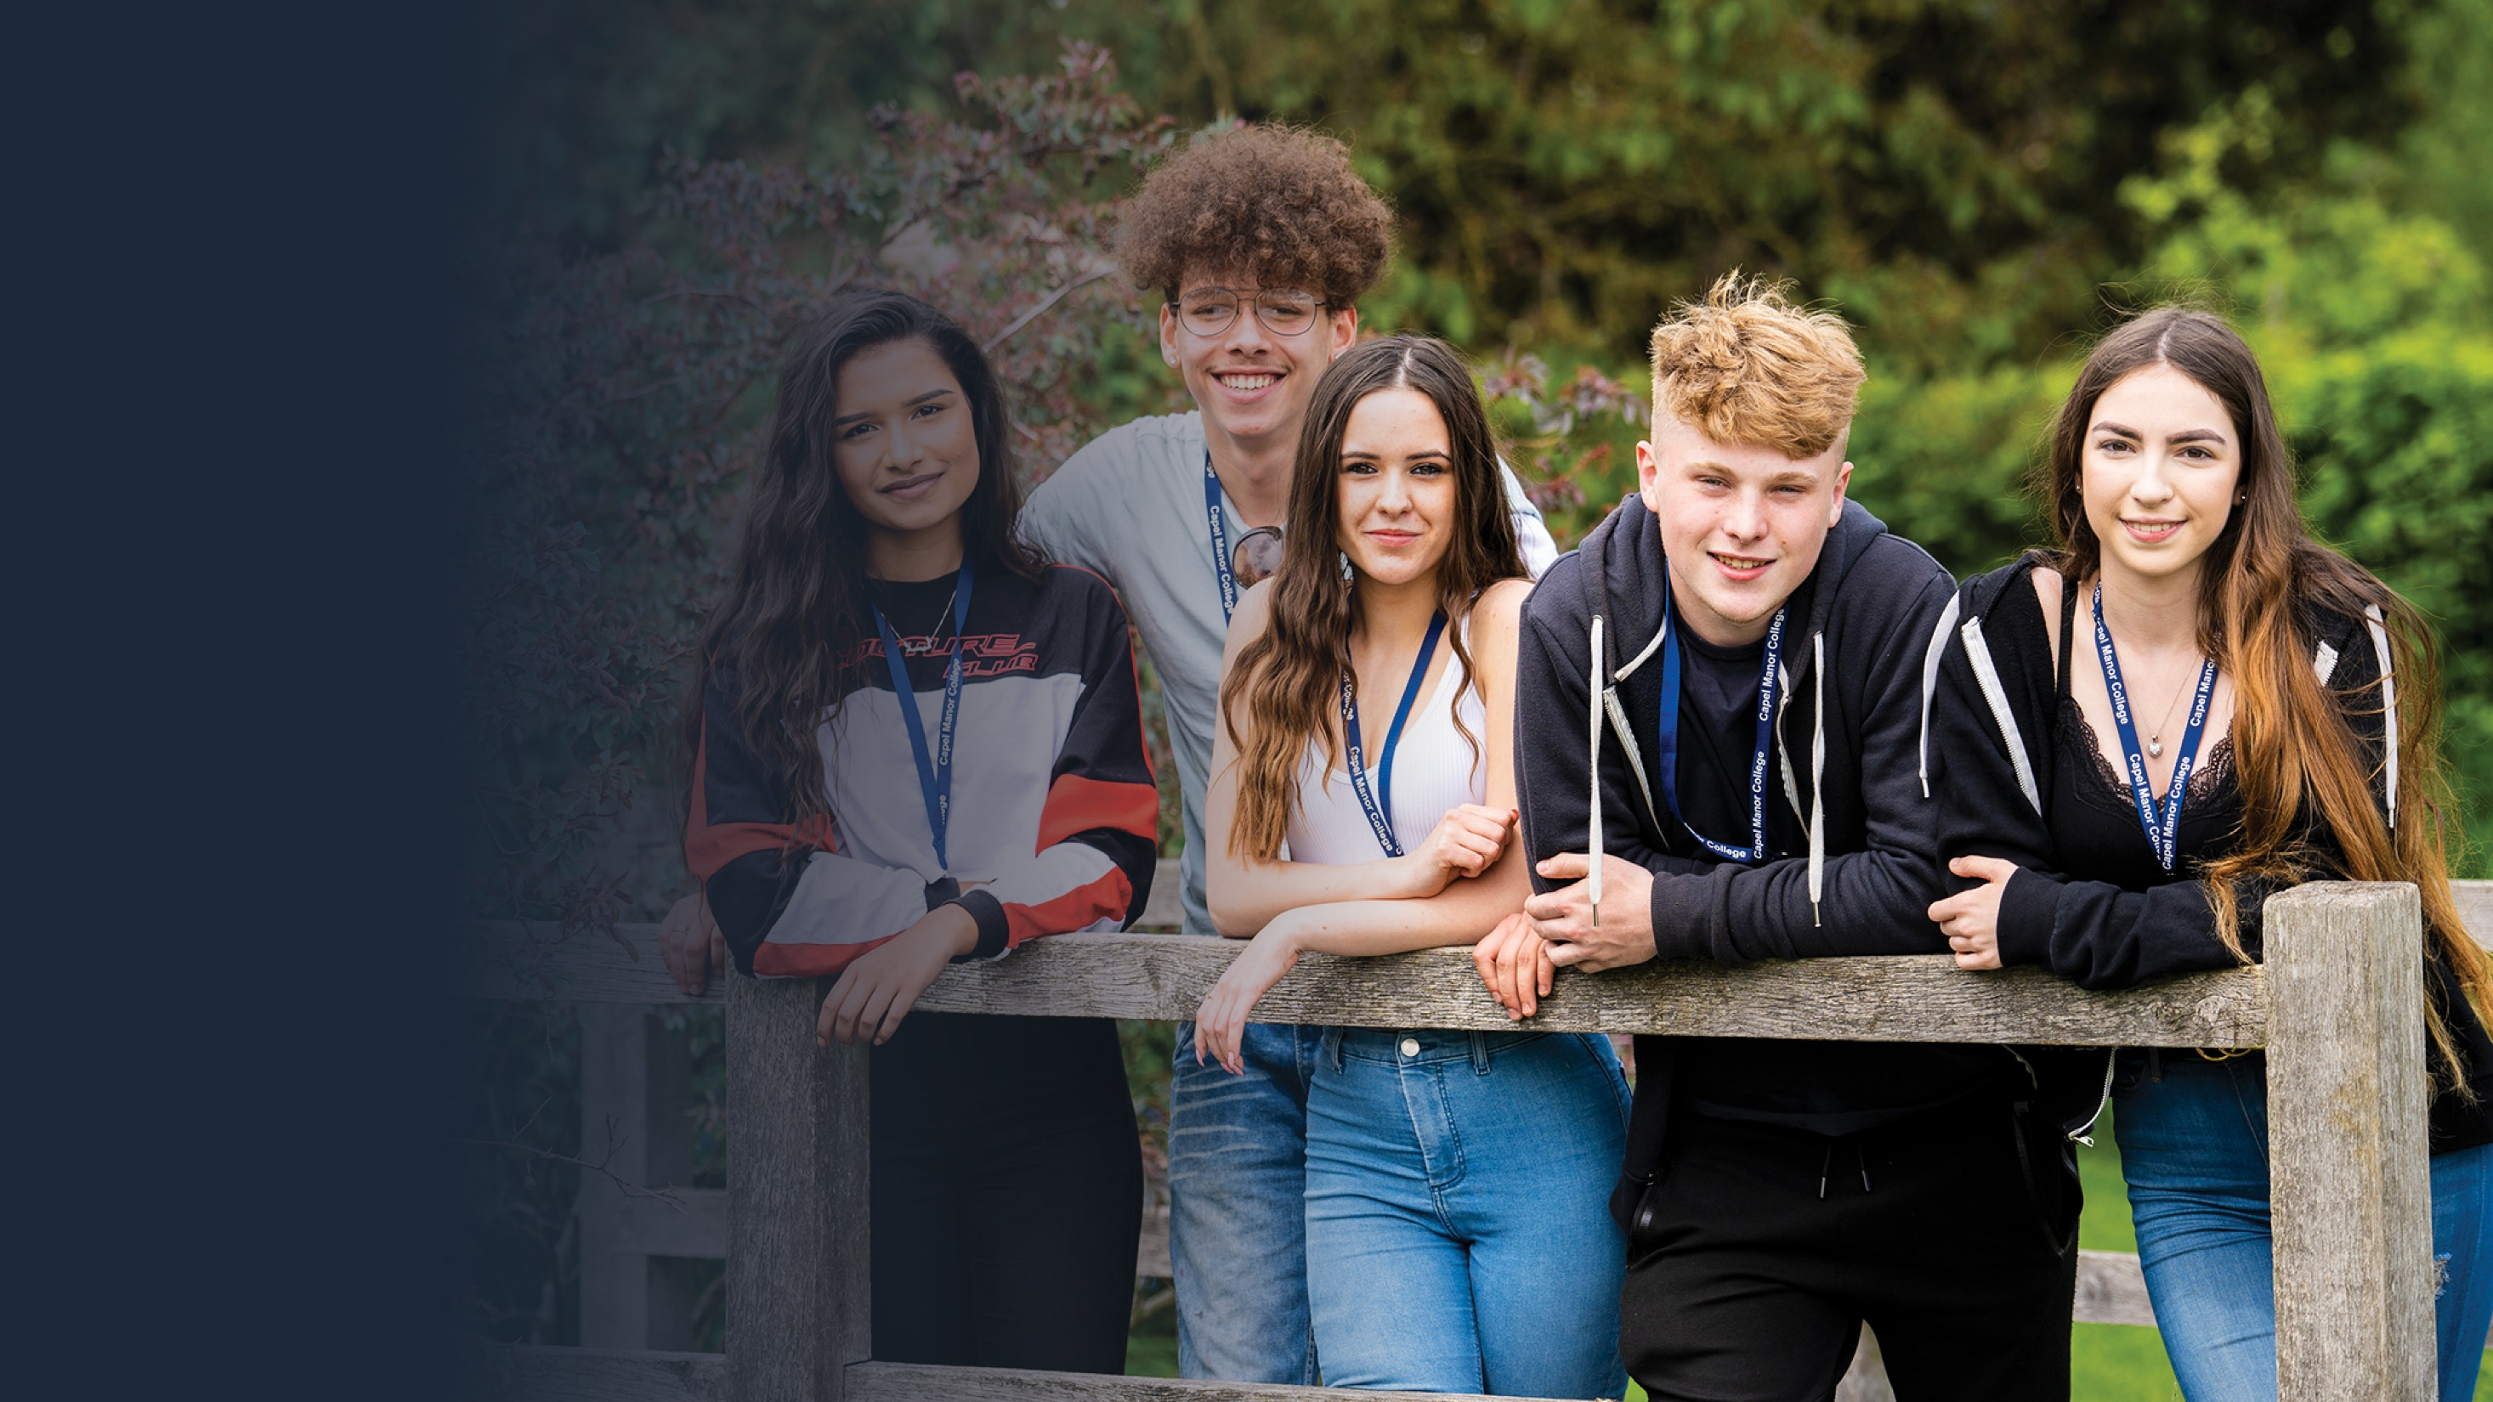
Online
Safety
&
Digital
Citizenship

Slide 2
Learning Outcomes
By the end of this session you will:
Be able to identify the problems that could occur once
you have pressed the send button
Be able to discuss the legal issues relating to sending
and distributing images of a person under the age of 18
Consider how this could have long-term effects on your
future, self esteem and even mental health
Be able to make informed choices about your online behaviour and support your friends
London’s environmental college capel.ac.uk
Notes:
Note to tutors: Choose the challenge level relevant to your class. You will also need the social media fact sheet.

Slide 3
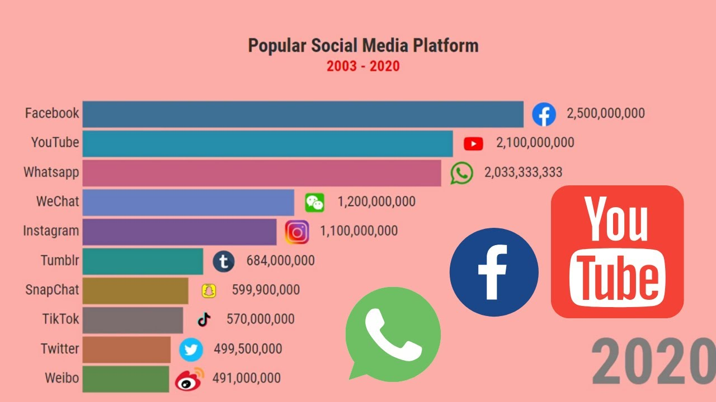
What do you use the internet for?
Activity
How do these figures compare to your personal
usage?
Can you identify any other popular sites, that are
not listed here?
Is everything you read on the internet true?
London’s environmental college capel.ac.uk

Slide 4
Activity
Challenge: What impression does Keira's profile give about her life?
More Challenging: Why do you think this?
Mega Challenge: Think about how Keria's online presence and persona, could impact on her 'real life' self esteem.
London’s environmental college capel.ac.uk

Slide 5
Keira spends 5 hours per day on social media, she constantly compares herself to the Kardashians & other On line Divas. We can now see that her on line life is highly embellished. Keira's self esteem is low.
Challenge: Why do people embellish their personas on line & how people might become addicted to social media.
More Challenging: Why do people create online personas, how would this impact their self esteem? Think about the esteem of others viewing her post.
Mega Challenge: Think about the consequences of mental health on keeping up with an on line 'invented' persona.
What are the consequences of becoming addicted to social media?
London’s environmental college capel.ac.uk

Slide 6
Watch the following clips:
https://www.youtube.com/watch?v=0EFHbruKEmw
https://www.youtube.com/watch?v=HffWFd_6bJ0 (only up to 2:40)
using your social media fact sheet, and the challenge set by your tutor.
Class Challenge:
As a class or in groups; consider what you would do If Keira was your friend, how would you help her to boost her low self esteem, and help her overcome her apparent addiction to social media?
Challenge: Give TWO examples from the first video of people lying about their lives. What message is the video putting across without using words?
Explain ONE way in which social media changes the brain (in the second video).
More Challenging: Name some of the different things that are being lied about in the first video. Are there any themes? At the end of the first video, what has happened to the couple’s relationship - how much is social media to blame? Explain what dopamine is and how it is affected by social media (see second video). What are the dangers of this?
Mega Challenge: To what degree do you think that the examples in the first video are exaggerated? What is the ending of the first video trying to imply about the long-term impacts of social media on people’s real lives? What do you think are the implications of social media on the future of society, given that our brains are being rewired like never before?
London’s environmental college capel.ac.uk

Slide 7
Sexting
Sexting is the taking and sending of indecent images. Sexting is when a person takes an indecent image of themselves and sends it to a friend, spouse, boyfriend or girlfriend via their mobile phone.
Once an image has been taken and sent, the sender has no control over what happens to that image and it could be sent to anyone, for example their employer, friends, family or even a paedophile.
Anyone who has or sends indecent images of someone under the age of 18 is breaking the law. Both having and distributing images of this nature is an offence under the Sexual Offences Act 2003. Encouraging someone to take or send 'sexts' is also illegal.
As well as the legal consequences, there are other issues to 'sexting' including the emotional and reputational damage this can cause. Think before you take a picture; would you be happy for your parents, colleagues, teacher, friends, family or local police officer to see it?
London’s environmental college capel.ac.uk

Slide 8
Your Goals Are in Your Hands
Challenge: How can you and your class become college ambassadors to promote positive habits on line?
More Challenging: In what ways can you use your on line platform to create a positive outlook that could impact your future and your career?
Think of some slogans to promote this message to your peers.
Mega Challenge: design a poster or write a blog to help your peers to make positive choices on line.
London’s environmental college capel.ac.uk

Slide 9
Benefits of the Internet
Dangers of the Internet
Information on almost every subject imaginable.
Ability to do research from your home
Platform for products like Zoom, which allow for holding a video conference with anyone in the world
There is a lot of wrong information on the internet. Anyone can post anything, and much of it is incorrect.
There are predators that hang out on the internet waiting to get unsuspecting people in dangerous situations.
Pornography that can get in the hands of people too easily and sexting makes personal photos easily accessible.
Easy to waste a lot of time on the internet.
Opportunity to make contact with new people and existing friends through social media
Sites where students can have readily available help for homework.
News, of all kinds is available almost instantaneously. Commentary, on that news, from every conceivable viewpoint is also available.
Hackers can create viruses that can get into your personal computer and ruin valuable data.
Hackers can use the internet for identity theft.
The internet can be used for cyber bullying or grooming
London’s environmental college capel.ac.uk
Notes:
Discuss with students the benefits and dangers of the internet.

Slide 10
Protect Yourself Online
Internet Privacy is the ability of individuals to control the flow of information and have reasonable access to data generated during a browsing session.
Every time you go browse the internet you will leave an internet footprint, even if you clear all website history.
Some information should never be shared online:
Your address & telephone number
Bank details
Date of birth
Pictures which include nudity
Passwords
The College protects your data in the following ways:
The College has a firewall to protect your data from being hacked
The College will never give any of your personal data to a third party, except where you have given us permission to do so
All paper personal data is kept in secure locked cabinets
All computer access is password protected
Internet Confidentiality allows authorized users to access sensitive and protected data. Specific mechanisms such as fire walls ensure confidentiality and safeguard data from harmful intruders.
Abuse of the college internet will result in your ID being blocked from using the college internet and reported to safeguarding.
Notes:
Discuss with students why this information should never be shared. Remind students that to share explicit photos of someone under 18 is a criminal offence and is classed as child pornography, even if the person in the picture sent it to you
Explain to the group what internet privacy is and its limitations.
Explain to the group internet confidentiality
Discuss with students how the college protects their data

Slide 11
Protect Yourself Online
Talk - Its important to remember that trolling isn't limited to children, trolling can happen to adults too – it's important to know where to go for help. Always talk to someone you trust.
College - Access Student Services, offering support, counselling and mentoring at your relevant Centre. For serious concerns contact safeguarding@capel.ac.uk Phone Number: 01992 707 027 or 429 from a college telephone
Cyber Mentors are groups of young people you can chat to online. They're specially trained and will listen to your problems, and help you come up with a solution.
CEOP - This button is on most websites. If you feel unsafe you can ‘click CEOP’ which will let you report incident images or give you advice on what to do.
Think you know – is a great site with lots of information and help guides. www.thinkyouknow.co.uk
London’s environmental college capel.ac.uk

Slide 12
Visit capel.ac.uk to browse courses and apply online

