Slide 1
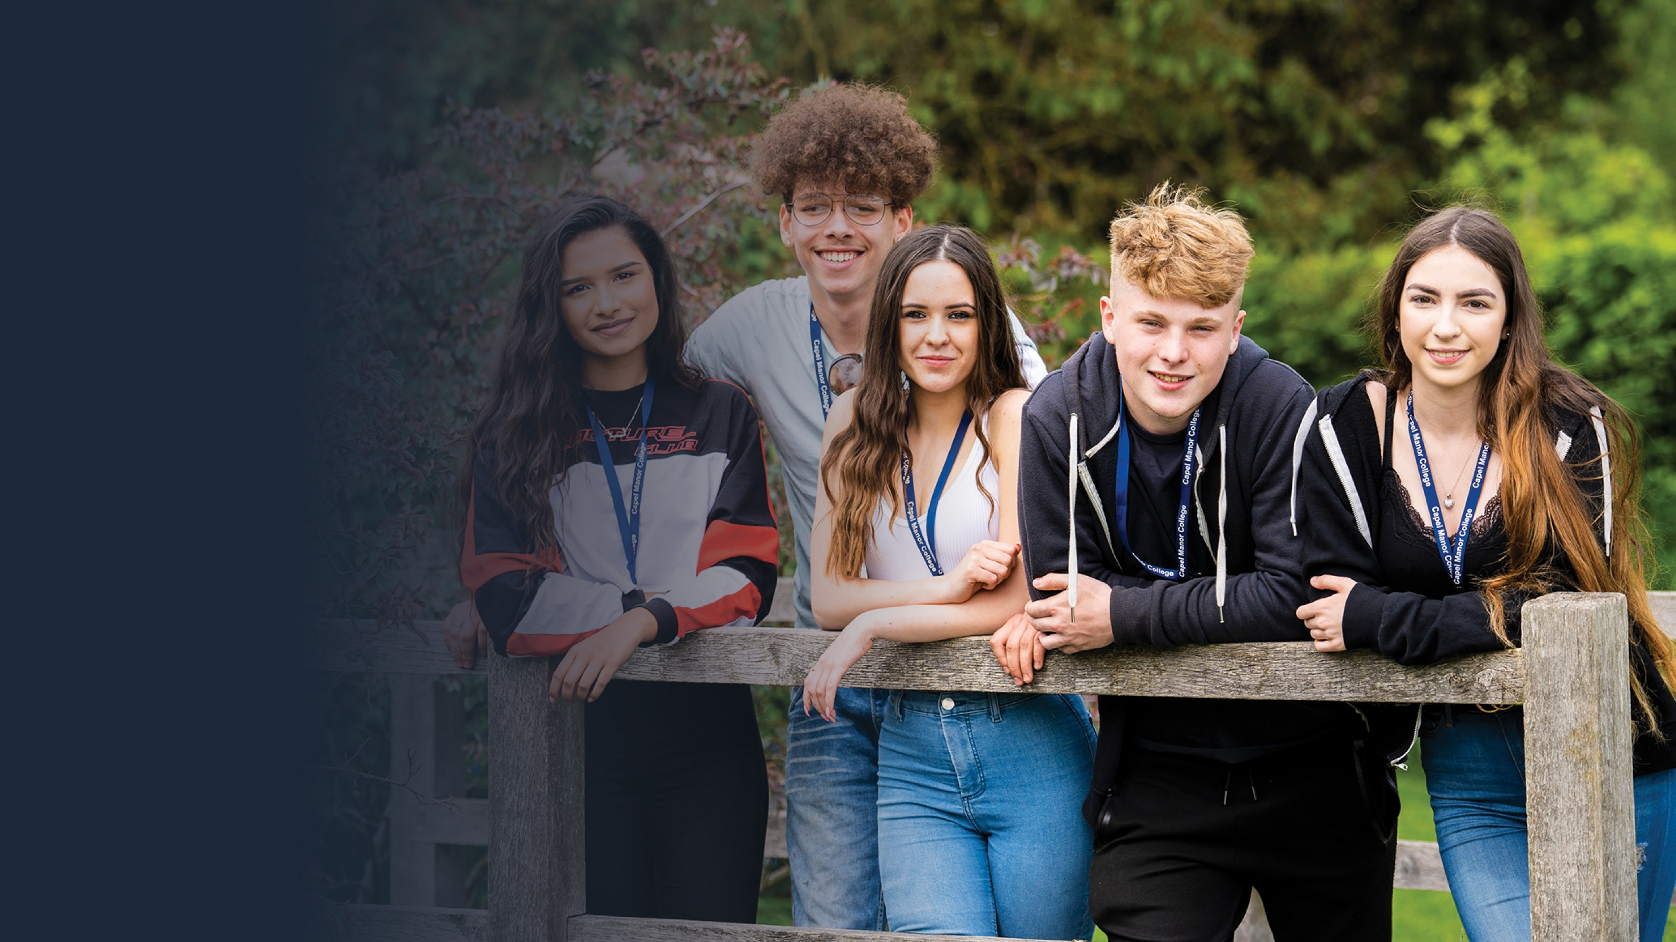
Personal
Safety

Slide 2
Health & Safety - Risks
Health & Safety – Regulations
& Controls
Activity 1
In your small groups discuss what risks you might face whilst studying at Capel Manor College.
When you have finished discussing feedback your answers to the rest of the class.
Activity 2
You have identified the potential risks that exist at College.
Now as a whole group identify the regulations and control measures that can be put in place to minimise the risks you face.
Complete questions 4.1 & 4.2 on page 6 on your safeguarding assessment booklet.
Health & Safety – Be Safe Quiz
Activity 3
Complete the Be Safe quiz in your safeguarding assessment booklet (Page 7 and 8)
London’s environmental college capel.ac.uk
Notes:
1. In small groups students to discuss what risks they might face whilst at College and feedback to the class. Teacher to list feedback on the board.
2. Students to brainstorm the regulations and control measure that can be put in place to reduce risks. Teacher to record these on the board.

Slide 3
Physical Safety
Emotional Safety
Physical safety is the absence of harm or injury that can be experienced by a person from a physical object or practices that include a physical object.
Examples of physical safety include:
The use of personal protective equipment such as boots, high viability jackets, ear muffs, gloves.
The use of risk assessments to identify potential risks and put in place control measure to minimise risk
The following of health & safety regulations and policy
The maintenance of equipment and buildings to ensure a safe learning environment
Emotional safety exists when an individual feels safe to express emotions, views and be themselves without fear of harm.
Examples of emotional safety include:
Being able to express views freely without fear of ridicule or violence
Being able to express sexuality freely without fear of ridicule or violence
Feeling respected and safe at College for who you are
Having someone to talk to in confidence if you feel vulnerable or unsafe and knowing where to go
London’s environmental college capel.ac.uk
Notes:
Explain what physical safety is and give examples.
Explain what emotional safety is and give examples. Remind students of the support available through Student Services

Slide 4
The Importance of Physical and Emotional Safety
Feeling physically and emotionally safe at College allows you to:
Stay safe from harm
Engage in a range of physical activities that promote understanding of your vocational subject
Get involved in group discussions, debates and extra curricula activities that enhance your learning experience
Develop friendships and relationships with students and staff based upon mutual respect, which support confidence, self value and a positive college experience.
London’s environmental college capel.ac.uk
Notes:
Explain why physical and emotional safety at college is important.

Slide 5
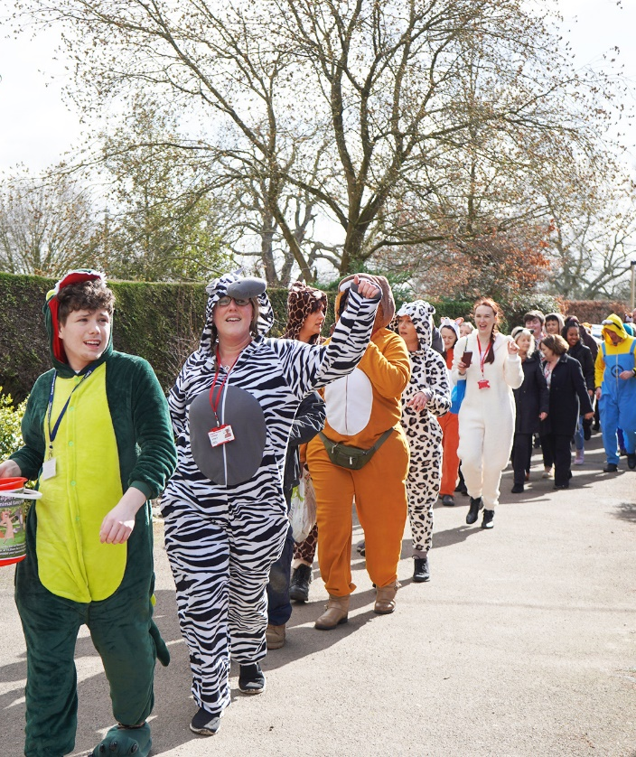
Safeguarding Physical and Emotional Safety at Capel Manor College
Activity
In your small group discuss what Capel Manor College does to safeguard your physical and emotional safety.
When you have finished discussing feedback your answers to the rest of the class.
London’s environmental college capel.ac.uk
Notes:
In small groups students to discuss what the College does to safeguard their physical and emotional safety and feedback to the class. Teacher to list feedback on the board.

Slide 6
Safeguarding Physical and Emotional Safety at Capel Manor College
Capel Manor does the following things to safeguard your physical and emotional safety:
Ensures compliance with the College Health & Safety policy
Qualified and trained teachers, practical instructors and first aiders
Risk assessments in place for all activities that involve a risk
Maintains the safety of all equipment and estate
Ensures compliance with Student Code of Conduct, Safeguarding, Bullying & Discrimination and Equal Opportunities policies
Qualified and trained safeguarding team, counsellors, learning and welfare support
London’s environmental college capel.ac.uk
Notes:
Explain how the college safeguards physical and emotional safety.

Slide 7
Establishing Safe Personal Boundaries
Activity
In your small groups identify 3 examples of personal boundaries.
When you have finished discussing feedback your answers to the rest of the class.
Examples of safe personal boundaries include:
Being careful with your personal information, including contact details and not sharing these with strangers on-line or in person
Not going to places you do not know to meet people you do not know
Not travelling in cars with people you do not know or people who do not have a full driving licence
Always tell somebody where you are going if you go out alone or to meet friends, ensuring that you have a means of contact, e.g. mobile phone
Avoiding contact with people who are involved in risky behaviour such as gangs, crime or drugs
In establishing safe personal boundaries you need to:
Be very clear about what your personal boundaries are and express these to those around you so that there is no confusion. For example:
Your attitude to:
Your personal space
Drinking alcohol or taking drugs
Staying out late at night
Meeting new people
Any health conditions or medication you may have
London’s environmental college capel.ac.uk
Notes:
In small groups students to discuss examples of personal boundaries and feedback to the class. Teacher to list feedback on the board.
Give students examples of personal boundaries.
Explain why it is important to express to others your personal boundaries so that you avoid being coerced into activities you are uncomfortable with.

