Slide 1
Deaf Awareness Week

Slide 2
What is Deaf Awareness Day?
Deaf Awareness Week takes place in the first full week of May. This year, it takes place from May 6 to 12. The purpose of this holiday is to increase public awareness about the issues affecting deaf people and deaf culture as a whole. Events and activities throughout Deaf Awareness Week encourage individuals to unite as a community for both educational and celebratory purposes.
It’s an important week for the recognition of deaf people, communities, and organizations. The week reminds the public that deaf people have their own communities, cultures, languages, and sign languages, which unite them. Deaf Awareness Week also aims to bring attention to the isolation that deaf people can occasionally experience, and heightens the importance of inclusion in the deaf community.

Slide 3
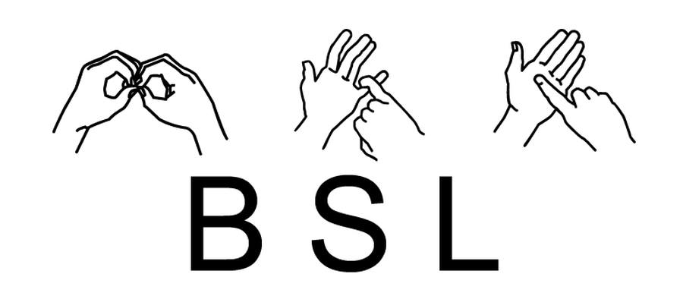
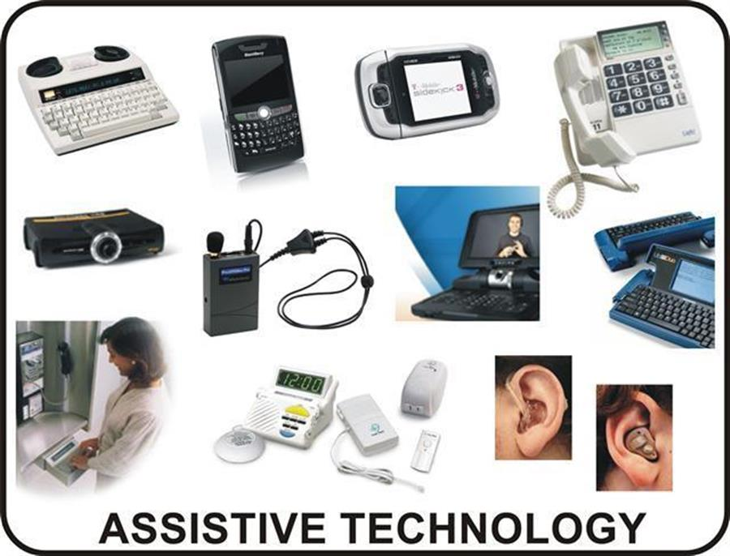
How Deaf People Communicate: The Different Methods Used
Sign language is the most common form of communication among Deaf people. It’s a type of communication in which meaning is conveyed by arm movements, nonverbal cues, and facial emotions.
Lip reading is another popular form of communication among Deaf people. It involves watching the lips of a person speaking and trying to interpret what they are saying. Lip reading can be difficult because there are many words that look alike when spoken. Additionally, lip-reading requires practice and concentration in order to be effective.
Cued speech is a system that uses hand shapes and mouth movements to help clarify spoken words. Impaired persons can use it along with sign language or as a standalone system.
Speech reading is a skill that involves lip-reading and using visual cues to understand what someone is saying. It is not an exact science, and it can be difficult to understand everything that is being said, but it is a useful skill for Deaf people to have.
Technological Aids - There are also a variety of assistive devices that can be used to help Deaf people communicate. These include things like text telephones (TTYs), captioning, and vibrating alarms.
Choosing the right method of communication depends on the situation and the needs of the people involved

Slide 4
How to communicate better with Deaf people?

Slide 5
5 INTERESTING FACTS ABOUT DEAFNESS
Second most common disability in the U.K.
Approximately 11 million people in the U.K. Live with hearing loss.
International versions of sign language.
There are international sign languages such as American sign language, British sign language, and French sign language.
Sign language varies by region.
Within the UK, for instance, there are regional variations of BSL just as with spoken language.
Lip-reading is challenging
Even the most skilled lip-readers usually miss up to 40% of what has been said.
There are four levels of hearing loss
These are mild, moderate, severe, and profound.

Slide 6
1. What is Deafness? A. When people can't hear B. When people can't see C. When people are easily distracted 2. Can Deaf people drive? A. Yes B. No of course not C. Maybe 3. Can Deaf people use the phone? A. Yes B. No of course not 4. Do you think Deaf kids can go to school? A. Yes B. No 5. How do Deaf people talk to others? A. They don't talk to others B. Sign language C. Using paper D. Using there mouths 6. Can you be born with Deafness? A. No B. Yes
Quiz
7. Are there other ways to become Deaf besides being born with it?
A. By old age
B. By medicines
C. By accidents
D. By exposure to loud sounds.
E. No you can only be born with it
8. If you have Deafness does this consider you behind with learning from others without deafness?
A. Yes
B. No
C. Sometimes
9. Can Deaf people answer the door or even hear a fire alarm?
A. No
B. Yes
10. Is there any famous people that have Deafness?
A. No
B. Yes
C. Maybe unsure

Slide 7
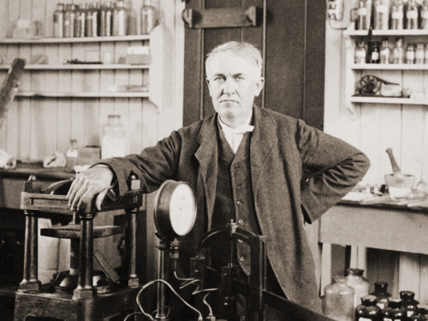
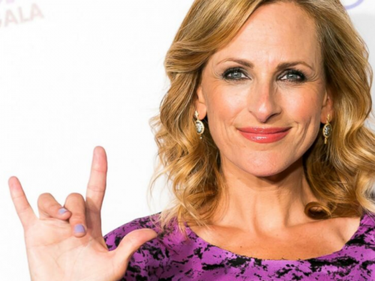
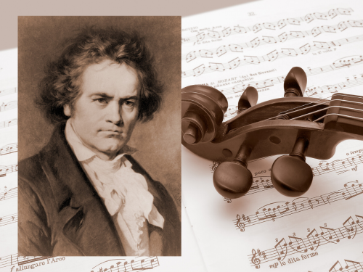
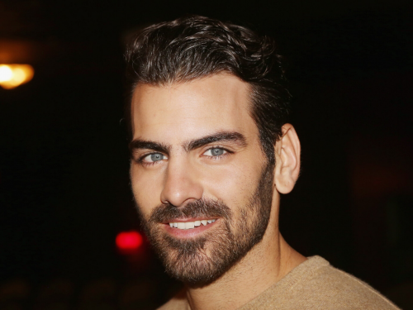
Famous Deaf People Who Changed the World
Thomas Edison was quite possibly the greatest inventor of all time. Many of his inventions have improved the quality of our modern day lives. During his career Edison’s inventions included the incandescent light bulb, the phonograph, and the motion picture camera.
Marlee Matlin - Actress, author and activist Marlee Matlin is the only deaf person to have ever won an Academy Award for Best Actress.
Beethoven - Ludwig van Beethoven is one of the most famous composers that ever lived. He was profoundly Deaf, but that didn’t stop him from composing his world-renowned music.
After experiencing buzzing noises when he was 26, Beethoven had lost 60% of his hearing by the age of 31 and became completely Deaf at 46.
Nyle DiMarco is a model, actor and Deaf activist.
He has been a winner on popular TV shows ‘America’s Next Top Model’ and ‘Dancing with the Stars’ in the US.
In 2016, he launched the ‘Nyle DiMarco Foundation’ a non-profit organisation that provides access to resources for Deaf children and their families.
Chella Man is an actor, model, artist and LGBTQ+ activist.
Chella started losing his hearing at 4 years old and was profoundly Deaf by 13. In March 2017, he started a YouTube channel posting videos where he openly discusses his identity as a Deaf transgender man. He also documented and shared his transition online.
In 2018, he delivered a TedX Talk titled ‘Becoming Him’, where he expressed his goal to normalise the conversations around gender issues for disabled and LGBTQ+ youth.
Hermon and Heroda Berhane (Being Her) Deaf twins and lifestyle bloggers Hermon and Heroda Berhane document their love of travel, fashion and beauty on their blog ‘Being Her’.

Slide 8
How to sign Basic Signs in BSL
Tips to learn sign language: https://www.hearinglikeme.com/how-to-learn-sign-language/

