Slide 2
Morning Session (09:15-10:45)
Group 1 Adebayo A Esther W David B Samuel VDB Sandra B | Group 2 Ella C-T Christine A Rafia H Andrew B | Group 3 Robyn F Shelley J Marianne L Tilly B | Group 4 Leanne H Lyndon B Barbara L Helen C
Group 5 Fleurian M Piers C Marcio PDM Precious D | Group 6 Iyisha P Kolawole F Sonia J Kim M | Group 7 Jessica P Vincent Y Shahin I Sarah R

Slide 3
Midday Session (11:00-12:30)
Group 1 Elena C Komal C Alison B Zoe Bl | Group 2 Zoe H Jodie G Sirod S Fay S | Group 3 Winifred M Sophia H Rachel W Paula M | Group 4 Harriet-Grace R Angela H Mahfuz A Tee R
Group 5 Cristiane TC Pauline H Susan A Benjamin W | Group 6 Natasha W Leonie K Tanya B | Group 7 Leona W Joanne L Grace E | Group 8 Rebecca M Leaha M Evangelia B

Slide 4
Afternoon Session (13:15-14:45)
Group 1 Sarah J-V Olha M Brandon B | Group 2 Derek P Oliver M Angel B Emily C | Group 3 Kai W Alex O Sophie P Julia W | Group 4 Helena B Tracy S Sayedeh P Neville S
Group 5 Erika F Arooj B Mostafa S Annette C | Group 6 Jodie P Nooralayne N Amanda W Georgina D-H | Group 7 Emily R Joanne N Antonia C-D | Group 8 Ashley C Alessia P Karen T Marie S

Slide 5
Capel Manor College – Supporting SEND Students
Developing and supporting effective learning and teaching to achieve great outcomes for all pupils, with a key focus on SEND students
Today’s aims:
Explore effective teaching and learning for all students, with a key focus on our SEND students
To reflect on the importance of involving all stakeholders when setting purposeful and meaningful targets, so students achieve their aspirations and goals.
Reflect on our current practice to ensure challenging situations are handled effectively and that we are aware of how different tools within our toolkit are essential for high quality learning, teaching and support.
To analyse how the team that surrounds and supports our SEND students work effectively to achieve a common goal.

Slide 6
A bit about me…
My names Bradley Mizon, I’m the new Quality Practitioner at Capel Manor College.
Prior to starting my role here I worked at Seven Kings School (4-19) in Redbridge as Head of Science, our school was the only mainstream school within the borough specifically designed to meet the needs of students with high levels of physical need, many of these students also had their own special educational needs and disabilities.
In my previous role, I was also a member of a team responsible for school-to-school support (similar to an advanced practitioner role). As part of this responsibility, I have worked with several schools and alternative provisions to support learning and teaching with a focus on improving provisions and outcomes for SEND students.
I hope that my different perspective, along with the work we’ve conducted as a college that we leave today ready to challenge and support our SEND students.

Slide 9
Fleas in a Jar
Society can often place limitations on our students, particularly SEND students. “Differentiation” has created an educational culture in which staff, at times, may set specific, less challenging work to pupils due to their label.
It is vital that we as a college provide equity for our students and provide genuine aspirations for them. This obviously applies to all our students, but particularly with our SEND students.
Many may not have had a positive experience in mainstream school and are seeking something different and engaging from us, with all we have to offer, we are undoubtedly in an excellent position to provide that for them.
There is no glass ceiling in education. We must always remember this.

Slide 10
Activity 1 – Part 1: The Student Voice
Think about the fleas in the jar, I’d like you to discuss the following:
Unlocking student potential:
Why is listening to student voice important?
Why is it important that we are aware of their aspirations and what they define as success?
Supporting progression:
How do students know what their targets and goals are?
How do they know if they have achieved those goals and what they need to do next?

Slide 11
Well Informed Learning, Teaching and Support
Initial/ Baseline Assessments
Creating an Engaging Learning Environment
Having Clear Routines so Students are Ready to Learn
Engaging with Student Profiles and SMART Targets
Engaging with EHCP Documents
Reviewing Previous Academic Reports
Strong Knowledge of SEND Strategies

Slide 12
Activity 1 – Part 2: What does effective teaching and learning look like in practice?
Right, so we have:
An awareness of the student’s aspirations and success criteria.
We’ve embedded clear summative checkpoints that students can monitor their progress against throughout the course.
We have developed the principles necessary to support all students with well informed learning and teaching.
But…
How do we know during a lesson if the teaching and support is effective and that students are learning?
What does student success look like from their perspective throughout the lesson?
How does a student’s perception of success differ from a lecturers/LSA’s/practical instructor’s perspective of success?
What are the differences between the two? Are there any?

Slide 13
Activity 2 - What happens when things don’t go according to plan?
Scenario
A lecturer is delivering a lesson and has an LSA supporting a student, they were caught in traffic and then called into a last-minute meeting. They haven’t had the opportunity to prepare the resources effectively for the lesson and have not communicated the aims of the lesson with the LSA.
What are the consequences to the lecturer and LSA?
What are the consequences to the student in this scenario?
What are the repercussions when teaching and support do not match the students needs?

Slide 14
Being aware of the barriers that may prevent effective delivery and engagement of our curriculum
Lack of planning and preparation (corridor planning)
The wrong student, wrong programme
Lack of confidence or support to try new things
It worked before so let’s stick with it!
Poor communication between teachers, support staff and students
The prepared resources/curriculum is not appropriately pitched or designed
Staff lack the toolkit and understanding to deliver or support SEND students
Anxiety, mental health, external influences and pressures

Slide 15
I know sometimes it feels like we can repeat the same messages and what we deliver in CPD goes full circle for those in education long enough.
However, I just wanted to remind all of us of the importance of putting SEND students at the forefront of our thinking…

Slide 16
Jarlath O’Brien
Headteacher, behaviour columnist for TES and The Guardian
Young people with SEND:
They will be six times more likely to receive a fixed-term exclusion from college
They will be eight times more likely to receive a permanent exclusion from college
Once they’ve left education they will be seven times less likely to work
If they are lucky enough to work, it will probably be part-time. It will probably be poorly paid.
They are one and a half times more likely to live in poverty
They are over four times more likely to have mental health problems as a child
They are more likely to have children with their own learning difficulties
They are at least three times more likely to end up in prison

Slide 17
Things I’ve heard from LSA’s in my 12 years of teaching Science
Please note, all of these were said directly in front of the class they were supporting.
New LSA joins my class: “I don’t know anything about Science, so I won’t be any use to you or the students. I’ll just get on with my own work at the back. I’ll help you hand out worksheets though!”
I took over a class in the middle of the year: “I do all her work for her, there is no point trying to get her to do it”
Talking about a year 10 girl in Foundation Science: “Why are you bothering setting this work for her, she will never be able to do it”
A year 7 student who came through our Primary School: “You want him to use a Bunsen burner? I wouldn’t trust him with a pencil”
To a Year 11 studying their GCSE: “Science doesn’t matter anyway, not for the jobs you’ll be doing”

Slide 18
Activity 3 – The Key to Success
Look at the task you have been given and work in pairs or threes within your groups to analyse a scenario you have chosen.
We will not have all the answers all the time and that is okay.
Every situation is different and everyone of us is different.
Your greatest strength is your colleagues and the collaboration that can take place between us.

Slide 19
Activity 4 – Diamond 9: What skills and qualities are needed to be effective in a teaching or learning support role.
I’ve included 7 which I’d like you to include in your Diamond 9, however, I would like your groups to add a final two based on your own opinion.
Flexibility/ Adaptability
Openness to Collaborate
Curriculum Knowledge
Being Reflective
Correctly Pitching Content/ Activities
Effective Communication Skills
Positive Relationships

Slide 20
Activity 5 – The Team Around the Student
How as a college do we as stakeholders collaborate and share students’ targets?
Within your groups, identify the stakeholders that surround and support our SEND students, who are the ones helping them achieve success?
How is good practice shared between all stakeholders?
Complete the team around the student handout for one of our SEND students.
Once you have completed this, can we reflect on where the strongest levels of communication and understanding are? Can we also identify where communication and understanding needs to be developed?

Slide 21
Setting high quality, meaningful targets
“Great goals make great people. People cannot hit what they do not aim for” – Roy Bennett (@InspiringThinkn), author of The Light in the Heart
When we set our student’s targets, we need to provide them with the time and opportunity to reflect on their true ambitions. What do they really want out of their college experience?
How can we facilitate and support their ambitions? What can the team around the student do to help them?
How can we create clear achievable goals that help them build towards their ambitions?
Reflect on the students understanding of their ambitions and dreams, how much do we need to break this down for them?
https://goblin.tools/
Set deadlines, stick to them, create a framework that allows them to review and evaluate their progress with honesty
Ensure all stakeholders are involved and engaged in the process.

Slide 22
Tips for Target Setting
Is it a challenge?
The target needs to stretch the student.
It cannot be something they already do.
Is it worth doing?
The target needs to be meaningful to them.
If they achieve it, will it make a difference to their lives?
Can you see it?
The student and you need to know when they have achieved their target.
The student can recognise their progress and articulate how they got there.
Can you prove it?
We need to be able to assess the student, there needs to be evidence that they can do what we say they can do.
More importantly, the student needs to be able to identify the impact it has had on their lives.
Coach them into identifying something that they can work on.
Can they articulate what difference it will make?
You can identify the actions, responses and skills they have developed.

Slide 23
How can students own and understand their targets?
We need to ensure students own and understand their targets in a way that is individualised for them.
Reflect on what we have covered today during the session, consider how you can personalise targets, collaborate with your peers and improve the communication between the team around the student.
What resources/support can be provided to engage students and enable them to recognise their success?
Keep everything up to date, show students that you recognise their progress and achievements. Share their achievements with others.
Identify key areas that your team need to work on in your action plans going forward, what do we need to do? What do we need to learn more about?

Slide 24
Why it is important that we reflect on how we present information/plans and also involve others…

Slide 26
One extra thing that helped me as a teacher…

Slide 27
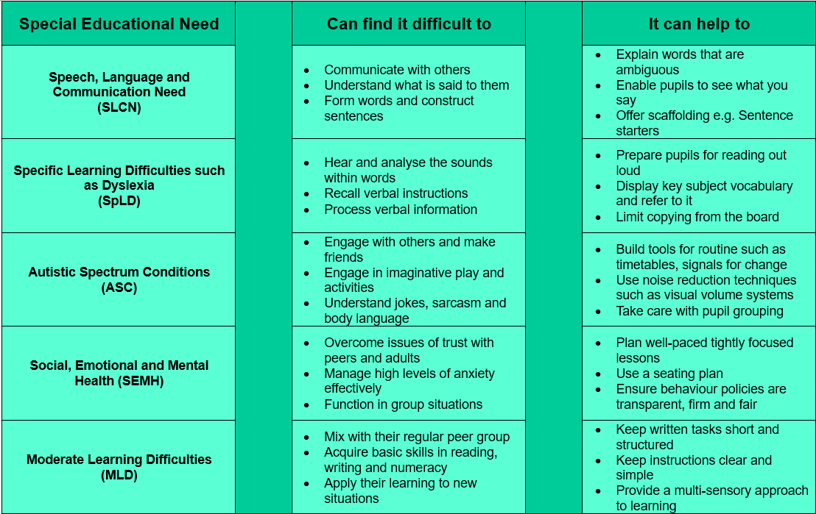

Slide 28
Feedback – Quick 2-minute Survey
https://www.surveymonkey.com/r/TCKCRRN

Slide 29
Visit capel.ac.uk to browse courses and apply online

