Slide 1
Save me – Exploitation Workshop
This film is dedicated to all young people suffering the hardships of exploitation.
Created by Amani Simpson –
Youth Coach and Film maker

Slide 2
Key Themes
Has anyone heard of these words and
can you describe what they mean?
Discuss in pairs/small groups:
Child Sexual Exploitation
Child Criminal Exploitation
Grooming
Intimidation & Control

Slide 3
Key themes - Answers
Child Sexual Exploitation
Is a type of sexual abuse where a child or young person is coerced, tricked, manipulated and/or
deceived into sexual activity with an abuser.
Child Criminal Exploitation
Is child abuse where children and young people are manipulated and coerced into committing
crimes.
Grooming
When someone builds a relationship, trust and emotional connection with a child or young person
so they can manipulate, exploit and abuse them.
Intimidation & Control
An act or a pattern of acts to assert dominance over another person. It can involve threats,
humiliation, fear and even physical abuse to manipulate

Slide 4
Video – Save Me - Short film

Slide 5
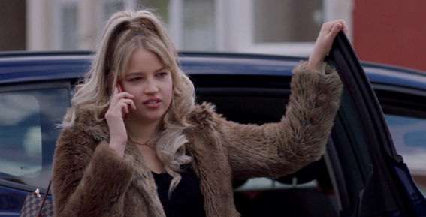
Key Moment 1 - Khaled picks up Fiona & Dean
What were your first thoughts about this situation?
What should Khaled notice here?
What did you notice about Fiona’s phone call?
Notes:
Small group discussion and feedback
You can have different groups working on separate Key moments and then feeding back to the whole group

Slide 6
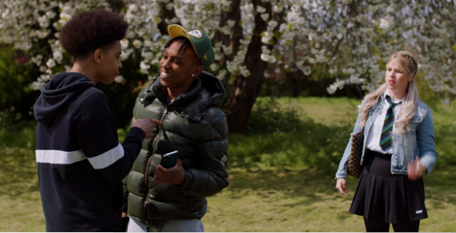
Key Moment 2 – Strykez and Dante
What was your impression of Fiona at this point?
What did you notice about the conversation between the boys?

Slide 7
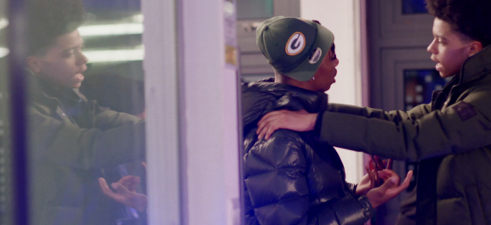
Key Moment 3 – Dante’s role in the film
What did you notice about Dante’s character throughout the film?
How accurate do you think this character is? i.e. always having one friend trying to help you make the right choices.

Slide 8
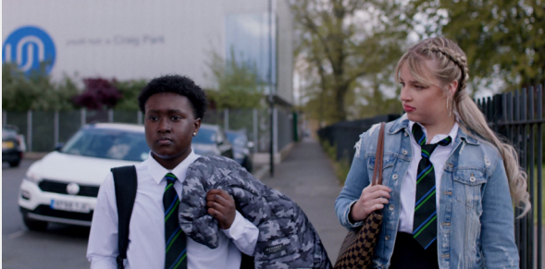
Key Moment 4 – Fiona and Dean get to know each other
What did you notice about their conversation?
Do you think Fiona was being genuine from the start?

Slide 9
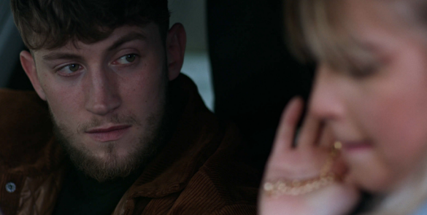
Key Moment 5 – Fiona meets Damian
What are your thoughts on the relationship between Fiona and Damian?
What did you notice about their conversation and interaction?

Slide 10
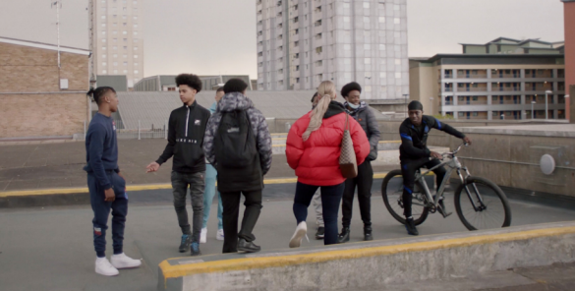
Key Moment 6 – Fiona and Dean at The Green
What do you think the moment in the trolley meant to Fiona and Dean?
How do you think Strykez’s comment to his boys would make Fiona feel?
What could be done to safeguard the pair while in the shopping centre?
What could be done to safeguard the boys on the roof?

Slide 11
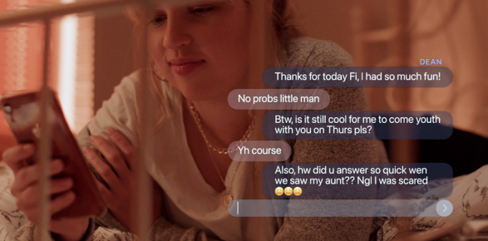
Key Moment 7 – Fiona texting in her bedroom
Do you think Fiona and Dean’s relationship is genuine?
What do you think about Fiona’s text to Damian?

Slide 12
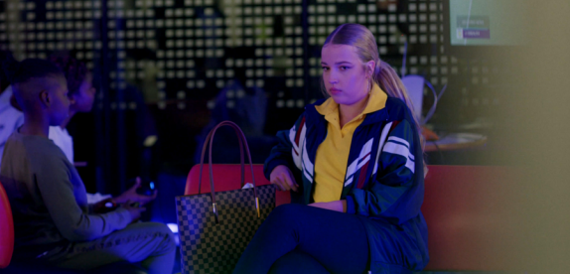
Key moment 8 – The video goes viral around the Youth Club
How could the youth workers and young leaders handle this situation? What would you do in this situation?

Slide 13
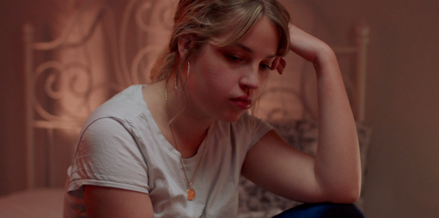
Key Moment 9 – Fiona agrees to set up Dean
What were your thoughts about how Fiona reacted?
How do you think Fiona was feeling when she sent her text to Damian?

Slide 14
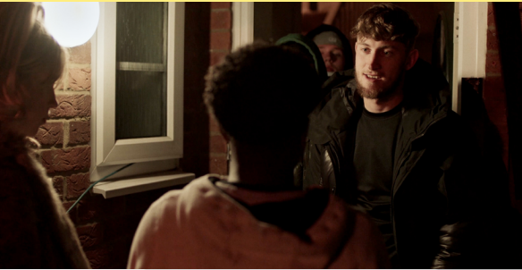
Key Moment 10 - Outside the trap house
What do you think about how Strykez reacted to being arrested?

Slide 15
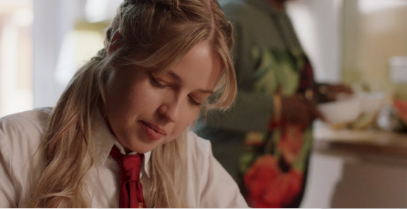
Key Moment 11 – Fiona’s fresh start
What did you think about this outcome for Fiona?
What do you hope has happened to Dean?
What do you hope has happened to Strykez?
Notes:
Explanation of the outcome for the students:
• Fiona is in care because her home environment was not safe for her. Sometimes this really is the
best intervention for a vulnerable young person.
• Being in care is not always a happy situation. It can be very tough to live away from your family
(even if it’s better for you).

Slide 16
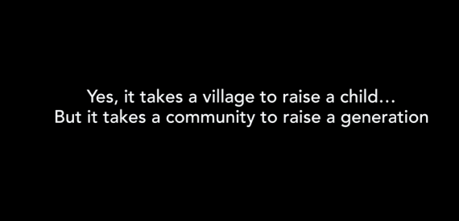
Final Moment – Final thought
What do you think this quote means?
What are you going to do differently after watching SAVE ME?

Slide 17
Signposting – Helpful contacts
Where can you get help?
Talk to someone that YOU trust such as – parents/Aunts/Uncles/School, GP, Police, health
professionals, mentors, sports coaches.
Enfield Children’s Portal
Childline - Charity providing a telephone counselling service for children and young people in danger and distress. Tel 0800 1111 (24-hour free helpline).
The Samaritans Charity providing 24-hour support for people feeling depressed, isolated or in despair. Tel 08457 9090 90
Crime Stoppers - Provides an anonymous free phone number for callers who have information about crime in the UK - Tel 0800 555 111.
Credits - Amani Simpson Founder & CEO - AVIA

