Slide 2
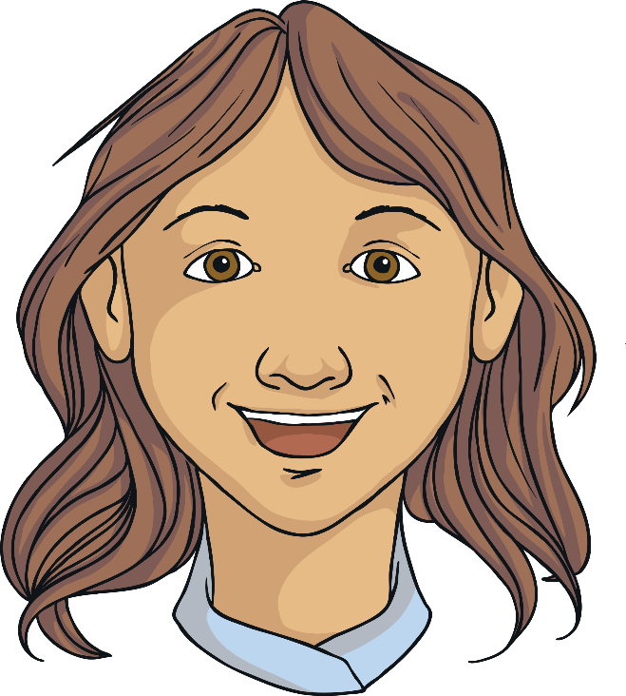
MINDFULNESS: What is mindfulness? How to be Mindful. How can we apply this to our lives?

Slide 3
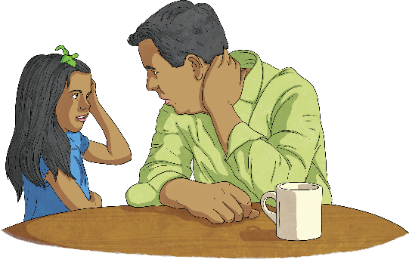
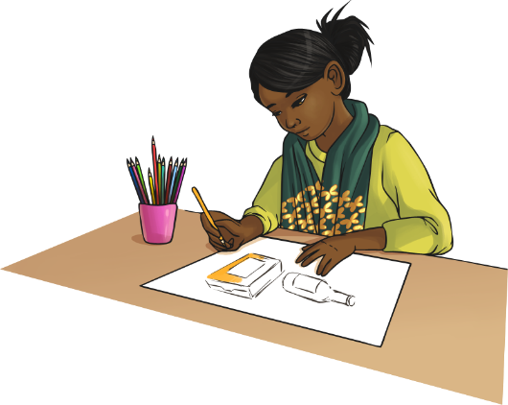
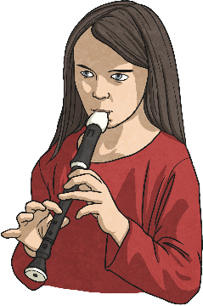
Top Tips to Manage Change
To identify what mindfulness is.
To practice mindfulness techniques.
To apply mindfulness to our everyday lives.

Slide 4
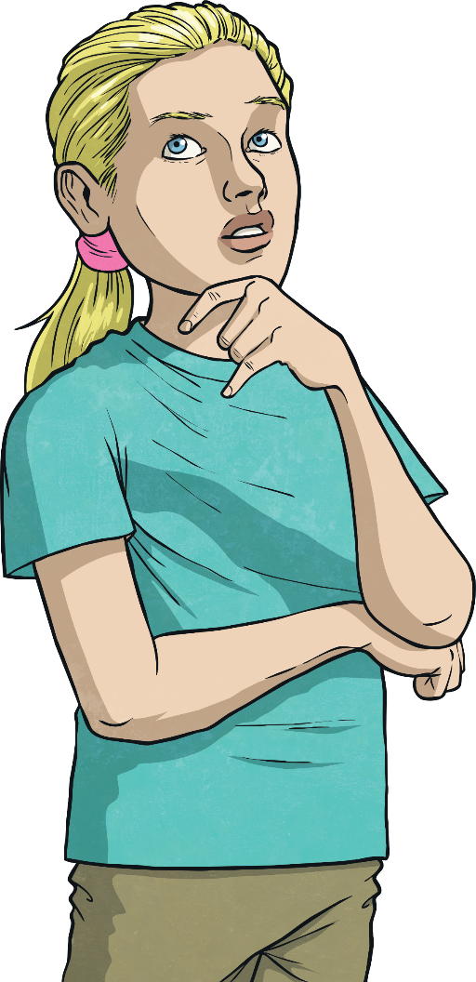
What is mindfulness? 5 minutes – discuss what you think mindfulness is

Slide 5
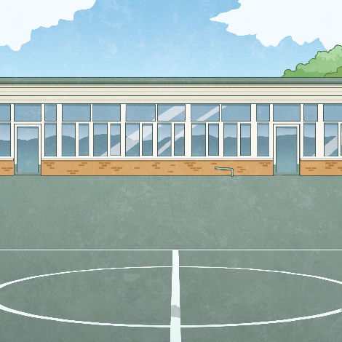
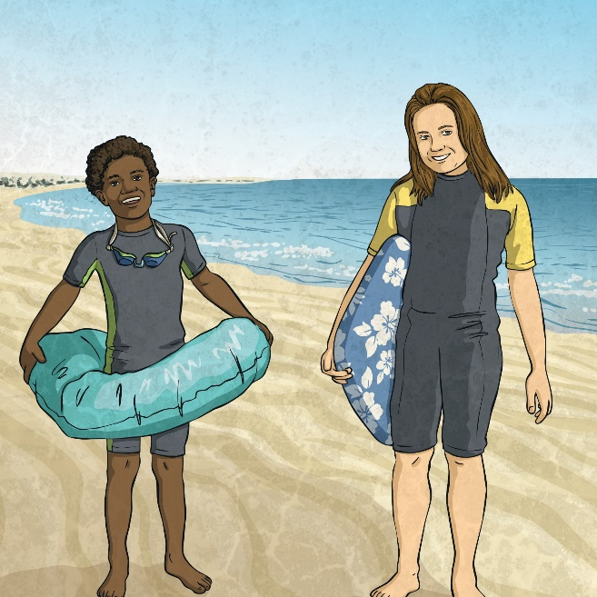
Mindfulness is...
Mindfulness is a technique you can learn which involves noticing what's happening in the present moment, without judgement. You might take notice and be aware of your mind, body or surroundings. The technique has roots in Buddhism and meditation, but you don't have to be spiritual, or have any beliefs, to try it. Mindfulness aims to help you:
become more self-aware
feel calmer and less stressed
feel more able to choose how to respond to your thoughts and feelings
cope with difficult or unhelpful thoughts
be kinder towards yourself.

Slide 6
REBECCA: A mindfulness teacher

Slide 7
How does it work?
Notice how thoughts come and go in your mind.
You may learn that they don't have to define who you are, or your experience of the world, and that you can let go of them.
Notice what your body is telling you.
For example, you might feel tension or anxiety in your body, such as a fast heartbeat, tense muscles or shallow breathing.
Create space between you and your thoughts.
With this space, you can reflect on the situation and react more calmly

Slide 8
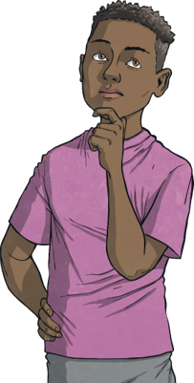
Can mindfulness help mental health problems?
Studies show that practising mindfulness can help to manage common mental health problems like depression, anxiety and feelings of stress.
There is some evidence that mindfulness could help with more complex mental health conditions, such as psychosis and bipolar disorder. But more research is needed in this area.
You might find mindfulness very helpful. Or you might feel like it doesn't work or makes you feel worse. It's important to do what works for you and your mental health.

Slide 9
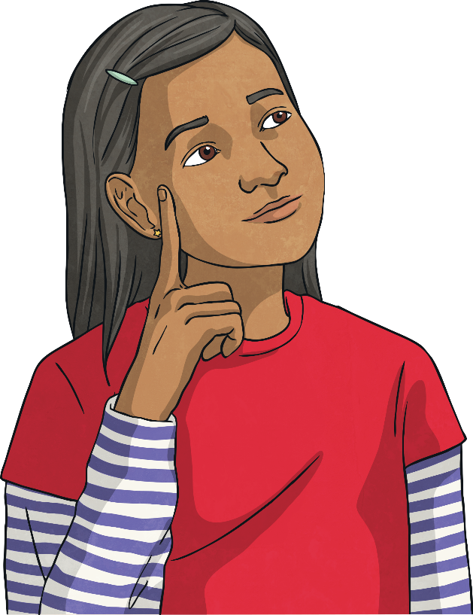
How do we practice mindfulness?

Slide 10
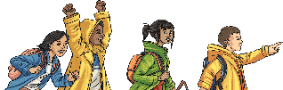
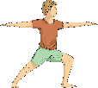
Mindfulness Activities –Prepared by Mind Choose 3-4 of the following activities (each is between 5-10 mins)to take part in with the class.
Gratitude | Mental Fitness | Visualising goals | Morning Wake Up // Afternoon Reset
Feelings | Heartbeat | The Senses | Resting with music
Focus Training | Walking Meditation | Sky Gazing | Soundscapes

Slide 11
Resting with music
1. Students should find a comfortable position. They might relax back in their chair or even lie on the ground. If it feels okay, invite them to close their eyes, or if they prefer to keep their eyes open, ask them to relax.
2. Play A Quiet Day (6 min)*. https://www.calm.com/schools/resources?day=4
3. Once you’ve started the song, encourage students to relax and listen deeply to the music. Let them know that there’s nothing to do right now but rest and tune in to the sounds. Muscles relaxed. Body heavy. If you feel the urge to move, try taking a few deep breaths or limiting their movements to small adjustments.
4. As the song ends, invite them to gently wiggle their toes and fingers, and start to bring some movement into the body.
How did this feel?

Slide 12
The Senses
The senses are a gateway to the present moment. The following technique invites students to connect with their senses by looking, feeling, listening, smelling, and tasting. It’s an extremely useful tool when it comes to helping both adults and children find calm in times of stress.
Mindfulness Activity: You should name:
5 things they can see
4 things they can touch
3 things they can hear
2 things they can smell
1 thing they can taste
What did you notice as you explored each sense?
Next time you feel stressed, what might you look at, feel, touch, smell or taste that would help you to feel calmer?

Slide 13
Mental Fitness
Just as we need specific physical exercises and movement to build strength, agility, and endurance; we can also benefit from exercises — or practices — to strengthen our mind’s capacity for concentration, compassion, clarity, courage, and composure. In this session, one of the greatest basketball players of all time talks about how meditation, sleep, and a healthy mindset are the keys to his extraordinary achievements and personal happiness.
Mindfulness Activity:
1. Find a comfortable position, seated or lying down.
2. Play https://www.calm.com/schools/resources?day=7
What makes it hard for you to focus?
What did you learn from LeBron James?
What do you want to bring more focus to in your life?

Slide 14
Morning Wake Up/Afternoon Reset
Movement is a helpful entry point to mindfulness, especially for anyone who struggles to sit still. The mind naturally begins to settle when we invite our attention to the body and the breath. In addition to giving the mind a break, mindful movement is a powerful way to release tension, boost your mood, and get better sleep. While moving mindfully can be applied to any type of movement or exercise, gentle stretching is a good place to begin — just five to ten minutes is enough to reduce stress and shift your mental and emotional state.
Mindfulness Activity:
1. Invite students to find enough space to stand with their arms stretched out.
2. Play
MORNING: https://www.calm.com/schools/resources?day=9
AFTERNOON: https://www.calm.com/schools/resources?day=18
How did you feel before and after the session?
Which movement felt good in your body?
What did you learn about your body today?

Slide 15
Walking Meditation
If we pay close attention to our surroundings and the steps we take, even walking can become a meditation. Slowing down and getting curious about an activity that we tend to perform automatically or without awareness can offer us new insight into ourselves and the world around us. Unlike formal meditation, we do walking meditations with our eyes wide open so that we can receive our environment and stay safe. Explore this exercise on campus or on a neighborhood walk. It can also be adapted for people in a wheelchair.
You and your class can then go outside and walk around some naturalistic landscape. Try to be quiet as you walk, with your own thoughts. You should return and consider the questions below.
What did you notice about your body when you were walking?
Did you see anything on your walk that you’ve passed by many times, but that you’ve never noticed before?
What’s different about walking meditation and regular walking?

Slide 16
Soundscapes
Listening to nature sounds, even pre-recorded ones, elicits the body’s relaxation response. So when you don’t have the opportunity to go for a hike, playing a soundscape is the next best thing. LeBron James takes advantage of this relaxation trick by listening to Calm’s Rain on Leaves soundscape during his daily nap.
1. Find a comfortable position, seated or lying down.
2. Play the following soundscapes for a minute each. Listen closely and note how each one makes you feel.
https://www.calm.com/schools/resources?day=12
Which soundscape made you feel the most relaxed?
Do you already use soundscapes? Do you think you could use them?

Slide 17
Gratitude
Gratitude is the feeling of thankfulness that comes with our appreciation of an experience, person, or thing. It can arise spontaneously, but can also be cultivated. Practicing gratitude creates a sense of spaciousness by opening the heart, relaxing the body, and bringing a fresh perspective to the mind. Even in challenging times, if we look around, we can find something or someone to appreciate. It doesn’t cancel out what’s hard in our lives, but it does invite a sense of balance and reminds us of what we have.
1. Invite students into a comfortable position, seated or lying down. Go around the circle and invite each student to name something or someone that they’re grateful for and explain why.
2. Play https://www.calm.com/schools/resources?day=14

Slide 18
Feelings
Growing up, many of us were taught that certain emotions are wrong. Perhaps that anger was bad, that joy was uncivilized, or that it wasn’t okay to cry. So instead of accepting our emotions as part of being human, we learned to push them away. Just as nature experiences sunshine and showers, mindfulness invites us to meet all of our emotions with openness and curiosity. Even if the rain forces us to cancel our outdoor plans, we can use the opportunity to snuggle up quietly inside while it nourishes a nearby vegetable garden. Meditation helps us to make space to experience our feelings and respond with care and appreciation.
1. Invite students into a comfortable position, seated or lying down.
2. Play https://www.calm.com/schools/resources?day=15
What did you learn about feelings?
Do you have any “shoulds” around what’s okay to feel and what’s not? What judgements do you have about feelings?

Slide 19
Heartbeat
A short burst of physical activity that increases the heart rate, releases endorphins, and speeds up our breathing is a great way to shift our state (mentally, physically and emotionally). With just 60 seconds of vigorous movement, we can transform our energy from tired to lively or anxious to calm.
1. Play the sound for one minute. https://www.calm.com/schools/resources?day=17
2. Invite students to jump up and down on the spot, dance with their whole body, or do jumping jacks for the entire minute.
3. After one minute, ask students to return to stillness and place their hands over their hearts.
4. Turn the music off and ask students to spend the next minute in stillness and silence. Invite them to become aware of their breath and heartbeat.
How did you feel before you moved?
What did it feel like to be in stillness after the movement?
What did you feel like after the activity?

Slide 20
Sky Gazing
This outdoor activity helps us connect with the natural world and discover that our meditation practice is always accessible to us. Meditation encourages us to focus our attention on an object or sensation that we can return to whenever the mind wanders.
1. Move outside and invite them to find a safe and comfortable position, seated or lying down where they can easily look up at the sky.
2. For the next five minutes is to relax and watch the sky. When you notice your are getting distracted, try to come back to sky watching. Consider the colours and shapes you see. Notice what it feels like to be outside. Is it warm or cold? Dry or damp? Breezy or still? Is the sky changing as you observe it?
3. If they’re you are having trouble focusing, take a few deep breaths and then notice if that changes the way you're able to experience the sky.
4. Draw the sky or write about how it made you feel.

Slide 21
Body Scan
Body scans are a way of deepening our relationship to self by paying attention to how our body feels. This tool helps us soak up the nourishment of good feelings and pick up on early warning signs of stress and tension in the body. Ultimately, the more connected we are to our bodies, the more information we have to take better care of ourselves.
1. Invite students into a comfortable position, seated or lying down.
2. Play https://www.calm.com/schools/resources?day=27
What did you notice about your body today?
What felt different than the day before?
Is there something you can do to support your body to feel better?

Slide 22
Visualise your goals
Paralympian Lex Gillette was only eight years old when he permanently lost his eyesight. For a free-spirited kid who was used to playing sports with his friends, this wasn’t just a huge shock; it was a complete upheaval of his life. Today, he’s one of the country’s most decorated long and triple jumpers and he makes space every day to envision success. In today’s session, we listen to him talk about how he works towards his goals using the practice of visualization.
1. Invite students into a comfortable position, seated or lying down.
2. Play https://www.calm.com/schools/resources?day=29
What challenges in your life have helped shape who you are today? What have you learned that has helped you?
What do you want to start envisioning for yourself?

Slide 23
Lets Practice as a group

Slide 24
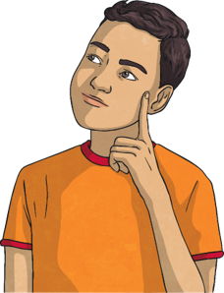
Quiet Time
Engaging in a quiet activity of their choosing can be rejuvenating and set them up to better focus afterwards. It’s a mental break that also supports learning. You may even find yourself with more energy and presence for the rest of the day.
1. Explain to students that we’ll be spending the rest of the session doing a quiet activity.
2. Here are a few examples of quiet time activities:
• Colour (colouring pages can be printed)
• Read
• Journal
• Start homework
• Doodle
• Meditate
3. Play Lo-Fi Beats https://www.calm.com/schools/resources?day=23

Slide 25
WAS THIS USEFUL? Where there any techniques we practiced today that you might use in the future? When would you use them?

Slide 26
Additional Resources
Free Audio Resources for Mindfulness Meditation: Mindful: https://www.mindful.org/audio-resources-for-mindfulness-meditation/ The Free Mindfulness
Project: http://www.freemindfulness.org/download Mindfulness Exercises: https://mindfulnessexercises.com/free-guided-meditationsmindfulness-talks/ The Mindfulness Network: https://home.mindfulness-network.org/practicemindfulness/audio-downloads/

