Slide 1
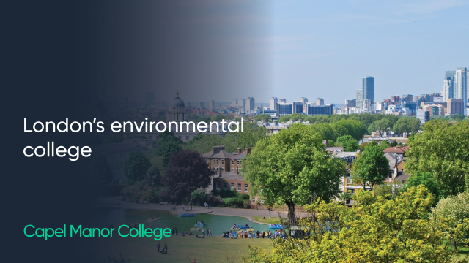

Slide 2
Study
SKILLS

Slide 3
Objectives
01
02
03
04
A few benefits of highlighting are:
To Identify what type of learner you are
To Explain the importance of time management and collaboration .
To Understand how to create an optimal studying environment and techniques
To apply knowledge to studying practice

Slide 4
01
What TYPE of learner are you?

Slide 5
Take the quiz below.
01
02
Follow the link
https://vark-learn.com/the-vark-questionnaire/
Once you have finished, exchange types of learning with those around you.
What techniques would help you as an individual? .

Slide 6
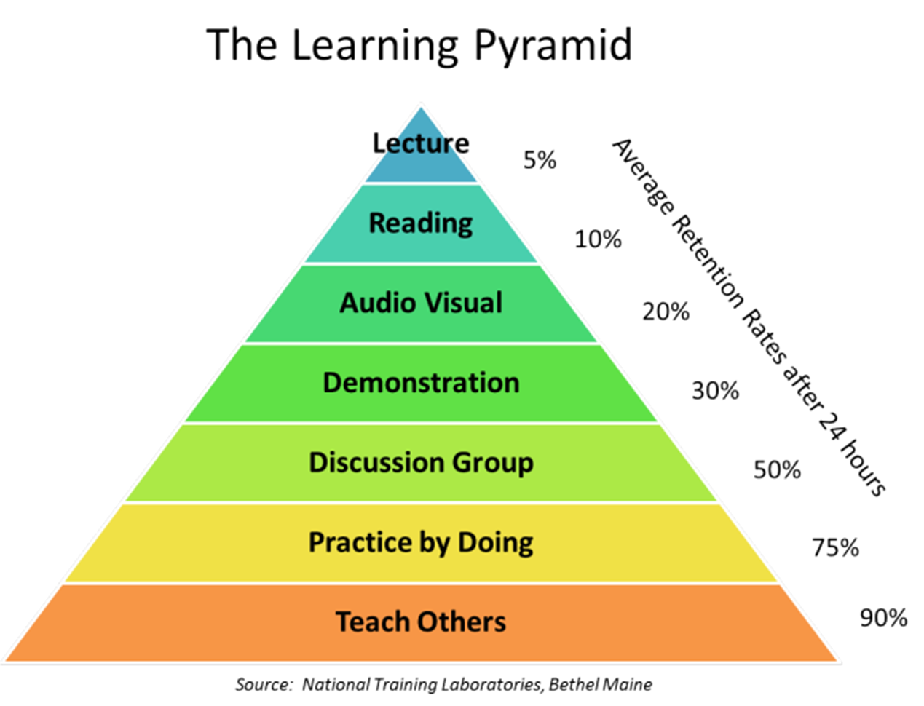
Retention Pyramid

Slide 7
02
Key study skills

Slide 8

Time Management
  Plan your time: (daily and weekly)
  Prioritise deadlines
  Timetable your study periods – (and stick to these)

Slide 9

Collaborative Learning
4 steps to success when seeking help:
BRAIN: Use your memory and notes to find the answer
BOOK: Research the answer
BUDDY: Ask a classmate
BOSS: Then approach your teacher for help

Slide 10
The important ideas of a text
The purpose of highlighting is to differentiate between:
01 | 02 | 03 | 04
Main ideas | Secondary ideas | Relevant dates | Key concepts or words

Slide 11
03
Creating a good studying environment and techniques

Slide 12

Effective Studying
To study effectively, you must GET RID OF TEMPTATION:
No clutter
No Phone
No TV
Get Organised (Books and Notes)
Create a study timetable
Split learning in to manageable chunks

Slide 13
Pomodoro Technique
5 Basic Steps: This will help you break down work in to manageable chunks
  Decide on the task to complete
  Set a timer for 25 minutes
  Work until the timer rings
  Take a short 5 minute break in the margin why the paragraph is relevant
  Repeat. After four pomodori, take a longer break (30-60 minutes)

Slide 14
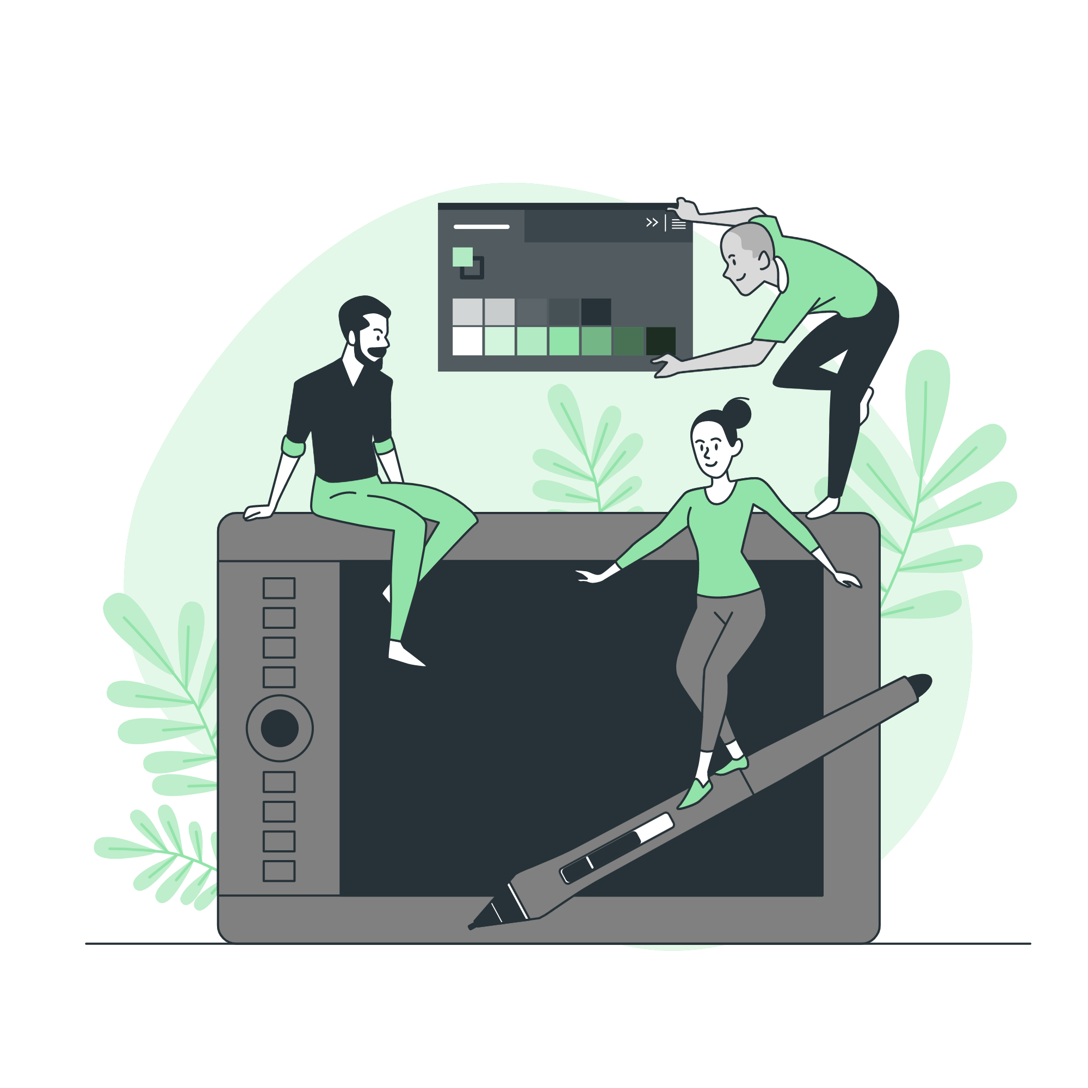
What actually is effective?
Not Effective
We often use these techniques because they are low stress. They don’t really challenge us, but they make us feel good, because we are doing something. We must Engage our recall.
Try to not only:
  Highlight texts
  Re-read
  Summarise texts
  YOU COULD ALSO...

Slide 15
What actually is effective?
Effective
This technique is pretty straightforward – keep testing yourself (or each other) on what you have got to learn. This technique has been shown to have the highest impact in terms of supporting student learning.. Some Ways to do this, include
  Create some flashcards, with questions on one side and answers on the other – and keep testing yourself.
  Work through past exam papers – many can be acquired through exam board websites.
  Simply quiz each other (or yourself) on key bits of information.
  Create ‘fill the gap’ exercises for you and a friend to complete.
  Create multiple choice quizzes for friends to complete

Slide 16
04
Applying Knowledge

Slide 17
Independent activity
Use one of the essay plan templates: Create an essay plan on one of your assignment topics.
OR
Complete some activities in the workbook: This is designed to help you with general study skills.

