Slide 2
Consent, Consequences and the Law
Session Objective
What we mean by Consent
How and where to access support
Learning Outcomes
Explain what is meant by consent, and what this means within healthy relationships.
Explain consequences of not giving consent to sexual activity
Analyse the signs of someone who may be giving non-verbal signals of withdrawing consent.
Assess how and where to access support and how to support a friend who may be experiencing abuse.

Slide 3
Ground Rules
Please be respectful of each others views
Remember that what is said in the room stays in the room
Please don’t use personal examples
If anyone is worried during or after the session, remember that we have counsellors, mentors and a safeguarding team that you can talk to in confidence.

Slide 4
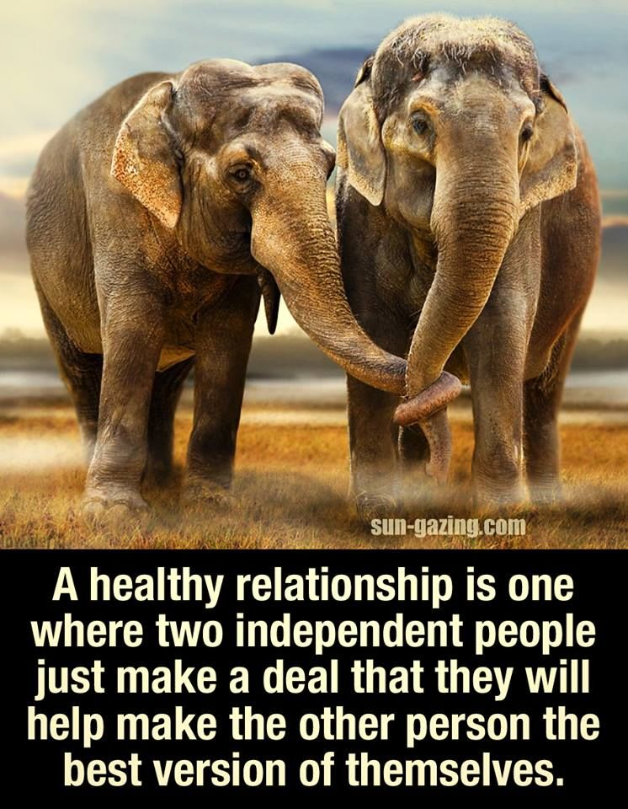
Starter Activity – 10 mins
Divide an A4 page into four sections and to write the word consent in the centre of their page.
Add ideas to the four different sections of their page around the word, using the headings:
Synonyms – what other words are related or have a similar meaning?
Examples – when might someone need to ask for consent?
Context – where have they heard the word used before?
Behaviour – how might someone know that someone is giving their consent?
Once the activity has been completed, put the sheet alside and we will return to it at the end of the session.

Slide 5
Consent and the Law
Consent is defined as an agreement made by someone with the freedom and ability to decide something. Under the law, it is the person seeking consent who is responsible for ensuring that these conditions are met.
Consent has to be given freely and no one can be made to consent if someone does something because they feel that they have to.
British law says that both people need to give consent before sex or any physical closeness.
The law also says that to consent to sex, a person must be 16 or over (in the UK this can vary from country to country) and have the ability to make the decision and not be impaired by e.g. drugs or alcohol.

Slide 6
Watch this short clip
https://www.youtube.com/watch?v=lSmohHSkg30
Discuss:
What are your initial thoughts?
Is this inline with what you thought consent was?

Slide 7
True of False? Myths and misconceptions about Rape
People who are raped usually ‘ask for it’ by wearing reveling or provocative clothing
A stranger is usually in a dark alley.
This is never the case, it is not the victims fault
If someone is raped while
they are drunk, they are
also somewhat
responsible.
Not every stranger in a dark alley is a rapist, although we should be careful when it is dark. We may be putting ourselves at risk of assault (although this is never the victims fault)
This is never the case, it is not the victims fault
If two people have had
sex before, it is always ok
to have sex again
When it comes to sex,
‘no’ sometimes means
‘yes’.
We need to be sure that we have consent before each sexual activity, this is very important
We must be sure we have CLEAR and fully informed consent before proceeding with sexual activity
Alcohol and drugs turn
people into rapists.
This is not the case, all those who drink and take drugs are not rapists, although such substances can impede our ability to consent to sexual activity
Rape is only rape if
someone gets physically
injured.
Men don’t usually mean
to force sex on anyone
but sometimes they get
carried away.
If you go back to
someone’s house, you are
saying you want to have
sex with that person
Rape is defined as…
forced sexual intercourse, including penetration.
Getting ‘carried away’ is not an excuse
This is not how consent is given or received.
Notes:
Tutors: Ask the class to sort the statements into true and false.
Please see separate resources to the answers to each statement, following the discussion you can read the true information out and compare the students thoughts and knowledge.

Slide 8
True of False? Myths and misconceptions about Rape – Discus and Vote
People often lie about
being rape if they regret
having sex with someone
Boys and men don’t get
raped.
It is not rape if the target
doesn’t clearly say ‘no’.
These statements are all FALSE:
Lying about Sexual Assault is not acceptable and rarely happens
Not consenting can happen in all manner of ways, it doesn’t HAVE to be the word ‘no’.
Boys and men can be raped
Statements such as these can be really damaging to those who have been victims of sexual assault. It can invalidate their feelings.
Notes:
Tutors: Ask the class to sort the statements into true and false.
Please see separate resources to the answers to each statement, following the discussion you can read the true information out and compare the students thoughts and knowledge.

Slide 9
How do I make sure that I ask for consent and ensure that I still have consent – remember people are always able to change their minds.
In groups or as a class make a list of ways that someone could show non – verbally that they are not consenting to sex or other sexual acts.
Then watch this video: https://www.youtube.com/watch?v=fGoWLWS4-kU&ab_channel=BlueSeatStudios

Slide 10
TASK: Dialogue – 20 mins
Obtaining consent often requires some dialogue before sexual activity.
This is a partially completed dialogue from Laura and Dan before they have sex. The persons speech that is completed is Dans.
Can you complete Laura's Reponses in the situation that she does want to have sex with Dan and is giving consent
Can you then complete the responses as if she does not consent to having sex with Dan
DAN
LAURA
What's wrong, you’ve been leading me on all night?
Response:
Do you like me?
Response:
You’re really special to me
Response:
Let’s go upstairs then!
Response:

Slide 11
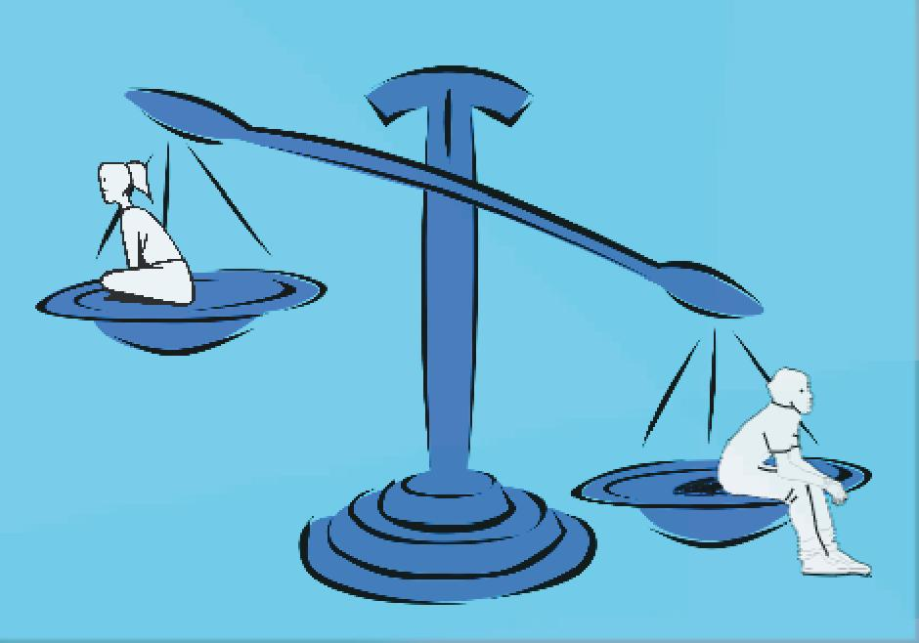
TASK: Power Dynamics
Having power over someone means being able to direct or influence their behaviour in a certain situation. The term power dynamics describes how this power might affect a relationship or situation between two or more people.
When it comes to sex, unequal power dynamics might affect a person’s ability to give proper consent. For example, if someone feels as though the other person has power over them in some way, they may not feel that they can say ‘no’ as easily, even if they want to.
On the following slide, there are a list of factors that ay affect power dynamics, for each you need to think of HOW this affects power, and give and example of a situation where someone may heave more vs less power.

Slide 12
TASK: Power Dynamics – 40 mins
 | How does this factor affect power | Example of how this may increase power | Example of how this may decrease power
Sexual Experience | Sexual experience can be intimidating. It can make someone feel or at least give the assumption that one individual has more power and is more comfortable in a situation | The person with more sexual experience | The person with less sexual experience.
Age
Intellectual Ability
Strength
Education
Ethnicity
Physical Ability
Fame
Wealth
Social Status
Sex/gender
Job

Slide 13
individual libertyconsewn
Considering Consequences
Consequences can either be positive or negative, and can have a lasting impact on people’s lives. Sex or physical closeness without consent can have extremely damaging consequences for both people involved, and the perpetrator could end up with a criminal record.
Disrespectful and unacceptable behavior can come in many forms. It isn’t limited to just physical behavior; it can also go way beyond that. For example, it’s not OK for someone to try and pressure you into sending a nude pic, or to expect the same things to happen that they’ve seen in a porn film. To make something do something they don’t want to do is completely unacceptable and illegal.
There is always help available both at college and with outside agencies, which we will explore.
If you are concerned about a friend or yourself please reach out to someone you trust.

Slide 14
Conclusion Activity – 5 mins
Return to your page on Consent that we completed at the start of the session and add more answers in a different colour.
Synonyms – what other words are related or have a similar meaning?
Examples – when might someone need to ask for consent?
Context – where have they heard the word used before?
Behaviour – how might someone know that someone is giving their consent?

Slide 15
Signpost Help and Websites
In college support, each site has student services where you can access, Safeguarding, Counselling and mentoring with any concerns:
Safeguarding safeguarding@capel.ac.uk 01992 707027
0303 003 1234 ex 429
07738 832321
Counselling/Welfare Support counselling@capel.ac.uk
Or you can ask your tutor who can help you to access these services.
Disrespect Nobody: this links to many outside agencies where you can learn more, report abuse and get external help please explore this link with your class so that everyone is aware of the help and websites available:
https://www.disrespectnobody.co.uk/need-help/
Notes:
Resources drawn from Disrespect nobody https://www.disrespectnobody.co.uk/need-help/
and https://www.bewiser.ie/your-sexual-health/

Slide 16
Visit capel.ac.uk to browse courses and apply online

