Slide 1
Please read aloud to your class before delivery:
This activity will cover important topics which require a mature and sensitive approach to discussing them.
Some of us might find these upsetting which is a natural response to feel.
If you see this symbol on a slide it is a Content Warning for the information to follow.
During this lesson or after this lesson you can access support from:
using your time out pass, or asking your teacher for some time out (If you are given time out make sure to take 5 mins and come back to class, this is so we know you are safe, if you need longer make sure to make a plan with your tutor)
accessing student services
speaking to your form tutor or Student Support.
speaking to one of the Safeguarding Team
outside agencies such as Childline, Young Minds, Kooth
C
W

Slide 2
Elimination of Violence against Women and Girls
C
W
Visual
As you watch the video think:
1) What does the news reporter suggest is the normal approach towards violence?
Can you think of any examples of this?
2) What does Horne suggest needs to be the alternative approach?
Women and their behaviour
Women need to change who they are and how they are
Cultural and societal changes towards the way boys are brought up to prevent them being socialised to cause harm / think harming is acceptable
After the Video Share your thoughts and ideas
If the embedded video does not work, please access here:
https://www.youtube.com/watch?v=ND6HIQM-lug

Slide 3
Elimination of Violence against Women and Girls
C
W
Visual
As you watch the video:
1) What version of ‘masculinity’ is prevalent within society?
2) How does this negatively impact men and women?
3) Why do boys need to be taught and supported to challenge toxic masculinity?
Toxic Masculinity – a set of negative behaviours that men think they have to follow in order to be ‘proper men’
Mental Health, suicidal thoughts/actions, struggling to show emotion
Sexism, harassment, and sexual harassment
Need a chance to not take forward negative ideas and stereotypes
Following the video: Discuss as a group
If the embedded video does not work, please access here:
https://www.youtube.com/watch?v=7kAqAFOHIxw

Slide 4
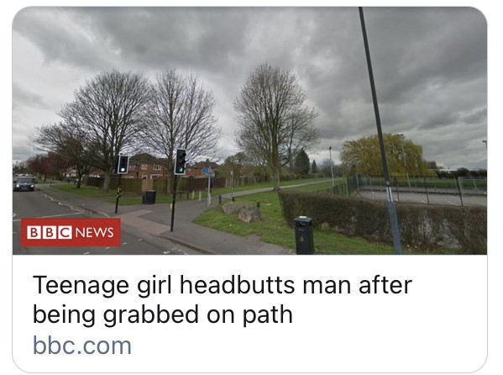
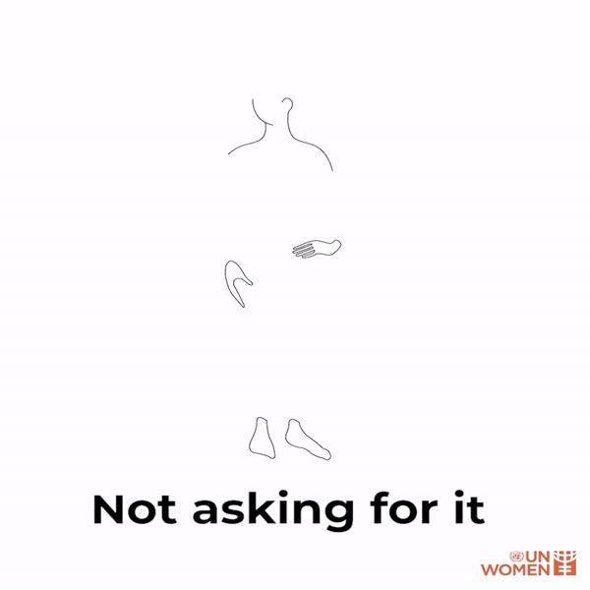
Elimination of Violence against Women and Girls
What is wrong with these statements?
C
W
Description
Victim Blaming: saying, implying, or treating a person who has experienced harmful or abusive behavior like it was a result of something they did or said, instead of placing the responsibility on the person who harmed them.
How could you reword the statements? Would rewording the statements begin to make a cultural change in peoples attitudes?

Slide 5
Elimination of Violence against Women and Girls
C
W
Description
Final thought about gender-based violence. Love has no gender - compassion has no religion - character has no race. Self respect by definition is a confidence and pride in knowing that your behavior is both honorable and dignified.
When you harass or vilify someone, you not only disrespect them, but you disrespect yourself also.
Let’s work together to support each other, you don’t have to understand someone to respect them.
Always be kind. Kindness is a super power that can help change culture for the best.

