Slide 2
LGBTQAI+
History Month
Celebration
February 2024 is LGBTQAI+ History Month in the UK.

Slide 3
OBJECTIVES
To identify
To Examine
To Examine
To Investigate
The importance of LGBTQAI+ History Month
How to make an inclusive college environment
Frequently asked questions about LGBTQAI+ History Month
Different LGBTQAI+ Icons

Slide 4
INTRODUCTION
01
Discussion
02
FAQ's
03
Colour the Flags
04
Research
05
CONCLUSION
06
What is LGBTQAI+ History Month?
How can we make Capel more inclusive to the LGBTQAI+ Community
Common Questions about the LGBTQAI+ Community
LGBTQAI+ Icons

Slide 5
01
Why is this important?
To identify why LGBTQAI+ history Month is important

Slide 6
WHAT IS LGBTQAI+ HISTORY MONTH?
A MONTH WHERE WE PARADE...
AND INFORM OURSELVES
LGBT History Month is a month-long annual observance of lesbian, gay, bisexual and transgender history, and the history of the gay rights and related civil rights movements
Supporters of the event countered that it is important to challenge heterosexist attitudes in society

Slide 7
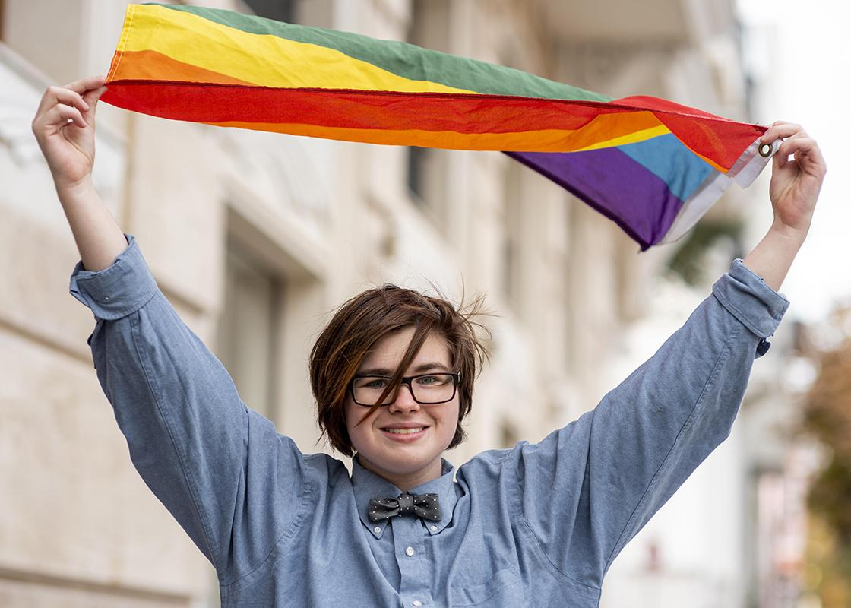
MAIN CHARACTERISTICS
WHAT DEFINES US
United by common culture
“Pride” is the community’s identity
Fighting against social-hate
Always advocating for LGBT+ rights
Not everyone in the community is LGBT

Slide 8
Video
02
Watch this Video:
https://www.bbc.co.uk/teach/class-clips-video/rse-ks4-teaching-inclusivity-at-school/zf82cqt

Slide 9
??
How can we make our curriculum and your time at Capel more inclusive to the LGBTQAI+ Community?
To examine how to create an inclusive environment at college

Slide 10
03
Frequently Asked Questions
To examine frequently asked questions

Slide 11
LET’S BE PROUD OF OURSELVES!
What do we mean by the term 'sexual orientation'?​
What do we mean by the term 'gender identity'?
Sexual orientation, or sometimes 'sexuality', refers to the part of a person’s identity that describes the types of people that they experience attraction to.
Often confused with 'sex' (which refers to the physical characteristics of a person’s body), gender is a person’s sense of self. It is how a person feels about themselves and knows themselves to be.

Slide 12
Why do the key words 'straight' and 'cis' not have symbols or flags?
Straight and cis people generally do not experience discrimination on account of their sexual orientation or gender identity. Straight and cis identities are affirmed and visible constantly in society (and often expected). Therefore, a straight and cis pride or protest has never been needed.

Slide 13
WHAT ARE THE COLOURED FLAGS?
Over many years, the LGBT+ community has developed positive symbols, such as flags, to visibly show commonality, solidarity and support for each other. You will see lots of these flags at events such as LGBT+ Pride, events that began as protests to challenge the discrimination experienced by LGBT+ people.

Slide 14
TODAY’S COLORS AND MEANINGS
ORANGE
GREEN
PURPLE
Meaning: healing
Meaning: nature
Meaning: spirit
RED
YELLOW
INDIGO
Meaning: life
Meaning: sunlight
Meaning: serenity

Slide 15
HISTORY OF THE PRIDE FLAG
EARLY 1978
MID-1978
1980 - PRESENT
Original eight-striped version designed by Gilbert Baker
Seven-striped version due to pink fabric unavailability
Current six-striped version modified for even stripe split

Slide 16
05
COLOURING PAGE
Complete the colouring page

Slide 17
RESEARCH TASK
06
To investigate LGBTQAI+ Icons

Slide 18
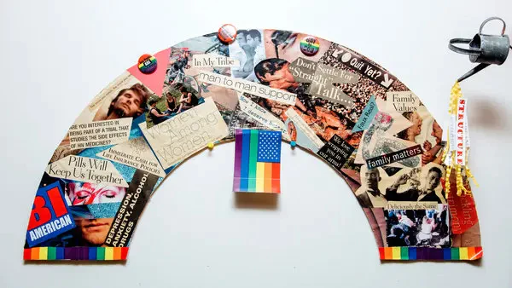
THE IMPACT OF ART
Art therapy offers an opportunity for the creative process, with therapeutic techniques, to provide a space that encourages one to explore their own unique identity.
Although coming out is only a small part of what being in the LGBTQ+ community entails, the positive finds of this research that connect creativity and mental health, are promising for other areas in which art therapy could help.
Creative activities overall have seemed to reduce stress and aid communication, which is why they are being used as therapy and could be hugely beneficial for the LGBTQ community

Slide 19
RESEARCH
Choose one of the LGBTQAI+ icons on the following slide, these people have created art pieces.

Slide 20
IMPORTANT LGBT+ ACTIVISTS
Buhpen Khakar
Frida Kahlo
Keith Haring
Syrus Marcus Ware
Zanele Muholi

Slide 21
TASK
The National Gallery is looking to create an exhibition for each of the artists on the previous slide.
Create a Brochure advertising one of the artists work.
REMEMBER TO INCLUDE: The artists life story, images, their inspiration and some fun facts.

Slide 22
IT TAKES COURAGE TO BE WHO YOU ARE

Slide 23
–HARVEY MILK
“There is nothing wrong with you! Hope will never be silent!”

