Slide 2
Tutor Time activity
What is HMD?
To define genocide
To explain what the Holocaust was and the effects of this
To create a presentation on a case study of genocide

Slide 3
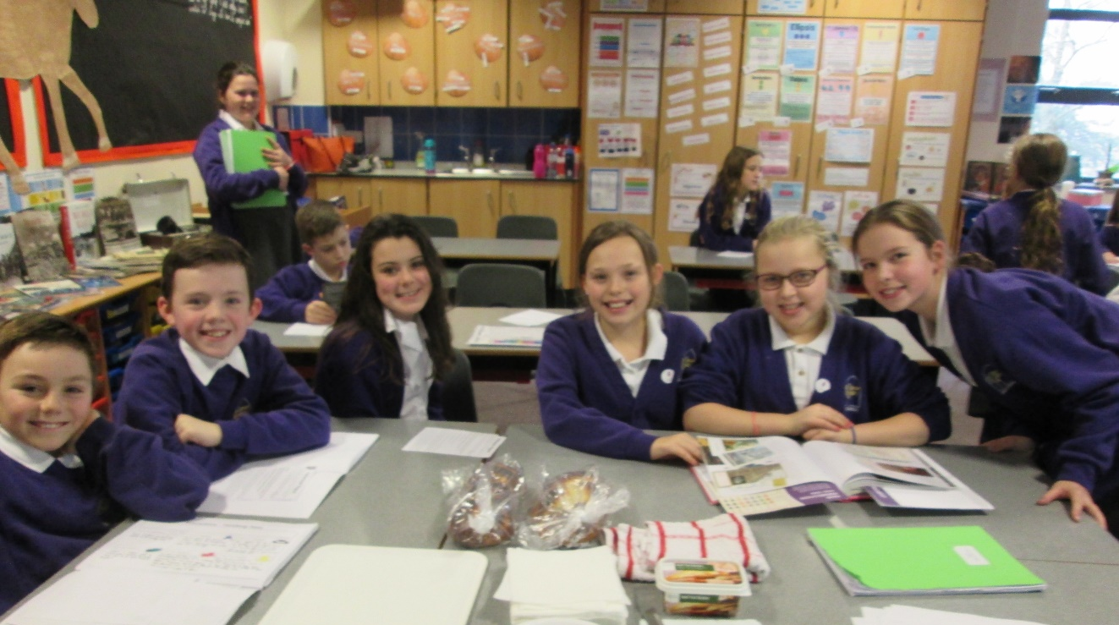
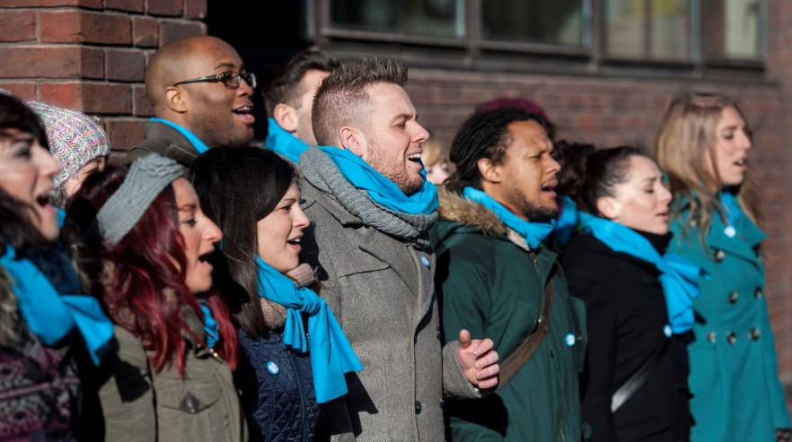
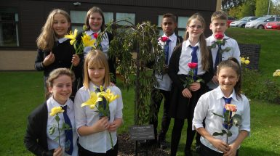
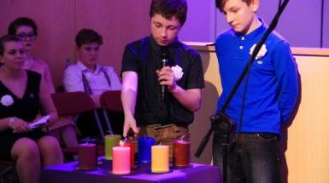
Holocaust Memorial Day is on
27 January each year

Slide 4
Can you define these words/phrases?
Darfur in Sudan

Slide 5
Genocide
Darfur in Sudan
The full legal definition of genocide is:
Any of the following acts committed with intent to destroy, in whole or in part,
a national, ethnical, racial or religious group, as such:
killing members of the group
causing serious bodily or mental harm to members of the group
deliberately inflicting on the group conditions of life calculated to bring about
its physical destruction in whole or in part
imposing measures intended to prevent births within the group
forcibly transferring children of the group to another group

Slide 6
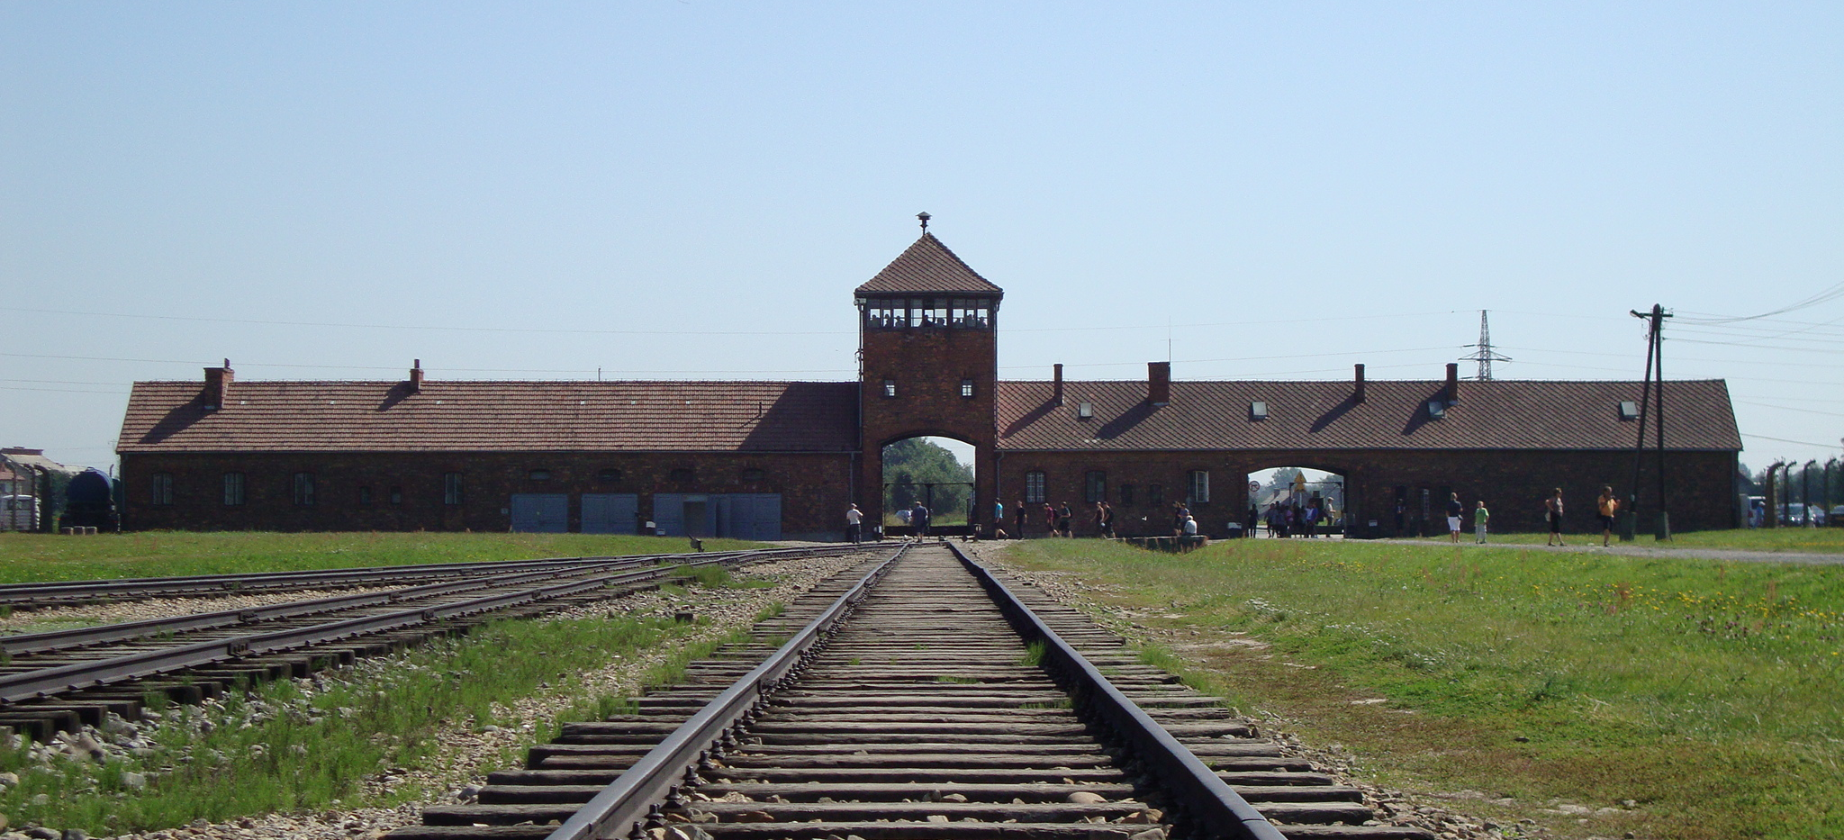
What is Auschwitz?
Darfur in Sudan
Auschwitz-Birkenau – Nazi death camp
27 January 1945 – Auschwitz-Birkenau was liberated.

Slide 7
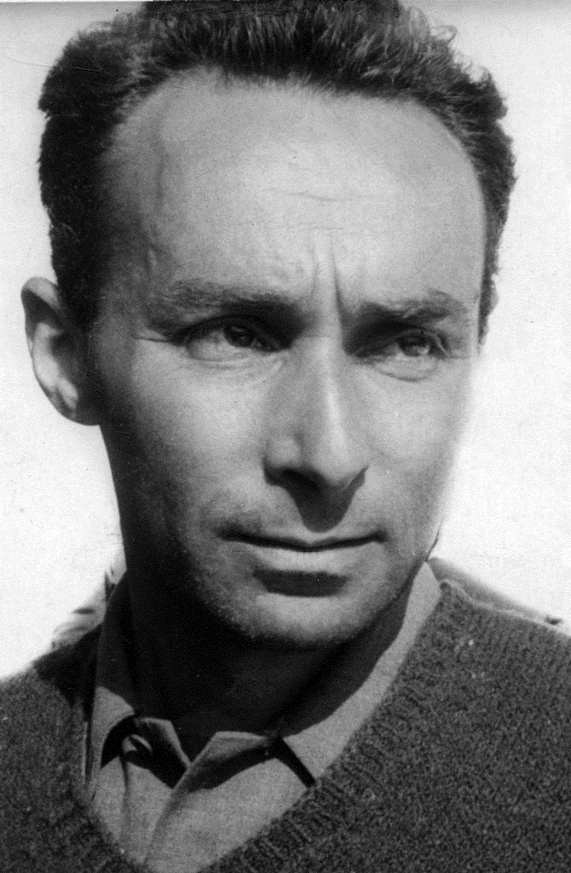
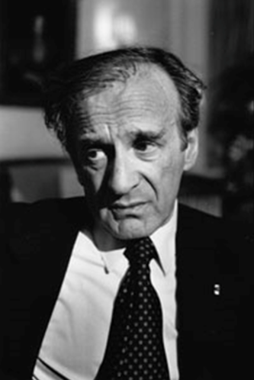
Quotes
Darfur in Sudan
Primo Levi
Elie Wiesel

Slide 8
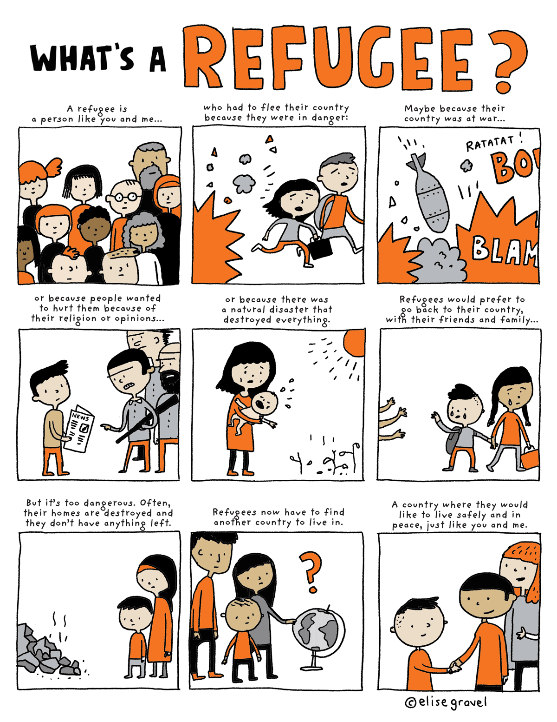
What is a refugee like?
Darfur in Sudan
The result of genocide is often refugees.
By 1939, Britain was home to over 60,000 Jewish refugees, 50,000 of whom settled permanently. They were joined after 1945 by a smaller group of Jews who had survived the Holocaust in Europe.
These refugees sought asylum from racial, religious and political persecution.

Slide 9
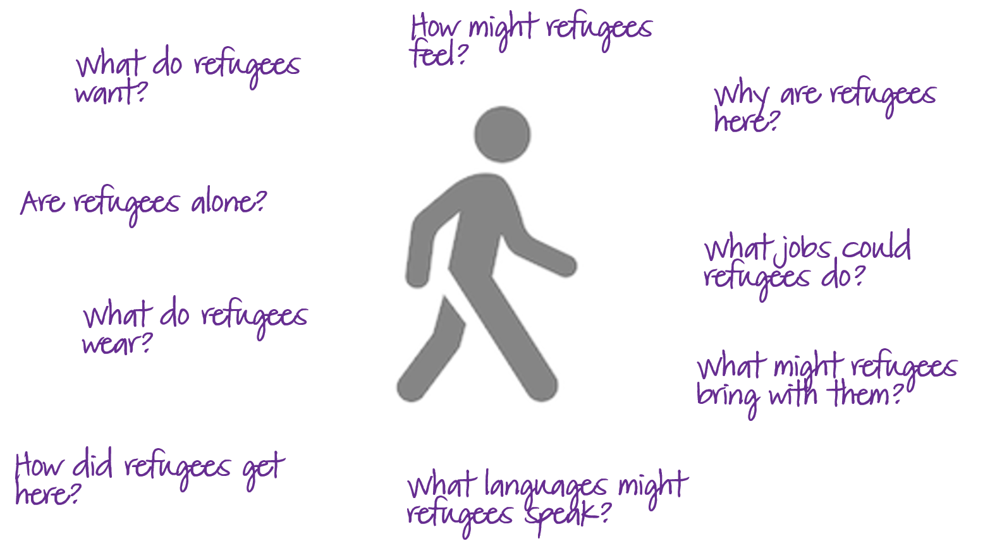
What is a refugee like?
Darfur in Sudan

Slide 10
Genocide
Darfur in Sudan
We now know what Genocide is.
YOUR TASK:
Split in to 4 groups, you will each be given a case study of genocide that has occurred
in the recent past. Your task is to create a presentation poster to present to the rest of
the class, answering the following questions:
What happened in the case that you have studied?
What were the effects on the victims?
Why is it important to learn from such cases, what have we learnt?
How can we reach justice for the victims? Has justice already been served?
Are there still challenges that are faced today in the relevant countries?

Slide 11
Genocide
Darfur in Sudan
HMD-Tutor-Times-Secondary.pptx - What happened in Cambodia?
HMD-Tutor-Times-Secondary.pptx - The Genocide in Rwanda
HMD-Tutor-Times-Secondary.pptx - The Genocide in Bosnia
HMD-Tutor-Times-Secondary.pptx - The Genocide in Dafur

Slide 12
Tutor Time activity
What happened in Cambodia?

Slide 13
Sokphal Din
Darfur in Sudan

Slide 14
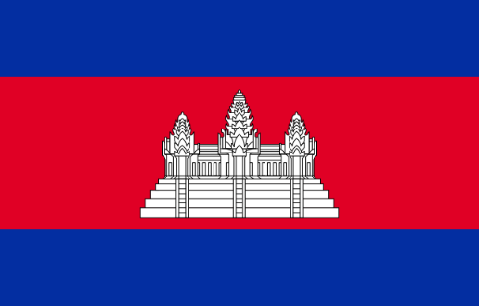
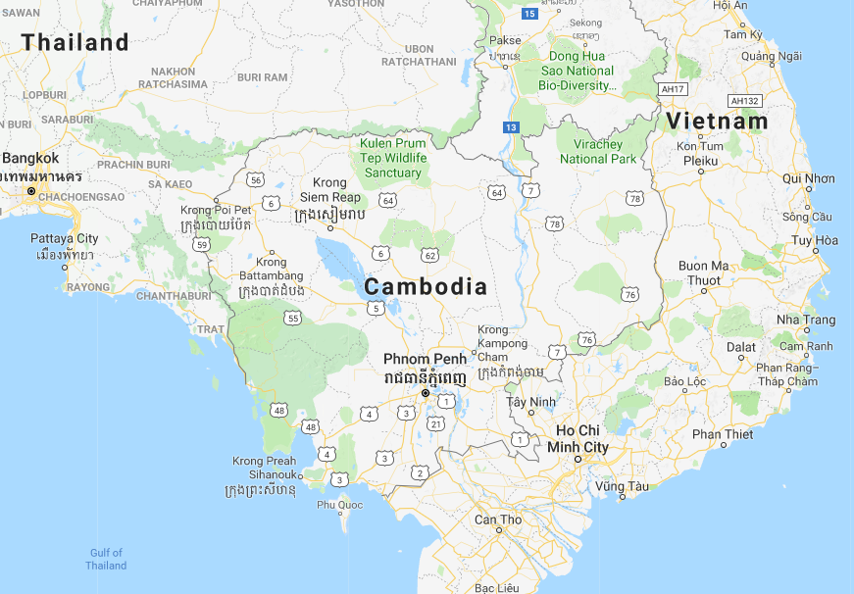
Sokphal’s story
Darfur in Sudan
Cambodia is a country in Southeast
Asia.
There was a genocide there from
1975-79.
The extremist Communist group
the Khmer Rouge forced Cambodians
into slave labour on large collective
farms, working and starving them to
death, and murdering millions of people.
Sokphal and his family were
forced to leave their home
without warning when he
was 17 years old.

Slide 15
Tutor Time activity
The Genocide in Rwanda

Slide 16
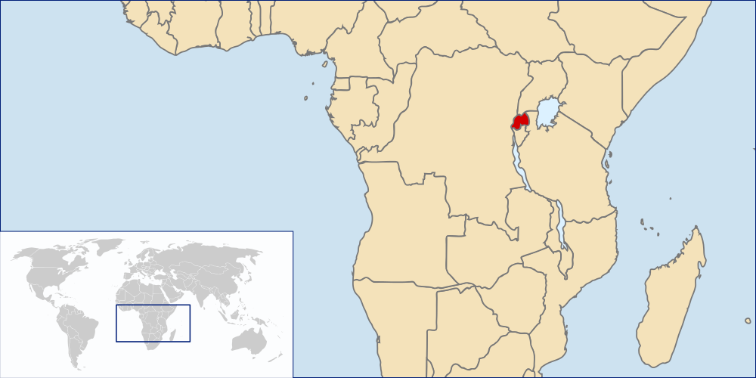
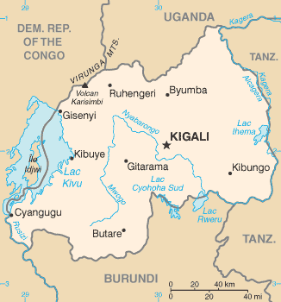
Rwanda
Darfur in Sudan
This flag was adopted in 2001.
The blue band represents happiness and peace.
The yellow band symbolizes economic development.
The green band symbolizes the hope of prosperity.
The sun represents enlightenment.
Rwanda is a small landlocked country in East-central Africa.
It is home to approximately 12 million people.
Historically there were two main social groups:
Tutsi (15%) and Hutu (84%). The difference between the
groups was social, and based on wealth and who
held power.
Rwanda was colonised by Germany in 1895,
then Belgium from 1916 - 1962. These colonial influences
widened the divide between Tutsis and Hutus.

Slide 17
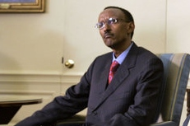
Genocide in Rwanda
Darfur in Sudan
Rebel group the Rwandan Patriotic Front (RPF) invaded Rwanda. The group is mainly Tutsis who had been living in exile in Uganda since 1959. Their invasion sparked a civil war between the Hutu government and the RPF.
1990
The government and RPF sign the Arusha Accords and agree to share power in Rwanda. There will now be peace, but extremist Hutus are not happy with the deal.
1993
6 April: The President’s plane is shot down, killing him. It is unclear who is responsible. Extremist Hutus blame the Tutsis. Radio broadcasts tell Hutu civilians that they must kill all the Tutsis in Rwanda.
1994
Despite the seemingly sudden nature of the genocide,
the government had been arming and training militia groups,
who immediately began attacking Tutsis.
On 17 July 1994 the RPF reached the capital city of Kigali and gained control of the country, ending the genocide.
The RPF leader
Paul Kagame is now the
President of
Rwanda.
Hutus who refused to take part in the killings, or tried to hide,
help or rescue Tutsis were also killed.
The genocide lasted 100 days and 1 million people were murdered.

Slide 18
Darfur in Sudan
What would you ask or say to Appolinaire?
These photographs are images of people murdered during the genocide.
They are displayed at the memorial in Rwanda.
They show only a small number of the total people killed.

Slide 19
Darfur in Sudan
Rwanda today
In 2004 the Kigali Genocide Centre opened, as a memorial to those who were murdered and a museum to promote
reconciliation and
awareness of genocide.
There are still challenges in Rwanda after the genocide:
Many children were left orphaned
Lots of the women have HIV/ AIDS from sexual violence
Survivors live with injuries, disfigurement and trauma
Rwandan
Rwandans have worked hard to rebuild a peaceful society following
the genocide, and feel a great sense of pride in the economic
development that the country has experienced.
The terms ‘Hutu’ and ‘Tutsi’ have been
banned, and people are encouraged to
consider themselves as ‘Rwandans’.

Slide 20
Tutor Time activity
The Genocide in Bosnia

Slide 21
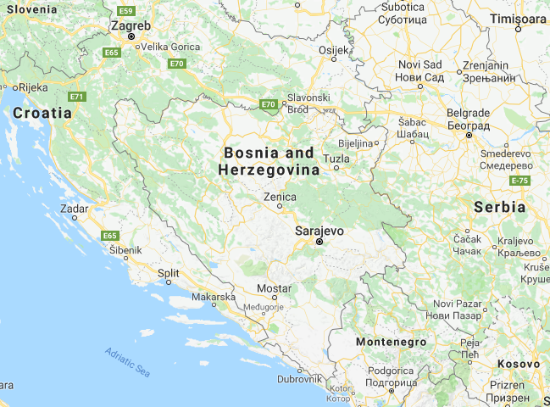
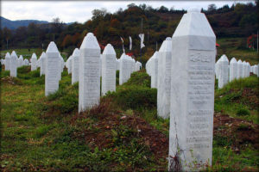
What happened in Bosnia?
Darfur in Sudan
Bosnian flag
Srebrenica Memorial
© Kathleen Franklin
Bosnia and Herzegovina is a country in south-east Europe.
In 1992 there was a civil war. Bosnian Serb forces targeted and killed Muslim civilians.
In July 1995, Bosnian Serb troops entered the ‘safe zone’ of Srebrenica.
Around 8,000 Muslim men, and boys over 12 years old, were murdered.
It was the worst massacre in Europe since World War Two.

Slide 22
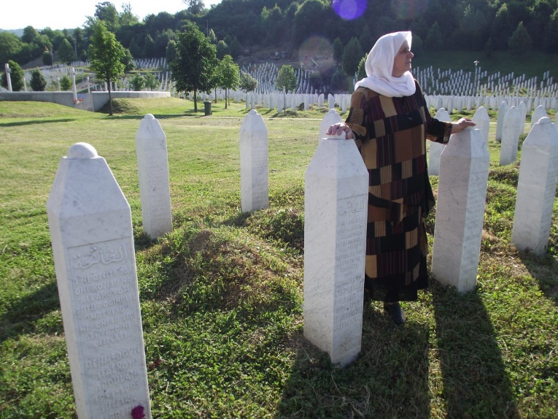
The Mothers of Srebrenica
Darfur in Sudan
Photograph courtesy of Remembering Srebrenica

Slide 23
The Mothers of Srebrenica
Darfur in Sudan
Bring a civil lawsuit against the
UN for failing to protect people.
Bring a civil lawsuit against the
Dutch government for their troops
failing to protect people.
Identify the bodies and
give them proper burials.
Establish a memorial to
the people murdered in
Srebrenica.
Photograph courtesy of Remembering Srebrenica

Slide 24
The Mothers of Srebrenica
Darfur in Sudan
Bring a civil lawsuit against the
UN for failing to protect people.
Bring a civil lawsuit against the
Dutch government for their troops
failing to protect people.
The UN was ruled to be
‘immune’ to prosecution.
The Dutch government was found to
be responsible for the deaths of
300 people.
Identify the bodies and
give them proper burials.
Establish a memorial to
the people murdered in
Srebrenica.
Thousands of victims have been identified
and received a proper burial, but there are many more who may never be identified.
A permanent memorial and
cemetery have now been built.
Photograph courtesy of Remembering Srebrenica

Slide 25
Tutor Time activity
The Genocide in Darfur – What does ‘refugee’ mean?

Slide 26
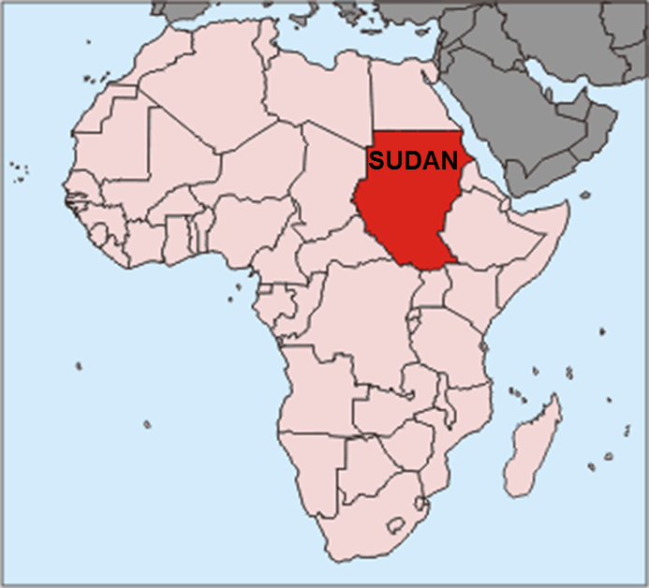
Faiza’s story
Darfur in Sudan
Sudan is a country in east
Africa.
There has been a genocide happening
there since 2003.
The Sudanese government trained and
armed Arab militia groups called the
Janjaweed (devils on horseback) to burn
whole villages, attacking and killing
black African farmers in Darfur – a region
to the west of Sudan.
This government has been charged with
the crime of genocide, but is still in power
today.
Faiza’s name has
been changed to
protect her identity.
She is still unable to
return to Sudan because
of the danger she is in.

