Slide 2
Drugs Fact File
Specific information in Specific Drugs, the law and the effects

Slide 3
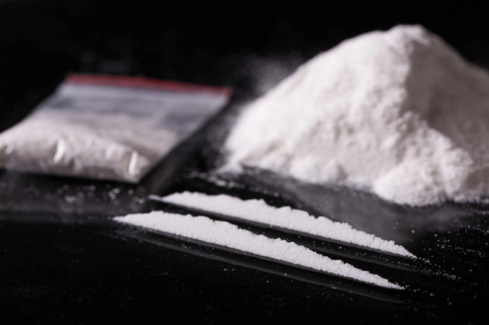
Cocaine
Names: Cocaine is known as coke, charlie, snow, C, dust, golddust, bugle and Crack. Appearance: Normally a white powder that can be snorted up the nose. Some users inject it. Law: Cocaine is a class A drug and can lead to a 7 year sentence for possession and up to life imprisonment for supplying. Paraphernalia (Things a user needs): Some of the things you may find a cocaine user with are needles (if someone is injecting), silver foil, straws, mirror, tourniquet, spoons and white powder residue.
Notes:
Slides 8-19 are Drugs Fact Files of the most common illegal drugs our students may have heard of- please read through with your class

Slide 4
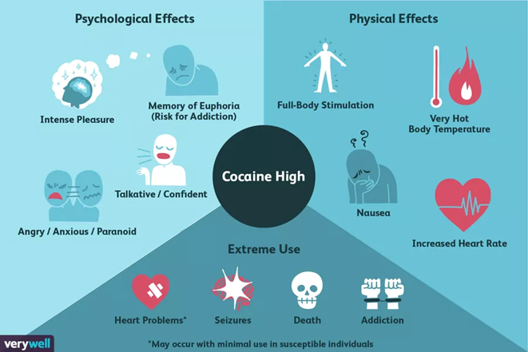
Cocaine effects
Short term effects: Cocaine is a stimulant and users feel a sense of wellbeing, confidence and alertness. Rise in body temperature coupled with dilated pupils and blood pressure rise also occur. The effects last roughly 30 minutes and users are left craving more. The comedown can last for days and lead to tiredness and depression. Long term effects: Long term users can become dependent and feel withdrawal symptoms when not using. It can lead to heart problems and chest pains and often convulsions. Snorting cocaine can lead to the septum in the nose becoming damaged as well as causing nasal ulcers and nosebleeds. Long term use can lead to serious mental health problems especially schizophrenia. Overdoses can be fatal. If a user injects cocaine then they are more at risk from catching blood born diseases such as hepatitis and aids.
Notes:
Slides 8-19 are Drugs Fact Files of the most common illegal drugs our students may have heard of- please read through with your class

Slide 5
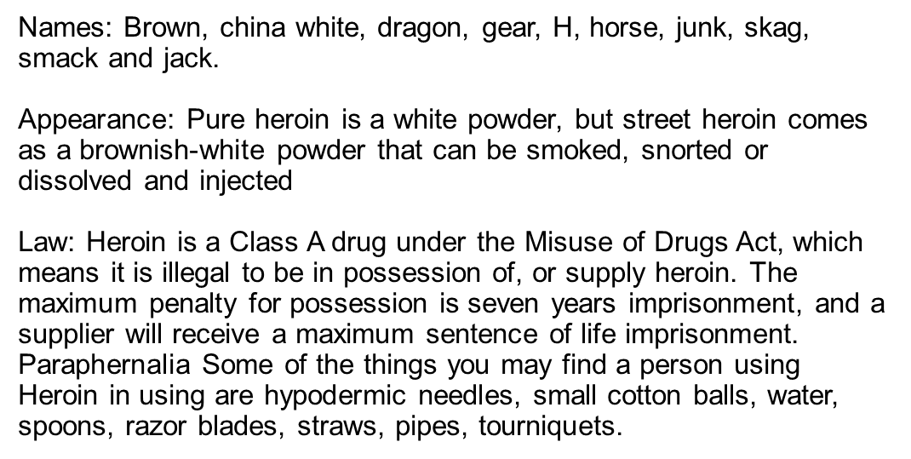
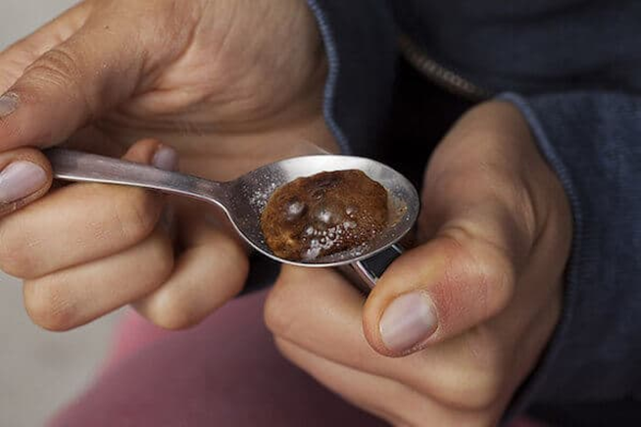
Heroin
Heroin (like opium and morphine) is made from the resin of poppy plants. Milky, sap-like opium is first removed from the pod of the poppy flower. This opium is refined to make morphine, then further refined into different forms of heroin.
Notes:
Slides 8-19 are Drugs Fact Files of the most common illegal drugs our students may have heard of- please read through with your class

Slide 6
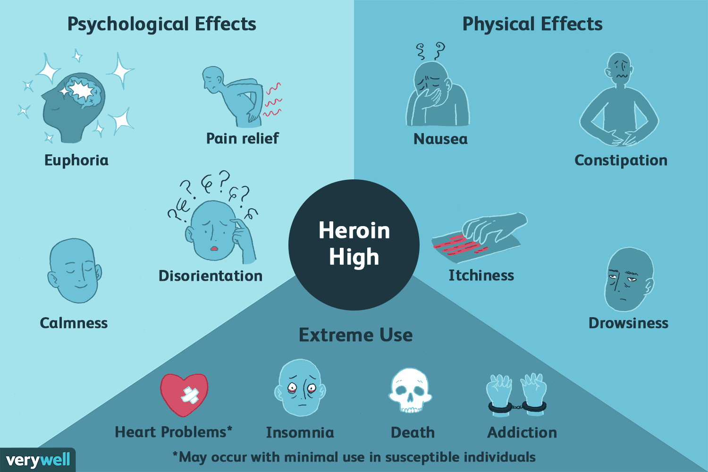
Heroin effects
Short term effect: Heroin is a painkilling drug and in small doses can give the user a sense of warmth and wellbeing. A high dose of the drug can make someone drowsy and relaxed. However when the dose is very high this can cause the user to enter a coma and even be fatal. Sometimes users report becoming dizzy and vomiting – but this normally only lasts for the first few times that a person takes the drug. Long term effects: Heroin is an extremely additive drug – some users report being hooked after only the first dose. After the last dose of heroin users report suffering from aches, hot and cold sweats, sneezing and spasms which peak after about three days. Because Heroin is an addictive drug users find themselves building up a tolerance for the drug and report having to use higher and higher doses just to feel normal. Those who start by snorting or smoking heroin often switch to injecting in order to maximize their high and injecting is dangerous. It can lead to damaged veins, gangrene, higher risk of HIV, hepatitis etc. Because heroin is so addictive users find that the heroin rules their lives and that they end up stealing and committing other crimes just to get the money for their next fix.
Notes:
Slides 8-19 are Drugs Fact Files of the most common illegal drugs our students may have heard of- please read through with your class

Slide 7
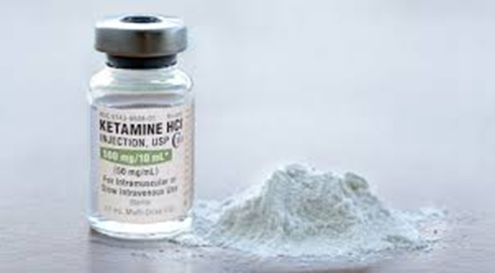
Names: Special K, Vitamin K, K, Green, Super K Appearance: Sometimes Ketamine comes in the form of a white powder which can be snorted up the nose. Ketamine also can come in the form of tablets and injectable clear liquid. Law: Ketamine is a class C drug and it is illegal to possess and supply it. You can get up to two years in prison or an unlimited fine or both for possessing ketamine and up to 14 years in prison or an unlimited fine or both for supplying it. Paraphernalia: Some of the things you may find is white powder, cut off straws, glass vials and needles if a user is injecting
Ketamine
Notes:
Slides 8-19 are Drugs Fact Files of the most common illegal drugs our students may have heard of- please read through with your class

Slide 8
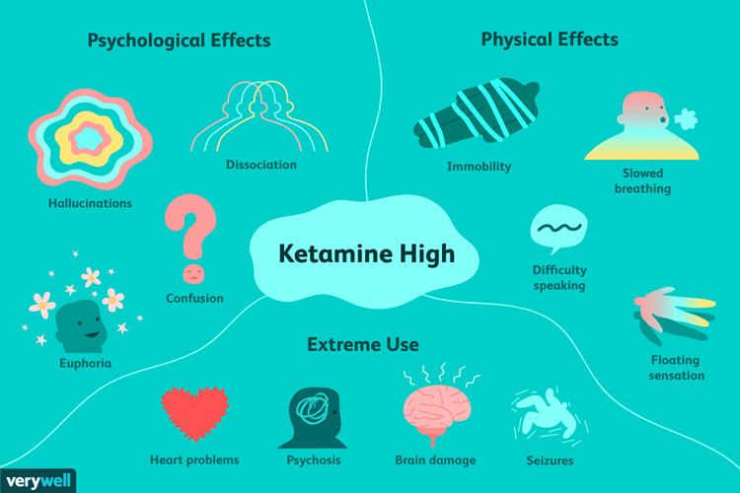
Short term effects: It can create an out of body type experience for up to 3 hours. It can cause hallucinations and strong painkilling effects. During the time the drug is active some users are unable to move and virtually paralyzed. Long Term Effects: Because it numbs pain users can are at risk from serious injury as they don’t feel the pain they are causing themselves. Excessive doses carry the risk of breathing difficulties is and heart failure. Although the long term effects of using this drug are not known it can be very dangerous when mixed with other drugs or alcohol.
Ketamine effects
Notes:
Slides 8-19 are Drugs Fact Files of the most common illegal drugs our students may have heard of- please read through with your class

Slide 9
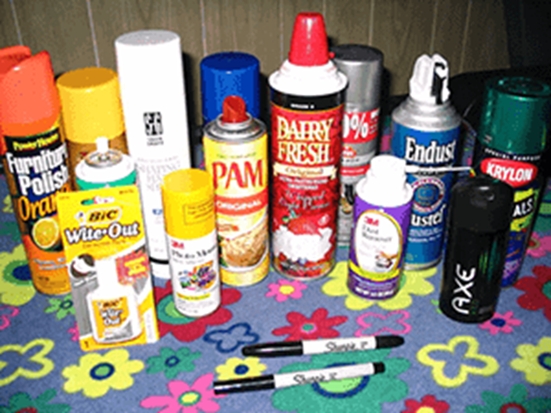
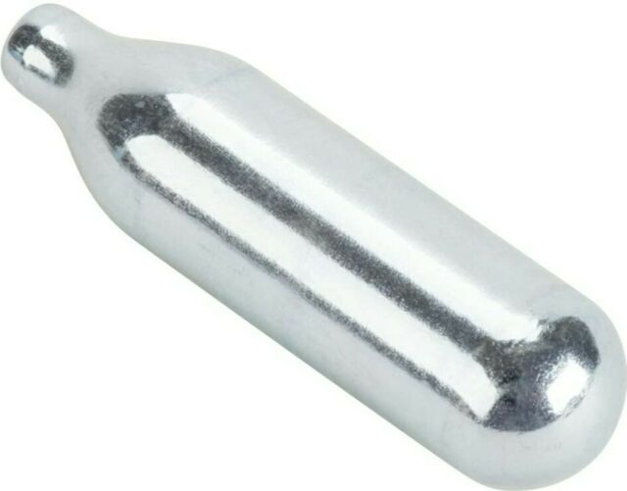
Names: The inhalants that are normally abused are : • Lighter Gas and fuel canisters • Aerosols • Tins/tubes of glue • Paint thinners/correcting fluids Appearance: Normally cans or tins or silver canisters (nitrous Oxide) Law: Solvents are used around the home every day so it is not illegal to possess them. However, the Intoxicating Substances (Supply) Act 1985 makes it illegal for a retailer to sell a volatile substance to anyone under the age of 18 if they believe it will be used for inhaling to cause intoxication. It is also illegal for a retailer to supply gas lighter refills to anyone under the age of 18, and breaking this law could lead to six months in prison or a maximum £5,000 fine. Paraphernalia: Some of the things that may indicate inhalant abuse are aerosol canisters, glue or other things containing noxious chemicals, rags, cotton wool balls, paper bags etc.
Inhalants
Notes:
Slides 8-19 are Drugs Fact Files of the most common illegal drugs our students may have heard of- please read through with your class

Slide 10
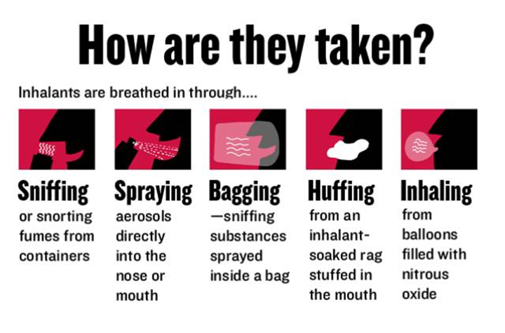
Short term effects: Most inhalants take effect almost immediately and take between 15-45 minutes to wear off. Most users report feeling an initial sense of euphoria and a lowering of their inhibitions. This is then often followed by a feeling of being drunk – disorientation, blurred vision, dizziness, slurred speech, drowsiness, hallucinations. Some users report frequent nausea, blackouts and sickness. The effects of inhalant use take a day or two to wear off and this may feel like a hangover to the user. Long term effects: Risks include fatal heart problems, nausea, vomiting, severe headaches and blackouts. The most obvious visual signs are the spots or rash, which the user develops around the mouth and nose. The long-term effects of solvent abuse might include brain damage, and kidney or liver failure as squirting stuff down the throat can cause the lungs to be flooded by fluids.. Many users also place plastic bags over their heads to get the full effect from the solvents, and this can lead to accidental suffocation, while other users face the risk of choking on their own vomit if they blackout. Tolerance to solvents does develop in regular users, which can develop into heavier use, but although physical dependence has not been reported, there have been some cases of withdrawal symptoms.
Inhalants effects
Notes:
Slides 8-19 are Drugs Fact Files of the most common illegal drugs our students may have heard of- please read through with your class

Slide 11
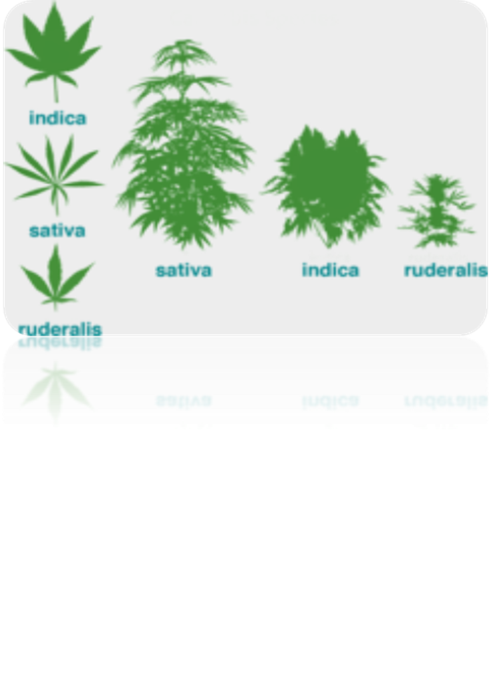
Cannabis
Names: bhang, black, blast, blow, blunts, bob hope, bush, dope, draw, ganga, grass, hash, hashish, hemp, herb, marijuana, mary jane, pot, puff, northern lights, resin, sensi, sensemilla, shit, skunk, smoke, spliff, wacky backy, weed and zero. Appearance: Cannabis can come in a solid, dark lump known as resin or as leaves, stalks and seeds called grass – sometimes it comes as a sticky oil. The Law: It is illegal to grow, possess or supply cannabis to another person. It is also an offence of allow your house (or any other premises you have responsibility for) to be used for growing cannabis or smoking it. The maximum penalty for supply, dealing and production (including cultivation) and trafficking remains at 14 years imprisonment. The maximum penalty for possession has been reduced from 5 years to 2 years imprisonment Paraphernalia: If someone you know is taking cannabis you may find cigarette papers, lighters, bongs, pipes, grinders and leaves (like tealeaves)
Notes:
Slides 8-19 are Drugs Fact Files of the most common illegal drugs our students may have heard of- please read through with your class

Slide 12
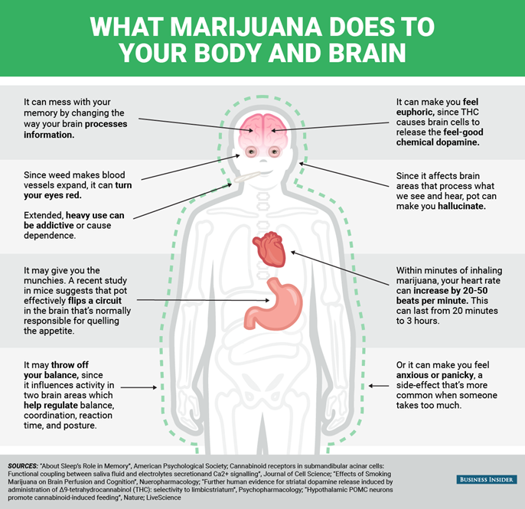
Short term effects: Getting ‘stoned’ on cannabis makes most people talkative and relaxed. Sometimes people become more sociable and have fits of hilarity where they find everything funny. It also heightens the senses especially when it comes to music, colour and taste. Hash in particular may bring on cravings for other foods, which is called ‘the munchies’. However cannabis can bring about several physical effects which are generally mild – these consist of increased pulse rate, decreased blood pressure, bloodshot eyes and a dry mouth. Long term effects: Use of cannabis is known to affect a persons short term memory and impair their ability to concentrate. It also affects coordination and can make accidents much more likely to happen. Some stronger forms of cannabis can make users paranoid and anxious and if the cannabis is very strong then users may have a hallucinogenic reaction. If cannabis is taken with tobacco then users often get addicted to the tobacco and smoking cannabis can lead to respiratory disorders and sometimes lung cancer. Many users find that cannabis is a hard habit to kick.
Cannabis effects
Notes:
Slides 8-19 are Drugs Fact Files of the most common illegal drugs our students may have heard of- please read through with your class

Slide 13
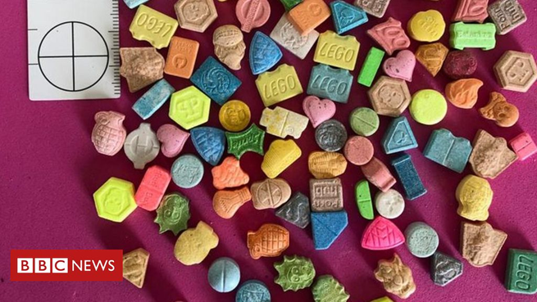
MDMA (Ecstasy)
Names: E, Molly, MDMA, XTC, disco biscuits, burgers, fantasy, hug drug, echoes, chiefs, Mitsubishis, dolphins, Rolexes, Adam and X. Appearance: Ecstasy comes in tablet form – the tablets come in many different colors and often have different pictures imprinted into the tablets. Law: Ecstasy is a Class A drug under the Misuse of Drugs Act 1971, which means that doctors cannot prescribe it, and it is illegal to be in possession of, or supply it. Maximum penalties for possession are seven years imprisonment plus a fine, and the penalty for supplying, or possession with intent to supply, is a maximum sentence of life imprisonment.
Paraphernalia Users of ecstasy will have no other items to indicate their drug use except the tablets.
Notes:
Slides 8-19 are Drugs Fact Files of the most common illegal drugs our students may have heard of- please read through with your class

Slide 14
MDMA effects
Short term effects: Users often feel alert and switched on to the environment around them, they report intense emotions, sounds, colors and music. The buzz that most ecstasy users feel and the fact that they often take it in clubs mean that they feel like they can dance for hours – and often do. A normal dose of ecstasy starts to work after approximately 20 minutes and can last for up to six hours. When users are ‘coming up’ (when the drug starts to take effect) they frequently feel a tightening of the jaw, nausea, sweating and an increase in heart rate. Long term effects After an ecstasy comedown users often feel tired, demotivated and depressed – for up to a week after they have taken the drug. Ecstasy has also been linked to liver and kidney problems in users. Ecstasy affects how the body regulates temperature, and as a result there is a serious risk of dehydration and overheating if the user doesn't consume/ drink enough liquid to replace the fluid they're losing. It also increases blood pressure, placing added strain on the heart. Continual or repeated doses can make the sensations more acute, and some users experience flashbacks, leading to panic and anxiety. Co-ordination can also be affected, and some experts are concerned that use of ecstasy can lead to brain damage According to government statistics, about 20 people a year die from taking ecstasy, usually as a result of hypothermia and dehydration. However, there is also evidence that hyponatraemia (the dilution of the body fluids) can occur when users drink an excess of water thinking mistakenly that this will counter the unwanted effects of the drugs
Notes:
Slides 8-19 are Drugs Fact Files of the most common illegal drugs our students may have heard of- please read through with your class

Slide 15
Free and confidential services are available to you in your local area if you would like support will the topics discussed today please contact the below or speak to your Tutor or College Mentors:
Sort IT!
Compass Enfield Young People’s Service 29 Folkestone Road Edmonton, London N18 2ER
Tel: 0208 360 9102 www.compass-uk.org.uk
https://www.changegrowlive.org/
https://www.ealingrise.org.uk/
Call the free Smokefree National Helpline on 0300 123 1044 or visit: https://www.nhs.uk/live-well/quit-smoking/

Slide 16
Visit capel.ac.uk to browse courses and apply online

