Slide 1
Drugs and Smoking Awareness
Learning objectives:
introduces learners to the types of drug available, their effect on users and the impact of drug misuse on those linked to drug user, the user’s own health and finally, issues associated with withdrawal from drug use, ending with hope and help.

Slide 2
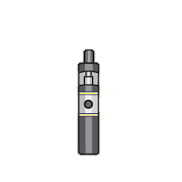
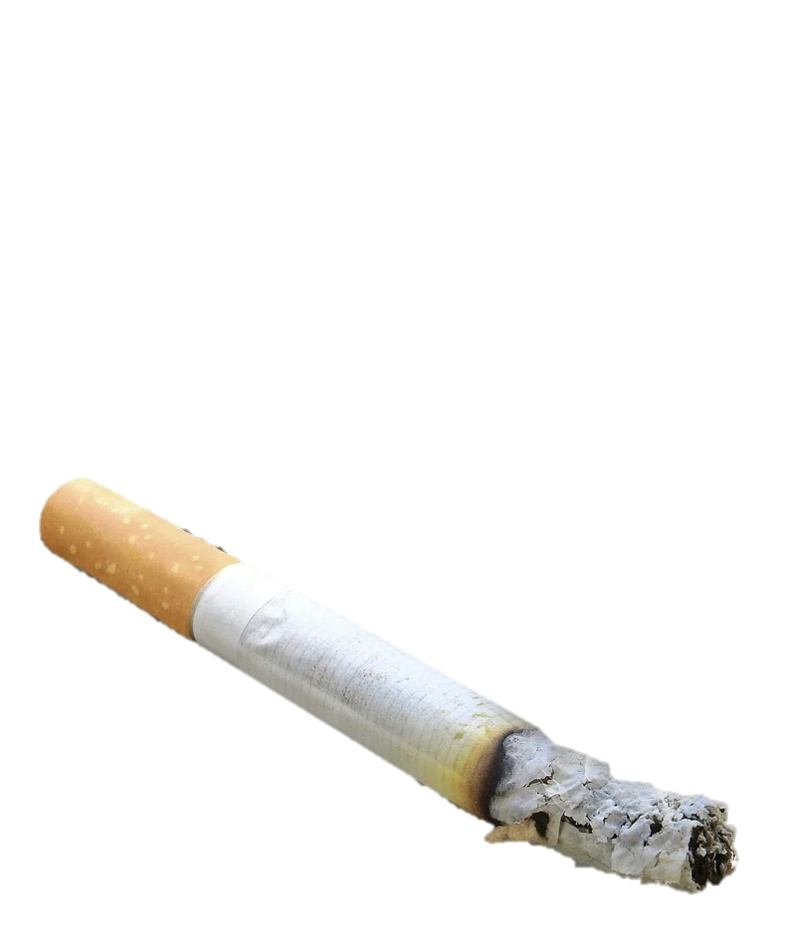
Smoking Vs’ Vaping Vaping and smoking both involve inhaling nicotine and other substances into your lungs. E-cigarettes heat liquid to make an aerosol; cigarettes burn tobacco, which creates smoke.
Smoking
Once you start smoking you can become addicted very quickly, it’s a costly habit that can also cost your health.
Tobacco is one of the only product sold legally that will kill half of all the people who use it – even though they’re using it just as the manufacturer recommends.
People who smoke long term have a 50% chance of dying from a smoking-related disease.
For every person that dies from smoking, there are 20 other smokers who suffer from a smoking-related illness.
Smoking can reduce the chances of having a baby later in life. For boys, this means having fewer sperm and problems having sex. For girls, it can mean trouble with becoming pregnant and dangers to the baby.
Over 80% of people in the UK don’t smoke
Is vaping worse than cigarettes?
Vaping is often thought of as safer than cigarette smoking, but vaping causes health problems, too.
Both vaping and smoking are addictive and bring dangerous chemicals into your body. The levels of many of these chemicals is higher when you burn tobacco, however still just as harmful in a vape.
People usually think vaping isn’t as bad as cigarette smoking, but the mist you breathe in still has nicotine and other harmful chemicals in it. Vaping isn’t safe and can cause health problems, including life-threatening lung injuries.
Vaping hasn’t been around long enough for researchers to know the full effects and damage it can do to your body,

Slide 3
Benefits to Not Smoking Watch the clip – Tips from an ex smoker. Then as a class consider the benefits of giving up.
The withdrawal from nicotine between cigarettes can heighten feelings of stress.
As the stress of withdrawal feels the same as other stresses, it's easy to confuse normal stress with nicotine withdrawal, so it can seem like smoking is reducing other stresses.
But this is not the case. In fact, scientific studies show people's stress levels are lower after they stop smoking.
If you find that you're prone to stress, replacing smoking with a healthier, better way of dealing with stress can give you some real benefits.
People breathe more easily and cough less when they give up smoking because their lung capacity improves by up to 10% within 9 months.
Stopping smoking or vaping gives you more energy
Within 2 to 12 weeks of stopping smoking, your blood circulation improves. This makes all physical activity, including walking and running, much easier.
You'll also give a boost to your immune system, making it easier to fight off colds and flu. The increase in oxygen in the body can also reduce tiredness and the likelihood of headaches.

Slide 4
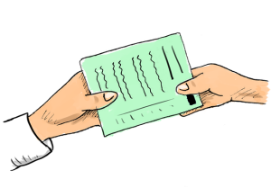
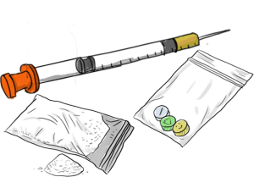
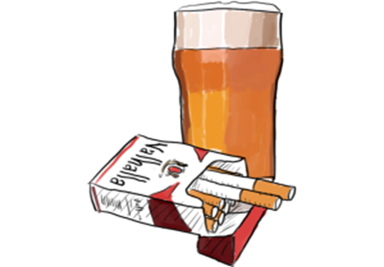
What is a Drug?
As a class discuss what you think the definition of a drug is.
A drug is a substance that has an effect on your body and/or mind.
There are many different types of drugs. As a group quickly think about what types of drugs are aware of? Once you are ready click on the images below:
Prescribed Drugs
Some drugs are legal and helpful, such as drugs given to you by a doctor to make you better during an illness.
Legal Drugs
Some drugs are legal and people choose to use them, such as smoking cigarettes and drinking alcohol. These drugs can be harmful to your health.
Illegal Drugs
Some drugs are illegal and can be very harmful if you take them, especially if you take them regularly or in high doses.

Slide 5
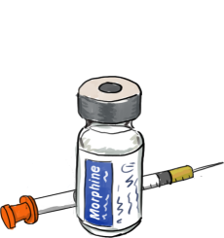
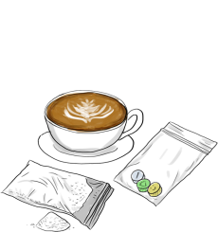
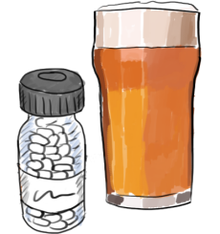
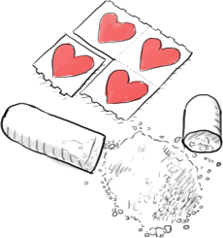
Most drugs come under one of the following groups. Click on the images to find out more.`
STIMULENTS
A stimulant is a type of drug that has an 'alert' effect on the brain.
Examples of stimulants are caffeine (found in coffee) cocaine and ecstasy.
Stimulants make the brain produce more of certain chemicals and less of others.
For a period of time, this can make you feel more alert, lift your mood and make your heart rate increase.
When the effects of a stimulant wear off, you can end up feeling very tired and struggle to concentrate.
DEPRESSANTS
A depressant is a type of drug that has a 'calming' or 'slowing' effect on the brain.
Examples of depressants are tranquilisers such as Valium and Xanax. Alcohol (including wine and beer) is also a depressant.
Depressants make the brain produce less of certain chemicals.
For a period of time, this can make you feel drowsy or calm. It can slow down your speech and body.
After the effects wear off, you can feel down, anxious or have trouble sleeping.
OPIATES
Opiates are drugs that reduce feelings of pain.
Examples of opiates are morphine and heroin.
Low doses of opiates can make you feel sleepy and reduce pain for a period of time. Some doctors can choose to prescribe these opiates as painkillers.
High doses of opiates can be very dangerous - they can slow your breathing and heart rate which can lead to death.
Opiates can be very addictive, which means it can be very hard to stop once you get used to taking them.
HALLUCINOGENS
A hallucinogen is a drug that causes hallucinations. This is where a person might see images, hear sounds and feel things that seem real but do not exist.
LSD is a hallucinogen. Cannabis and Ketamine can both also have hallucinogenic effects.
For some people, these effects can be enjoyable and exciting. For other people, it can be scary and confusing. It is hard to know how a person will react to it.

Slide 6
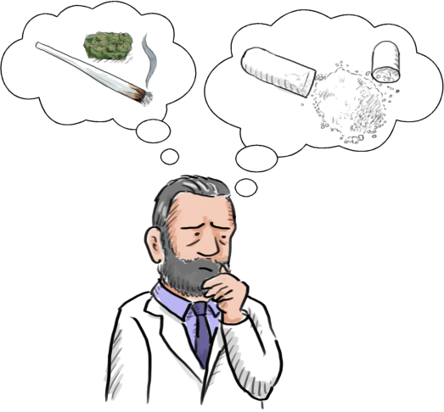
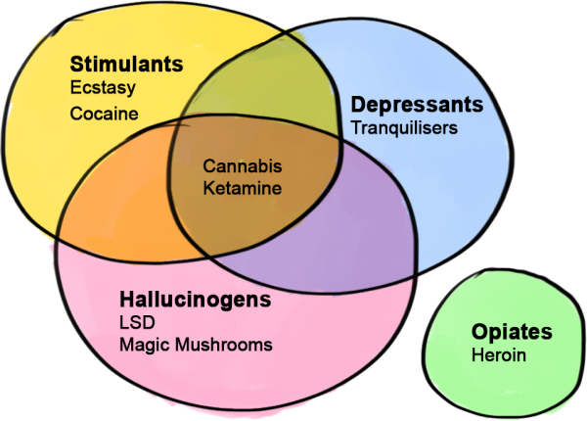
ODD ONES OUT
List of illegal drugs
See the list of illegal drugs under their correct headings.
Cannabis and ketamine are both a bit tricky.
They can have hallucinogenic effects. They can also have depressant or stimulant effects.
So which group do they go in?
Basically, they can fit into any of those three groups: stimulant, hallucinogen or depressant.
It has been suggested, these should become a new group called 'Oddigenics'. But the scientists wouldn't go for it sadly.
Inhalants (Balloons)

Slide 7
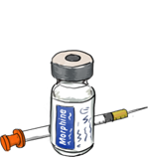
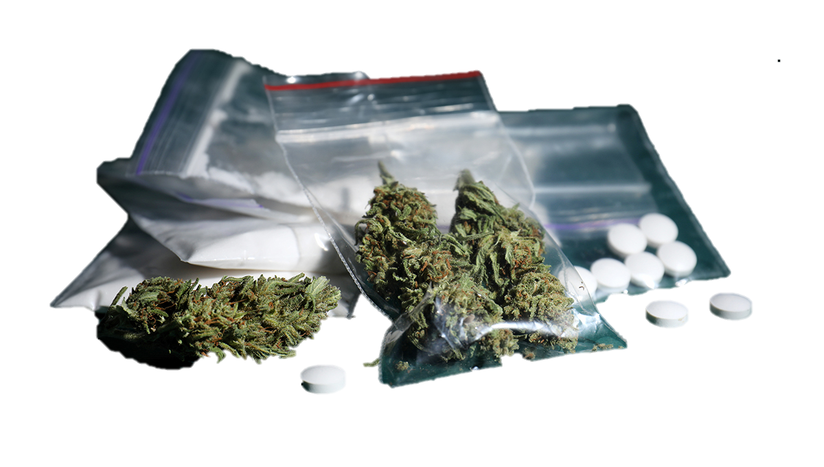
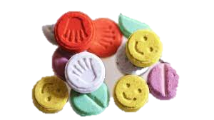
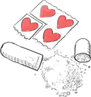
Dispelling the myths
The serious consequences for drug users:
What users are told they will feel:
What users actually feel:
Euphoria (happiness)
Mild and pleasant hallucinations
Heightened awareness
General feelings of wellbeing
More energetic/chilled out/confident
Suicidal
Paranoia
Erratic Mood swings (aggression/depressed)
Extreme and scary hallucinations
Increased and decreased heart rate
Insomnia (trouble sleeping)
Increased body temperature and blood pressure
Schizophrenia (hearing voices)
Depression
Anxiety
Over – confident
Brain damage
Blindness
Stroke or heart failure
Coma
Seizures
Lung Dieses
Catching HIV or Hepatitis
Have a criminal record
Suicide
Overdose
Death

Slide 8
Ad – dic - tion
The continued repetition of behavior despite adverse consequences
Addiction Poem – A message of hope

Slide 9
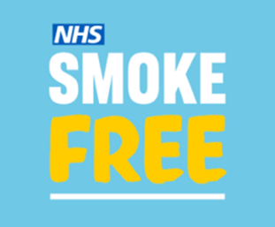
Help is always available: You can talk to your student service team where there are counsellors and mentors available.
Sort IT!
Compass Enfield Young People’s Service 29 Folkestone Road Edmonton, London N18 2ER
Tel: 0208 360 9102 www.compass-uk.org.uk
https://www.ealingrise.org.uk
https://www.changegrowlive.org
https://stepbysteprecovery.co.uk/rehab/drug/london/
Call the free Smoke free National Helpline on 0300 123 1044 or visit: https://www.nhs.uk/live-well/quit-smoking/

