Slide 1
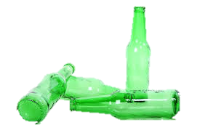
Alcohol awareness
Alcohol awareness – learning objectives
In this lesson, students explore the reasons why some young people choose to drink alcohol and the impact this can have on their health, wellbeing and overall lifestyle.
Using peer-to-peer discussion, scenarios and videos, students will be encouraged to identify and assess the risks associated with underage or irresponsible drinking and how to deal with pressure from peers.

Slide 2
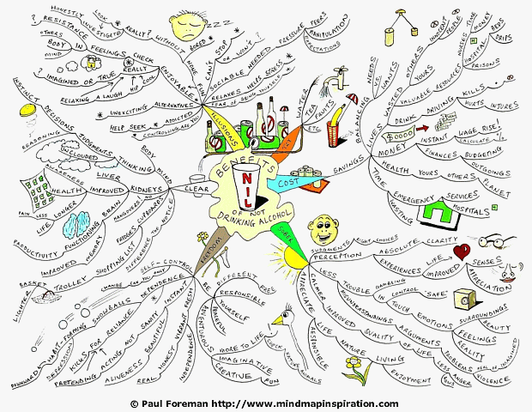
Discuss as a group… Make a mind map of your thoughts & Ideas
• Why do some people choose to drink alcohol?
• What are the possible negative effects of drinking alcohol?
• What are some of the risks associated with drinking regularly?
*As you go through this lesson, add your thoughts and feeling to your mind map.
Notes:
Why do some people drink alcohol? Socializing, relaxing, celebration etc.)
• Minus points (What are the possible negative effects of drinking alcohol? Not being
in control, being sick, doing things that you might not remember, feeling silly the next
day, doing it because of what others say rather than because you want to…etc.)
• Interesting points (What facts do you already know about alcohol? Laws, unit
counts, decline in drinking among young people, etc.)
Discuss students’ responses to the stimulus question – if it hasn’t been mentioned already, highlight that
purchasing alcohol under the age of 18 is illegal. Challenge 25 is a retailing strategy that encourages anyone who is over 18 but looks under 25 to carry acceptable ID if they wish to buy alcohol. Introduced by the Retail of Alcohol Standards Group as Challenge 21 in 2006, Challenge 25 rolled out in the off trade in 2009.

Slide 3
Its up to you – Party edition watch this video, and be aware of how you feel about the characters responses. You are the new kid in the video. Play along and be aware of your feelings.
•Stop the Video at 2:22 (Sugar free cola/Vodka)
How do you feel being put on the spot?
Head down thumps up vote – which option would you choose? (Continue video)
Stop video at 4:57 lobster. (down them/leave them)
How did you feel when your character decided to drink?
Do you think its fair to put your friend under pressure?
• How did you feel in the play back, when your character decided not to drink?
• Why do you think some people pressure other people into drinking?
Is this acceptable behavior from someone who is a friend?
Notes:
Further questions to explore:
Drinking alcohol can lower your inhibitions;
why could this be a problem?
further challenge questions • Drinking alcohol can lower your inhibitions; why could this be a problem? • Why might it have been difficult for your character to resist the temptation to drink?
• What could someone do if they make a decision that has unforeseen dangerous or negative consequences?

Slide 4
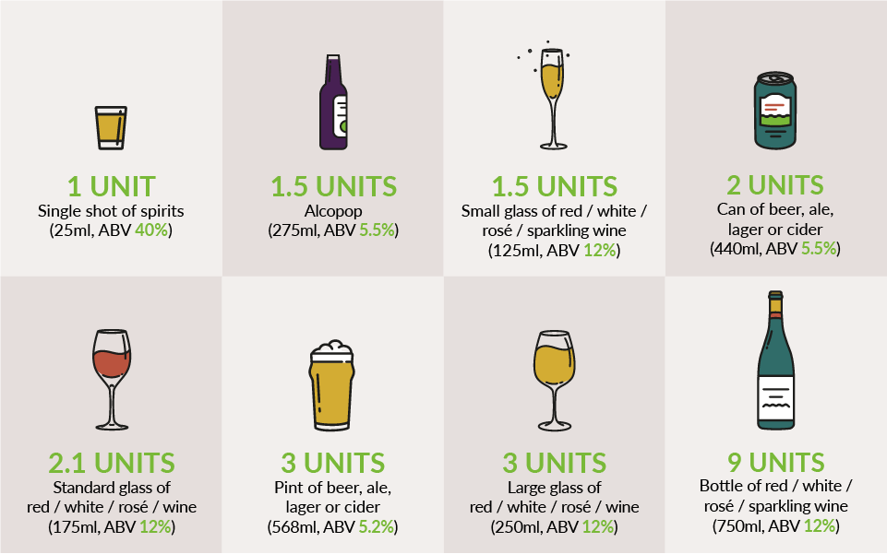
What does drinking do to your body? Watch the clip to the left to find out (2:06)
How many of us really know what a unit of alcohol is?
With so many different drinks and glass sizes, from shots to pints – not to mention bottles – it's easy to get confused about how many units are in your drink. Especially at home – we don’t always stick to a unit and may not be aware we are drinking way more then we realize.
The idea of counting alcohol units was first introduced in the UK in 1987 to help people keep track of their drinking. Units are a simple way of expressing the quantity of pure alcohol in a drink one unit equals 10ml or 8g of pure alcohol.
Research shows that regular drinking or having 1 or 2 heavy drinking episodes per week, increases your risks of death from long term illness and from accidents and injuries. Also increased is the risk of developing a range of health problems, including cancers of the mouth, throat and breast, the more you drink on a regular basis.
If you drink, it is recommended to have at least 3 days per week with no alcohol at all.
In groups discuss:
Do you think that society's attitudes' towards drinking, encourages people to drink more than might be considered healthy, and more than they might realize?
Notes:
In your discussion, think about the phrases people use to normalize drinking culture, ‘’its been a long day, I bet you cant wait for a glass of wine’’ ‘’lets celebrate with a drink’’, ‘’I’ll have a drink with my meal/ whist I’m cooking to unwind.’’
Remember drink can also act as a depressant, so does it really help you to unwind? Is it the drink that makes you unwind, or is it the act of stopping to have a meal or a ‘chill out’ that makes you unwind. Is it necessary to link this to alcohol? Why do you think society does this?
What does drinking do to your body.
https://youtu.be/-oN2emCHMIg

Slide 5
Drinking for other reasons
Before you watch the video discuss:
Have you heard of the phrase functioning alcoholic; what does this actually mean? What do you think it means?
Add any ideas onto your spider graph.
Beat the Assumptions – as a group look at these statements below and see if you think they are true or not.
If you drink and can be okay at work the next day, you don’t have a drink problem
If you drink and don’t get drunk you don’t have a problem
If you only drink for special occasions
You don’t have an alcohol problem if you eat
Now watch the video and see if you feel differently about the statements above.
Think about
Are there any other reasons that people may choose to drink?
What do you think they could do instead?
Notes:
Please highlight that these are not true but things you might often here people say to make their habit okay, and often society will help to excuse the problem making it more difficult to spot.
If you drink and can be okay at work the next day, you don’t have a drink problem – this is a functioning alcoholic, however over time this can have terrible health and mental health issues.
If you drink and don’t get drunk – just because there is a higher tolerance build up it often means that more alcohol needs to be consumed to get the desired ‘buss’ causing major issues in the long run.
If you only drink for special occasions – often this is a good excuse as we can make even having a long day a special occasion and reason to drink,
You don’t have an alcohol problem if you eat – this is simply not true

Slide 6
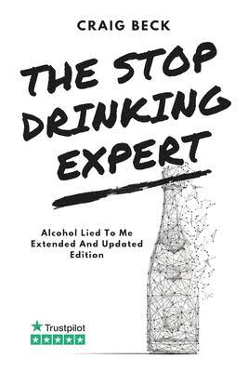
If you are concerned Help is available
Sort IT!
Compass Enfield Young People’s Service 29 Folkestone Road Edmonton, London N18 2ER
Tel: 0208 360 9102 www.compass-uk.org.uk
https://www.changegrowlive.org
https://www.talktofrank.com/drug/alcohol
Craig beck: @Stopdrinkingexpert
You can talk to your student service team where there are counsellors and mentors available.

