Slide 1
Healthy Relationships

Slide 2
What do you consider to be a healthy relationship?
Discussion:
Brainstorm your ideas in small groups or pairs for five minutes and then feedback to the rest of the class.

Slide 3
Activity – Values and Attitudes
Notes:
For a group:
Are there any qualities you wish you find more important than the other? Rank statement in order of importance.
Would the person with your chosen qualities make an ideal friend? Are there any differences in what we want from a partner and a friend.
What can you do if your partner doesn’t have all the qualities you want? Or you don’t have all the qualities that they would like?
Imagine you are over 50 – do you think you would look for the same qualities? What might change over time?
Would men and women bid for the same qualities? What about people who don’t identify as male or female?

Slide 4
Values and Attitudes
Trustworthy | Has nice eyes | Honest | Has a fit body | Wants children
Nice teeth | Respectful | Sexy | Confident | Good hair
Reliable | Good kisser | Romantic | Owns a car | Affectionate
Dresses well | Spontaneous | Tall | Hardworking | Doesn’t drink
Independent | Doesn’t smoke | Can cook | Likes to drink | Shares your values
Doesn’t take drugs | Gets on with your family | Passionate | Ambitious | Expresses their views
Understanding | Communicates well | Has good manners | Positive vibes | Good listener
Open minded | Sense of humour | Likes to dance | Shares religious views | Works out
Likes to travel | Has a beautiful smile | Kind and considerate | Shows intimacy | Looks after their mental health
Self - aware | Generous | Can admit when they are wrong | Intelligent | Ability to empathise
Financially stable | Compassionate | Grows with you | Compromises | Patient
Notes:
What are your values/attitudes when looking for a partner?
Would any of these be the same for a friend/colleague/family member etc?
Print this list out and get students to work on their lists in pairs or small groups

Slide 5
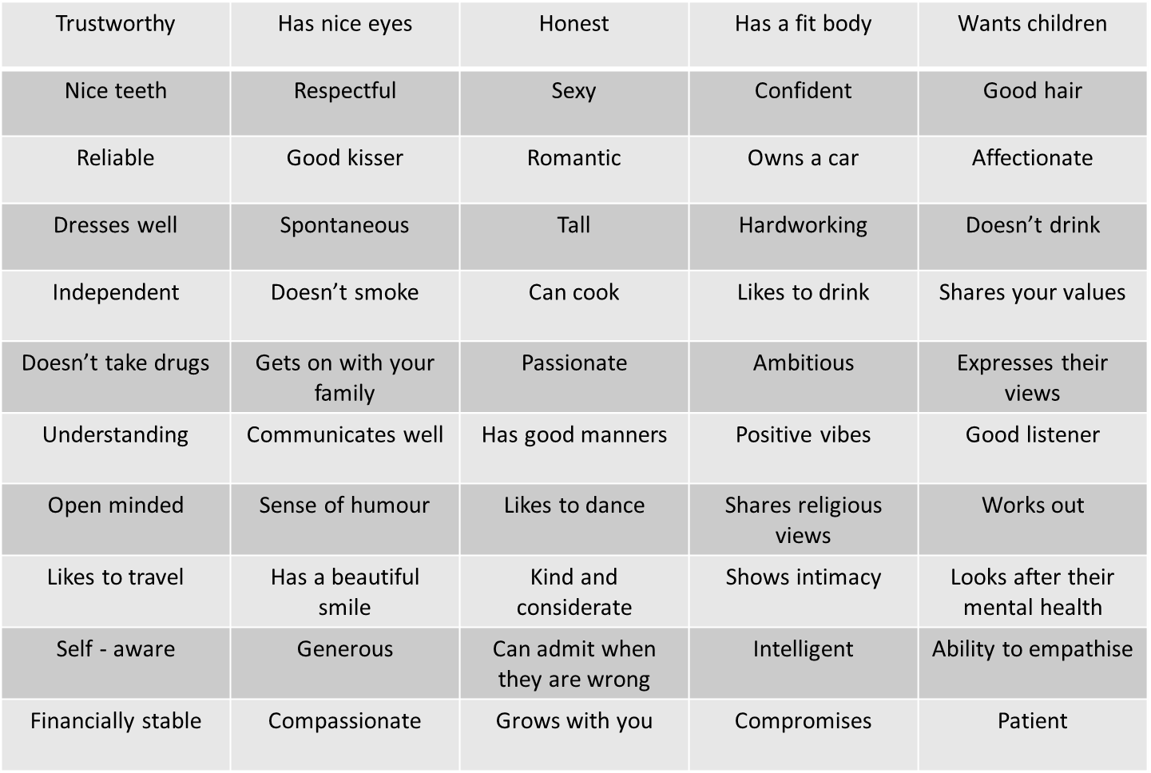
Group work
Working in groups:
Are there any qualities you wish you find more important than the other? Rank statement in order of importance.
Would the person with your chosen qualities make an ideal friend? Are there any differences in what we want from a partner and a friend.
What can you do if your partner doesn’t have all the qualities you want? Or you don’t have all the qualities that they would like?
Imagine you are over 50 – do you think you would look for the same qualities? What might change over time?
Would men and women bid for the same qualities? What about people who don’t identify as male or female?

Slide 6
Relationships
What makes a relationship healthy / undesirable?
Individually or in small groups - make some notes on what makes a relationship healthy and what makes a relationship undesirable
Feedback written on flip chart or feedback verbally as a group
Discuss
Discussion points
What do you notice about the lists? What do you notice about the two lists? Does one list have more points than the other?
Could relationships change over time and move between the lists?
Does a friend or partner have to have all of the elements on the healthy list? What if they don’t?
Do sexual relationships have the same ingredients as a friendship?
Which of the ’healthy relationships’ list do you think you are good at providing?

Slide 7
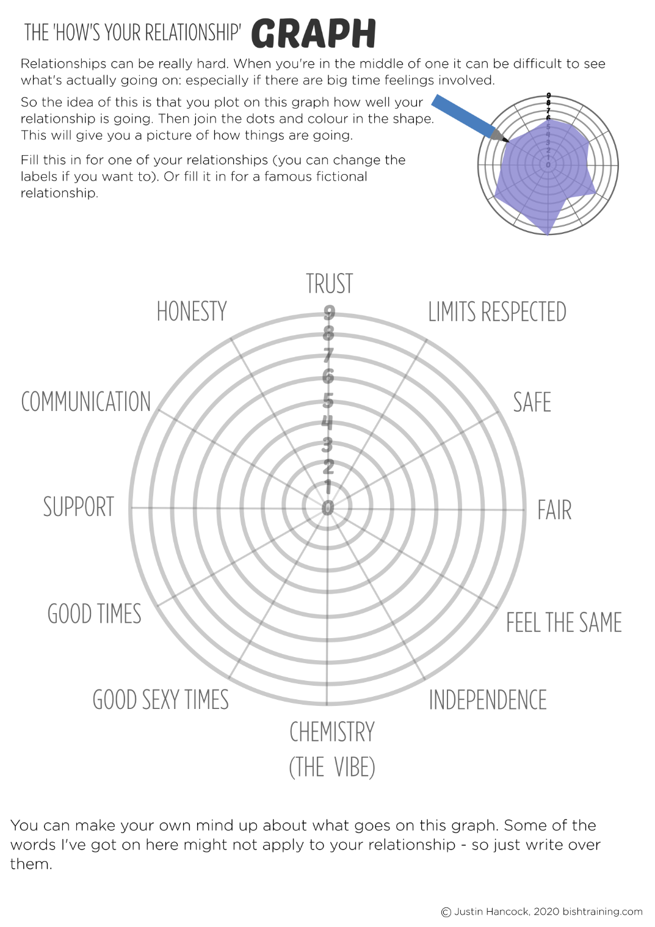
How’s Your Relationship Graph
Individual activity:
Thinking of a relationship or friendship, or a famous fictional relationship. Plot around your copy of the graph for each category
9-Good
1-Unacceptable
https://bishtraining.com/wp-content/uploads/2020/04/22-relationship-graph.png
Notes:
These categories can be changed and are just suggestions. This could be used for a sexual relationship, an asexual relationship or a friendship. Have a think about what is important to you in a relationship. What do you want and why? Read the supporting information on the BISH UK website for each section.
Plot on the graph how well your relationship is going. Then join the dots and colour in the shape.
After doing the graph it may become evident that your relationships are not that great, or even abusive so check out the guide to abusive relationships on BISH UK. https://www.bishuk.com/relationships/abusive-relationships-2/

Slide 8
Video - Healthy and Unhealthy Behaviours in Relationships
While watching the video thinking about your own relationship or friendships and
think about if there are areas that you would like to change in them.

Slide 9
Relationship Continuum
Take each sentence (1-10) and list it on the continuum where you believe it falls (healthy, unhealthy, abusive).
Checking your partner’s phone.
Constantly checking up on where your partner is.
Encouraging your partner to run for student government.
Calling your partner names in front of his/her friends.
Telling your partner when you are upset with them and why.
Pressuring your partner to text you inappropriate photos.
Making decisions together.
Making you feel guilty when you spend time with your friend.
Pressuring your partner to do something he or she does not want to do.
Getting jealous when you do better at something than them.
Healthy
Unhealthy
Abusive
Notes:
Ask your students to copy the relationship continuum on to a blank piece of paper then list where they feel each sentence should go- they can just list the sentence number on the continuum for speed. Discuss as a class where they feel each sentence should be placed.

Slide 10
Signposting Support
If you feel you want to discuss further the topics spoken about today please speak to your Tutor or a College Learning Mentor:
Enfield
Caroline Howard: caroline.howard@capel.ac.uk
Jaimie Squillino: Jaimie.squillino@capel.ac.uk
Tracey Gordon: tracey.gordon@capel.ac.uk
Gunnersbury Park,
Sophie Patel: sophie.patel@capel.ac.uk
Mottingham and CP
Igho Okorde: igho.okorde@capel.ac.uk
Respect: Men’s Advice Line offers advice and support to men suffering domestic abuse – phone +44 808 801 0327, email them at info@mensadviceline.org.uk or contact them online. https://www.respect.uk.net/
Women’s Aid also offers help to women who feel they need help- email helpline@womensaid.org.uk or contact them online between the hours of 10:00am – 4:00pm Monday to Friday, and 10:00am-12:00pm Saturday and Sunday. https://chat.womensaid.org.uk/
Solace offers support for women in London who’ve been abused – phone 0808 802 5565 or email advice@solacewomensaid.org.

