Slide 1
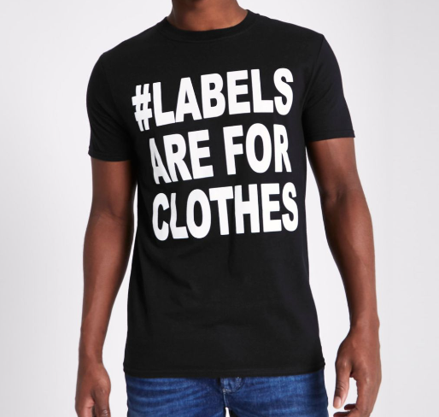
Labelling and Stereotypes
I am NOT Black, you are NOT white
Starter:
In pairs take a minute to discuss what you think the differences are between ‘Labelling’ and ‘Stereotypes’. Share ideas with the whole group.
What is labelling?
Labeling can be defined as a categorization.
Labeling can be understood as the act of attaching a label to an individual or else putting someone in a category. In most instances, labeling can be negative and harmful for the individual.
What is Stereotyping?
Stereotyping can be defined as a form of generalization of a group of people or else a simplified outlook.
Stereotyping takes place based on differences in people. It can be gender, religion, race, etc.

Slide 2
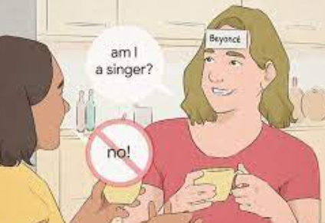
Labelling activity
Students will have randomly selected pre-written labels from the list below to stick onto either their forehead or back. They shouldn’t be able to see their own labels.
Then students will spend 5-10 minutes moving around the classroom and interacting with other students trying to get clues from each other in order to pinpoint their ‘labels’
Were you able to determine your label based on how others were interacting with you?
How did you feel during this experience?
How did you feel interacting with others based on their labels?

Slide 3
I am NOT Black, you are NOT white
Discussion – This is a slam poem by Prince EA.
Before we listen, what do you think this poem will be about?

Slide 4
Group Discussion: How do labels affect our relationships with ourselves and others and how do we navigate life with labels?

Slide 5
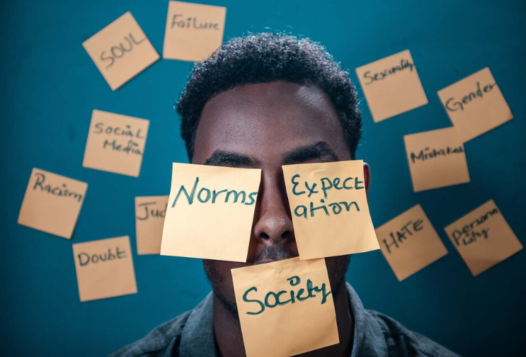
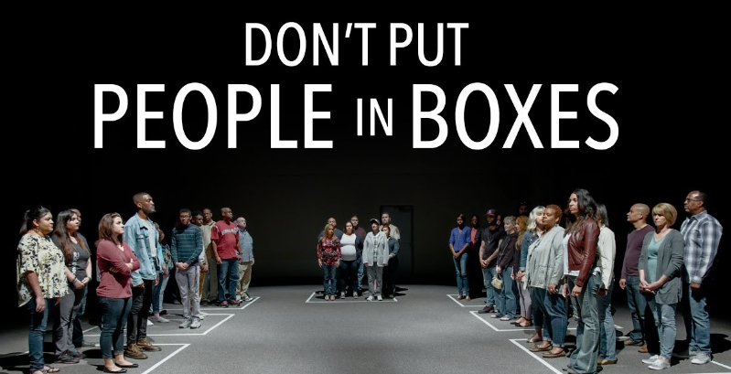
I am NOT Black, you are NOT white
Final thought:
In this poem, Prince EA conveys the important message that our exterior is of little relevance to who we are as human beings, it is our interior that shows our true personality.
In a world where we seem to see increasing division, separation, and at times hatred of the other, perhaps the way forward is to recognize that we need to focus less on our external differences and more on our internal similarities.
Activity:
Create a poster exploring the question below.
Who would you be if the world never gave you a label?

