Slide 1
Democratic Engagement

Slide 2
01 | What is Parliament?
02 | What are the issues?
03 | What would you change?
04 | Making your voice heard You will need: Paper, Pen and the Internet

Slide 3
What is Parliament?
When it comes to politics, making informed decisions is pretty important. But, having the understanding to make all these informed decisions can sometimes feel a little intimidating. Especially when things like global pandemics happen and how the government and UK Parliament works is in the spotlight even more than usual!
Luckily, the UK Parliament really wants people to have an understanding of how it works so they can get involved and influence the decisions that get made. Because the more you know, the more you can effect change.
And they also understand that young voters, especially, are passionate about positive change and getting their voices heard.

Slide 4
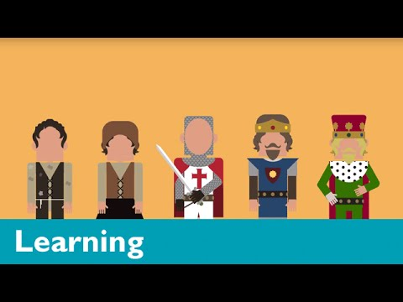
What is Parliament?
To help out, UK Parliament have created a YouTube channel called Teach Parliament, full of videos that explain, in bitesize chunks, the whats, the hows and the whys when it comes to Parliament.
In the first set of videos, you’ll find out about how Parliament is structured, how Parliament checks and challenges the work of the Government, how ideas become laws, different types of elections and how to have a voice in Parliament, from voting to petitioning and campaigning.

Slide 5
What are the issues?
What issues does Parliament affect?
The UK Parliament website has many videos and resources for you to explore which explain some of the issues facing the country.
You can use the page below to explore some of the different topics which Parliament has debated:
https://learning.parliament.uk/resources/
Or watch the videos on their YouTube page:
https://www.youtube.com/c/ukparliament/
(Check out their “Teach Parliament” playlist)
Task: Visit the websites and choose a topic which interests you.
How has this issue been dealt with by Parliament?
What do you think of what Parliament has done so far?

Slide 6
What is Social Action?
What would you change?
Social action is when you take practical action in the service of others.
It involves activities carried out by individuals or groups that are not for profit and aim to bring about a change or benefit for communities.
This might involve giving time and/or money.
It includes volunteering and community involvement such as taking part in a programme like the National Citizen Service.
It is how citizens can influence decision-making through the democratic process.

Slide 7
The ‘WHAT’
What would you change?
You have one minute to decide on a cause that you feel deserves social action.
You can choose a campaign that is local to your immediate community, is a national issue that affects people across the UK, or is a global issue which affects people in many different countries.
If you're struggling, you might like to think about:
Your local food bank and community issues
The effect coronavirus has had on young people in the UK
An environmental issue you feel strongly about

Slide 8
The ‘HOW’
What would you change?
Now that you know what issue you care about you need to decide how you are going to make a difference.
You now have time to write down:
WHAT is the problem you are choosing?
WHY is it an issue?
who is impacted and how
what will happen if nothing is done?
SOLUTION - what can you do about it?
STAKEHOLDERS - who can help you?
IMPACT - what do you hope to achieve?

Slide 9
Contacting your MP
Your Member of Parliament (MP) is elected by people in your local area (called Constituency).
You can find out which constituency you live in and who your MP is by using this website:
https://members.parliament.uk/FindYourMP
As a resident, you have the right to contact your MP to ask them to support a cause you feel strongly about or to argue in the House of Commons on your behalf.
Many people write to their MP when they want something done, and MPs will often respond.
Making your voice heard

Slide 10
Making your voice heard
Writing a letter to your MP
Be succinct – do not be longer than one side of A4
Keep to the point – focus on one issue
Include your address- let your MP know where to send the response
Check your MP’s correct title (e.g. Mr, Mrs, Dr, Sir, Rt. Hon)
Introduce yourself and share why you care about the issue, e.g. you have a personal connection
Be EPIC:
E = ENGAGE your MP. Get your MP’s attention with a
dramatic fact or short statement
P = State the PROBLEM. How widespread or serious is the
problem?
I = INFORM the MP about the solutions. Give examples of
how the problem could be addressed
C = CALL TO ACTION. Let your MP know what you want
them to do about it

Slide 11
Making your voice heard
Writing a letter to your MP
Your turn!
Task: Using the guidance on the previous page, write a letter to your MP about the cause you are passionate about.

