Slide 1
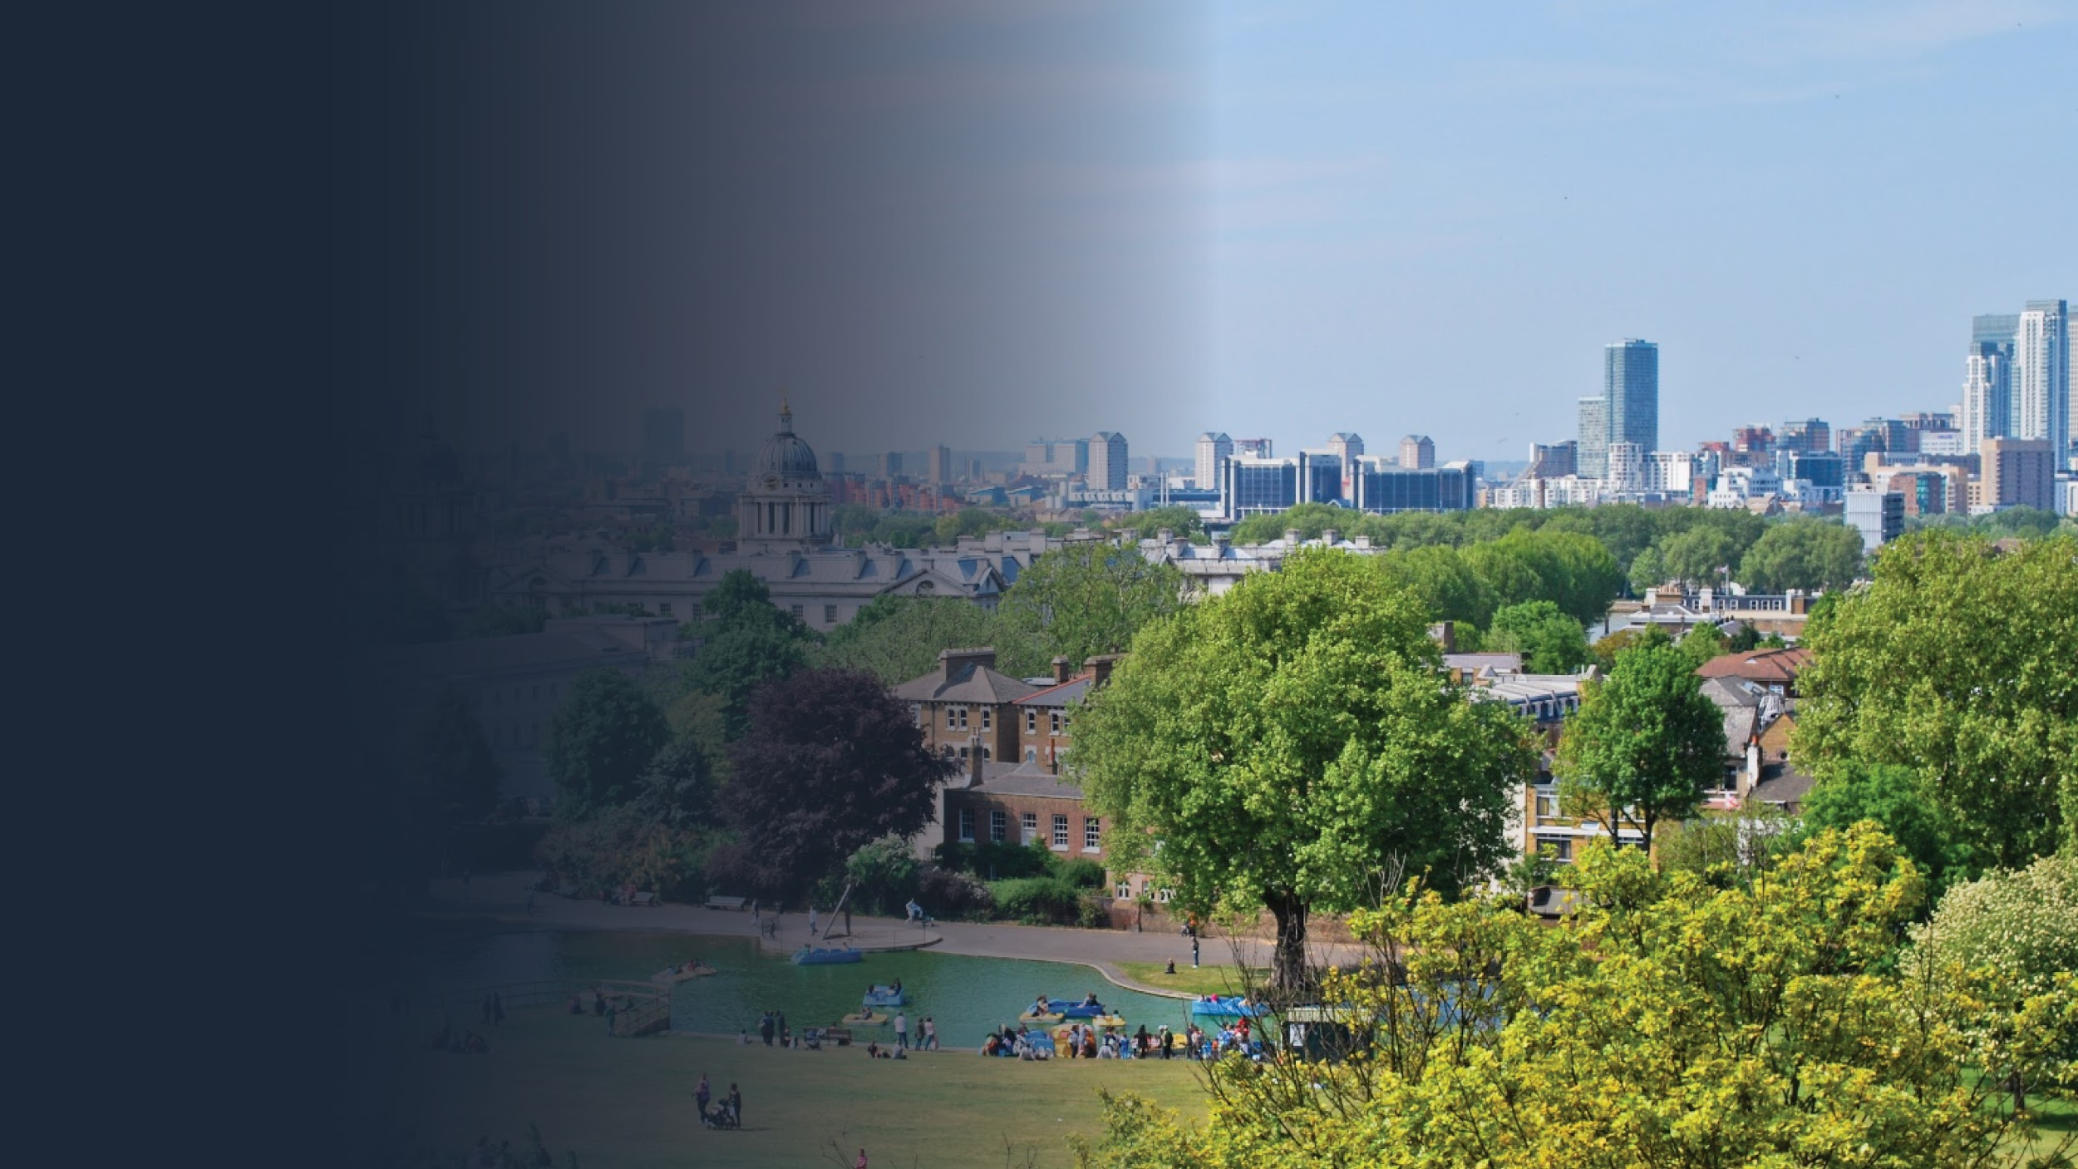

Slide 2
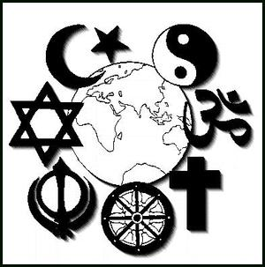
Do we live in a multi-faith society?
Overview:
Explain what do you think is meant by a multi-faith Society and mono-Faith Society?
Consider some advantages and disadvantages of a multi-faith society.
Evaluate- Do we live in a Multi-cultural Society?

Slide 3
What is the difference-
Multi Vs Mono??
Multi-Faith Society
Mono-Faith
Society

Slide 4
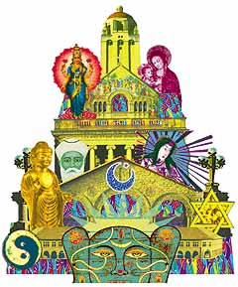
Starter- 2 minutes
What do you think we mean by ‘multi-faith society’?
Give examples to support your answers.

Slide 5
Definitions
Multi faith society – many different religions living together in one society.
Mono faith society – a society with only one religion.
Religious Pluralism – when a society gives members of any religion the freedom and right to worship.
What is your faith? How many different faiths are there in your class?
Notes:
Discuss as a whole class

Slide 6
2001 Census – Britain
2018 Census – Britain
Religion | Percentage of people
Christian (10% of whom are Roman Catholic) | 71.6
Muslim | 2.7
Hindu | 1.0
Sikh | 0.6
Jewish | 0.5
Buddhist | 0.3
Other | 0.3
No religion | 15.5
Not stated | 7.3
Religion | Percentage of people
Christian | 50.7
Muslim | 2.5
Hindu | 0.7
Sikh | 0.3
Jewish | 0.6
Buddhist | 0.6
Other | 1.5
No religion | 41.5
Not stated | 1.6
How do you feel this represents your class, and the area that you live in? How do they compare?

Slide 7
education
You can use this to guide to help you – think about advantages or disadvantage of a multi faith society.
improve own faith
more understanding
Advantages
stop religious conflicts
multi-faith
Disadvantages
conversion
mixed marriages
The information on the following sheets
Gives examples of different types of beliefs use this to form your views and look at the similarities and differences of each faith
children
suspicion

Slide 8
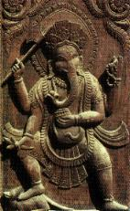
Hinduism - This Sanskrit letter is pronounced ‘Om’. Hinduism uses the word OM in contemplation to represent ultimate being or divinity. Its intonation suggests the great harmonic sounding of the sacred source of flowing and flowering within all.

Slide 9
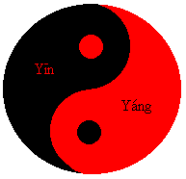
Taoism - The subtle yin-yang symbol of Taoism reminds us not just of the apparent opposites of life, but of the empowering underlying Oneness.

Slide 10
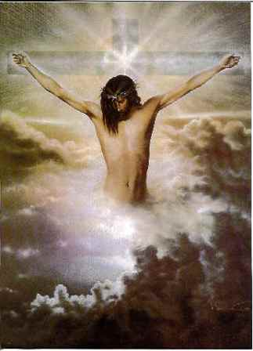
Christianity - The cross has been used in many cultures to represent the spiritual intersecting of the temporal and the eternal, the specific and the universal. The Christian cross as a symbol of Jesus' approach to living and dying reminds us particularly that only through unconditional loving-kindness can the painful dichotomies of life be overcome.

Slide 11
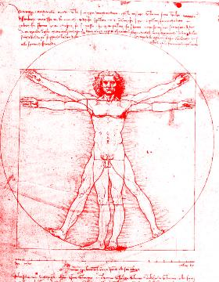
Humanism - The exuberant outreaching human figure is a 3200 year old Chinese ideogram for Humanism defined as the understanding that knowledge and wisdom come not by instruction but by the human mind reflecting on the experience of life.

Slide 12
Naturalism - The Tree of Life is used to represent the "earth centred" or Primal religions. The symbol reminds naturalists of the Oneness of being and its rich multiplicity of life forms.

Slide 13
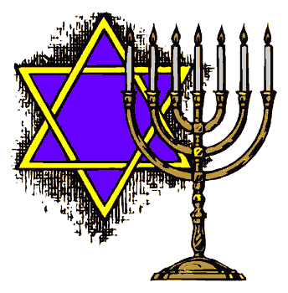
Judaism - Various cultures have used intertwined triangles to represent the mutual embrace of humanity's transcending spiritual impulse and divinity's historical creative impulse. This symbol in Jewish tradition reminds us particularly of the covenant of holiness.

Slide 14
Buddhism - The eight-spoked wheel stands for Buddhism's Noble Eightfold Path-- the path of understanding, consideration and devotion by which we can take ourselves from our self bound suffering past fearfulness, neediness and confusion to blessedness and peace.

Slide 15
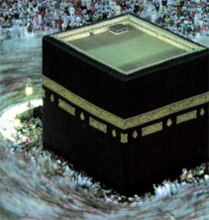
Islam - The star and crescent can be said to represent the shining beauty of harmony and existence. This symbol reminds us of the central truth of Islam, that is profound surrender to the goodness of God.

Slide 16
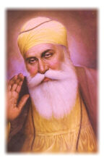
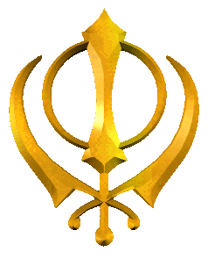
Sikhism – Sikhism was founded in the Punjab by Guru Nanak and is a monotheistic religion. Sikhs think religion should be practiced by living in the world and coping with life's everyday problems.

Slide 17
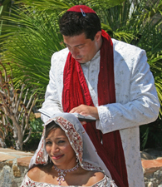
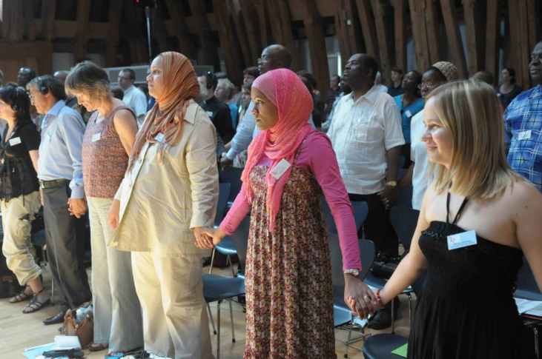
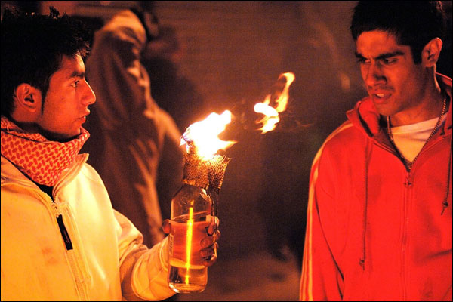
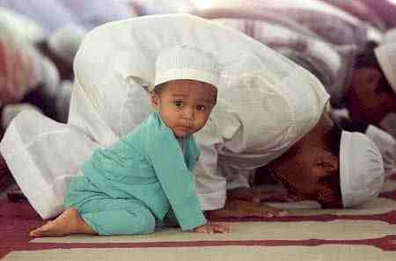
Group Task: 5 minutes
Use the sheet on the next slide to state some advantages and disadvantages you can see of a multi-faith society.
Number 2’s: What are the disadvantages of a multi-faith society?
e.g. It is bad because people’s religious beliefs have lead to violence, for example, Christians have clashed with Muslims in Bradford.
Number 1’s: What are the advantages of living in a multi-faith society?
e.g. It is good because you get to learn about others cultures and can learn from everyone.

Slide 18
Advantages and Disadvantages of Multi-Faith Societies
The advantages of a multi-faith society | The disadvantages of a multi-faith society

Slide 19
Multi-faith’ in the UK causes more trouble than it is worth’
Vote with your Feet – Evaluate.
Now you have a broader overview of different faiths, have your original views changed?
Totally Disagree
Unsure
Totally Agree
What do I think?

Slide 20
Visit capel.ac.uk to browse courses and apply online

