Slide 1
Prevent, Channel Radicalisation and Extremism

Slide 2
What is Extremism?
The law and extremism:
Extremism crosses the line between freedom of speech/legal protest and criminal activity.
Extremists may be convicted on a range of different charges such as inciting racial or religious hatred; soliciting murder; terrorism; and using the Internet to stir up racial hatred, religious hatred, or hatred based on sexual orientation
Many of these carry jail sentences
HM Government defines extremism as:
“Vocal or active opposition to fundamental British values, including democracy, the rule of law, individual liberty and mutual respect and tolerance of different faiths and beliefs“.
Extremism is:
a person who holds extreme political or religious views
Problems arise when views lead to dangerous or criminal behaviour or incitement to hatred
Most people who believe in a religion or a political or animal rights cause are not extremists but such causes have sometimes attracted extremists who have resorted to violence and intimidation.
Extremists operate either as organised groups or ‘lone wolves’

Slide 3
Does the group state that it will use ‘any means’ in the name of its cause?
Is it prepared to use violence or violent protest even just as a last resort?
Does it express negative attitudes towards other groups such as Muslims; Christians; LGBT groups; people from different ethnic groups?
Are its members prepared to engage in illegal activity such as damaging property or sending bomb hoaxes?
Does it engage in activities that may put others at risk of harm?
Be Alert; Sings to look for:
Groups will not use the word ‘extremist’ to describe themselves so look out for the danger signs.

Slide 4
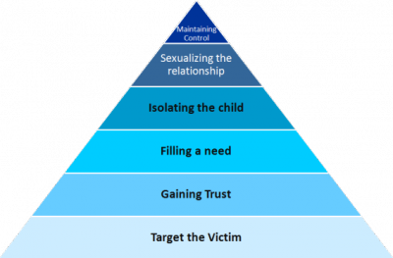
Radicalisation
Radicalisation is the process ‘by which a person comes to support terrorism and forms of extremism leading to terrorism’
Students are often targets and are especially vulnerable to online radicalisation
Grooming techniques are used that are similar to those used in sexual grooming

Slide 5
What does prevent and channel stand for in safeguarding?
Simply put, Prevent is about safeguarding individuals from being drawn into terrorism, ensuring those vulnerable to extremist and terrorist narratives are given appropriate advice and support at an early stage. Prevent is no different to any other form of safeguarding from harm. Click on the video below for an overview of the prevent strategies.
Channel is a multi service approach, meaning that the most
vulnerable people in society and people who have been drawn
into terrorism will be offered full help and support.
‘’780 individuals have left the Channel process since April 2015 with no further terrorism-related
concerns. This change will improve the efficiency of Channel panels and so ensure that such
individuals receive the support they need in a timely manner to guide them away from
such activity.” Rt Hon Ben Wallace MP, Minister of State for Security and Economic Crime
If you are concerned that you or a friend are being drawn into extremist activity, tell someone:
Student Services where there are Safe guarding officers, mentors and counsellors available to support.
Your Course Manager or a tutor that you trust
Email the Safeguarding group: safeguarding@capel.ac.uk
You can report out side by using the Government reporting tool https://www.gov.uk/report-terrorism
If you are in danger call 999.
Child line: 0808 800 5000 or emailing help@NSPCC.org.uk

