Slide 1


Prevent,
Radicalisation
and Extremism

Slide 2
HM Government defines extremism as
What is Extremism?
In groups of 2-3 agree on a definition of what you think extremism is.
“Vocal or active opposition to fundamental British values, including democracy, the rule of law, individual liberty and mutual respect and tolerance of different faiths and beliefs“.
The law and extremism
Extremism crosses the line between freedom of speech/legal protest and criminal activity.
Extremists may be convicted on a range of different charges such as inciting racial or religious hatred; soliciting murder; terrorism; and using the Internet to stir up racial hatred, religious hatred, or hatred based on sexual orientation
Many of these carry jail sentences
Extremism is…
Extremist – a person who holds extreme political or religious views
Problems arise when views lead to dangerous or criminal behaviour or incitement to hatred
Most people who believe in a religion or a political or animal rights cause are not extremists but such causes have sometimes attracted extremists who have resorted to violence and intimidation.
Extremists operate either as organised groups or ‘lone wolves’
London’s environmental college capel.ac.uk
Notes:
Flipchart paper exercise in small groups – definitions can be pinned to wall and then discussed with the whole class.

Slide 3

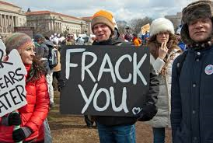
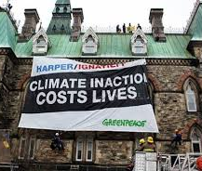
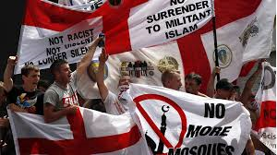
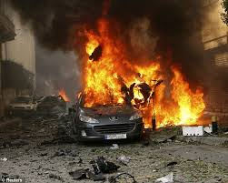

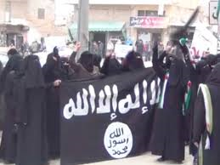
Extremism

Slide 4
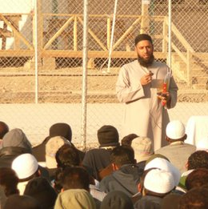
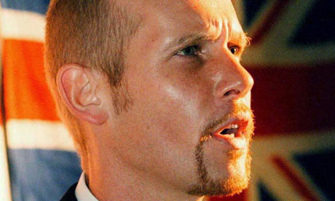
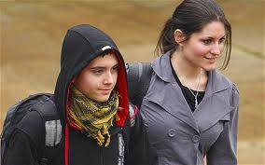
Imam Asim Hafiz, an Islamic adviser to the Ministry of Defence and the British armed forces' first Muslim chaplain
Billy Wright, Loyalist Paramilitary.
Threatened with execution by his own terrorist organisation.
Responsible for more than 20 sectarian killings
Christopher Potter, 20 and Maria Neal, 21. Animal Rights Extremists
Caused more than £12000 of damage in six attacks
London’s environmental college capel.ac.uk
Notes:
In small groups or as a class, students to label each picture “extremist”, “victim” or “government advisor”
Students’ labels may reflect a stereotype and if not, please congratulate them on not stereotyping. Talk about the consequences of stereotyping when it comes to extremism.

Slide 5
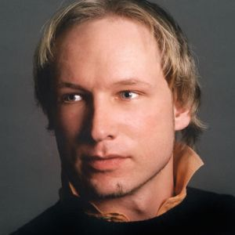
Anders Behring Breivik is the perpetrator of the July 22, 2011 attacks in Norway. Breivik is a Norwegian citizen who has admitted to carrying out Norway's biggest massacre since World War II. He is responsible for killing 77 people and injuring hundreds in Oslo, Norway's capital.
On July 22, 2011, a bomb exploded in a car outside the office of Prime Minister Jens Stoltenberg in central Oslo. The powerful blast killed eight people and injured hundreds. Anders was responsible for the bomb.
As news of the blast spread, Breivik boarded a ferry to the island of Utoya, 25 miles northwest of Oslo. Breivik was armed and dressed in a police uniform. Utoya was the location of a political youth summer camp organized by the Norwegian Labor Party. Breivik went on a deadly shooting spree at the camp, killing 69 people, mostly teens.
Hours before the attacks, Breivik e-mailed a 1,500-page manifesto to 5,700 people, titled 2083 - A European Declaration of Independence. In the document, Breivik attacks multiculturalism and the "threat" of Muslim immigration to Norway, as well as Marxism and the Norwegian Labor Party. His manifesto claimed "multiculturalism is an anti-European hate ideology“.
London’s environmental college capel.ac.uk
Notes:
Read out the information about Anders Breivik and ask students the following questions:
How do they feel about what they just heard?
What does the line from his manifesto “multiculturalism is an anti-European hate ideology” mean?

Slide 6
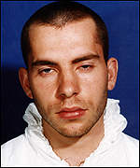
David Copeland is an English Neo-Nazi militant who became known as the "London Nail Bomber" after a 13-day bombing campaign in April that resulted in three people killed and more than a hundred injured. Widely labelled a terrorist, Copeland was a former member of two far-right political groups, the British National Party and then the National Socialist Movement.
Over three successive weekends between 17 and 30 April, Copeland placed homemade nail bombs, each containing up to 1,500 four-inch nails, in holdalls that he left in public spaces around London. The first bomb was placed outside the Iceland supermarket in Electric Avenue, Brixton, an area of south London with a large black population. The second was in Brick Lane in the East End of London, which has a large Bangladeshi community.
The third was inside the Admiral Duncan pub in Soho's Old Compton Street, the heart of London's gay community. The bombs killed three people, including a pregnant woman, and injured 139, four of whom lost limbs.
He told police, "My main intent was to spread fear, resentment and hatred throughout this country; it was to cause a racial war." My aim was political. It was to cause a racial war in this country. There'd be a backlash from the ethnic minorities, then all the white people will go out and vote BNP."
London’s environmental college capel.ac.uk
Notes:
Read out the information about Anders Breivik and ask students the following questions:
How do they feel about what they just heard?
Why do you think he wanted to cause a ‘race war’?

Slide 7
Extremist Groups: Examples
Extremist groups use direct illegal action to promote their cause. Here are some examples:
National Action - a racist neo-Nazi group that was established in 2013. It has a number of branches across the UK, which conduct provocative street demonstrations and stunts aimed at intimidating local communities. Its activities and propaganda materials are particularly aimed at recruiting young people. The group is virulently racist, anti-Semitic and homophobic. Its ideology promotes the idea that Britain will inevitably see a violent ‘race war’, which the group claims it will be an active part of. The group rejects democracy, is hostile to the British state and seeks to divide society by implicitly endorsing violence against ethnic minorities and perceived ‘race traitors’.
ISIL/ISIS - ISIL (DAESH) is a highly violent extremist group that has killed thousands of men, women, and children, mostly Muslims. The group calls itself the “Islamic State,” but its members follow an extreme, fringe interpretation of Islamic law. They do not represent mainstream Islam, and the vast majority of Muslims are horrified by their actions.
Feuerkrieg Division (FKD) - a white supremacist group founded in late 2018 that has an international footprint, with members across North America and Europe. The group celebrates the concepts promoted in a collection of essays which advocate the use of violence and mass murder in pursuit of an apocalyptic race war.
Remember: if you think any information an extremist group tells you might be true, you are more likely to believe their other beliefs and values, which may promote violence.
London’s environmental college capel.ac.uk

Slide 8
Extremist Groups and 2020
Black Lives Matter
A self-described local leader of the Ku Klux Klan, a white-supremacist US extremist group, has been charged with assault after driving his car into demonstrators at a Black Lives Matter protest in Virginia. Prosecutors say Harry Rogers, 36, drove “recklessly” towards protesters and “revved the engine” before driving into the crowd. A hate crime investigation is underway.
According to an internal intelligence note produced by the Department of Homeland Security, a white supremacist group has used its channel on an encrypted messaging app to urge its followers to start shooting at crowds gathering in cities across the US to protest against the murder of George Floyd, who was killed by a police officer on 25 May.
London’s environmental college capel.ac.uk
Notes:
Once you have read the information in the slide, ask students the following questions:
How are extremist groups using protests to further their cause?
How should people who are peacefully protesting respond to this extremist behaviour?

Slide 9

Does the group state that it will use ‘any means’ in the name of its cause?
Is it prepared to use violence or violent protest even just as a last resort?
Does it express negative attitudes towards other groups such as Muslims; Christians; LGBT groups; people from different ethnic groups?
Are its members prepared to engage in illegal activity such as damaging property or sending bomb hoaxes?
Does it engage in activities that may put others at risk of harm?
Danger Signs
Groups will not use the word ‘extremist’ to describe themselves so look out for the danger signs.
London’s environmental college capel.ac.uk

Slide 10
True or False
 | True or False?
You can spot someone with extreme beliefs purely by looking at them.
Extremism always leads to violence.
Extremism can apply to issues such as nuclear weapons, rights for fathers and animal testing.
Extremism exists all over the world
Some extremist groups believe that they are following God’s instructions.
Extremist groups sometimes target susceptible young people.
 | True or False?
You can spot someone with extreme beliefs purely by looking at them. | False
Extremism always leads to violence. | False
Extremism can apply to issues such as nuclear weapons, rights for fathers and animal testing. | True
Extremism exists all over the world | True
Some extremist groups believe that they are following God’s instructions. | True
Extremist groups sometimes target susceptible young people. | True
London’s environmental college capel.ac.uk
Notes:
Quick fire true and false.
Teachers notes for exercise:
You can spot someone with extreme beliefs purely by looking at them. False: anyone can harbour extremist beliefs.
Extremism always leads to violence. False: Extremism can be seen in non-violent acts such as protest movements, online and in literature.
Extremism can apply to issues such as nuclear weapons, rights for fathers and animal testing. True: Extremism can be non-violent but still dangerous.
Extremism exists all over the world: True: Extremism has taken place by ETA in the Basque Region, in the Israel-Palestine Conflict and by the IRA in Ireland often involving the use violence.
Some extremist groups believe that they are following God’s instructions. True: Some extremists target religious groups that may more heavily influenced than non-religious people. For example, Al Qaeda and affiliates see young Muslim’s living in the West as a key target audience to their messaging.
Extremist groups sometimes target susceptible young people. True: Young people are seen as being more easily influenced than an adult due as they question issues relating to their identity , beliefs and values during adolescence.

Slide 11
Prevent - Case Study
https://www.youtube.com/watch?v=cSUUbJe2qCs
Discussion
  Why was the young man drawn into terrorist activities?
  Which kinds of people do you think might be vulnerable to recruitment by extremist?
The young man was vulnerable:
  Lonely
  Negative changes in his life
Needed to belong; to feel accepted; to have friends
Organisation took advantage of vulnerability and used grooming techniques
London’s environmental college capel.ac.uk

Slide 12
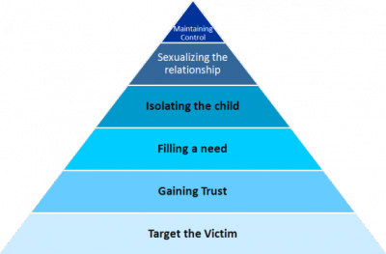
Radicalisation
Radicalisation is the process ‘by which a person comes to support terrorism and forms of extremism leading to terrorism’
Students are often targets and are especially vulnerable to online radicalisation
Grooming techniques are used that are similar to those used in sexual grooming
London’s environmental college capel.ac.uk

Slide 13

Tackling Extremism
There are ways to tackle extremism without resorting to hatred or violence.
The English Disco Lovers (EDL) are a pro-equality group, who use humour (and disco!) to ridicule the English Defence League (EDL). Their message –
“Don’t Hate, Gyrate”
What can you do to prevent extremism in your community and your college?
Notes:
Education, Information groups, action groups

Slide 14
In pairs discuss: What’s the best way of fighting extremism?
There’s no right or wrong answer to this question. But be prepared to explain your thoughts and ideas.
Better education about these issues/groups
Counter-demonstrations.
Ridiculing arguments that don’t stand up to scrutiny

Slide 15
What can we do?
Our government says: “Extremists take advantage of institutions to share their poisonous narrative with others, particularly with individuals vulnerable to their messages. The government must do more to address extremism in locations where it can exert control, such as prisons, and increase oversight where it is needed, such as some independent and religious schools.”
https://www.youtube.com/watch?v=K4db14pSZZI
If you are concerned that you or a friend are being drawn into extremist activity, tell someone:
Student Services
Your Course Manager or a tutor that you trust
Phone the Safeguarding number on the back of your ID
Contact Childline 0800 1111 or chat on line at - www.childline.org.uk
London’s environmental college capel.ac.uk
Notes:
Once you have watched the video ask the students the following questions and discuss their answers:
This news clip was from 2010, what do you think has changed in 10 years?
Do you think freedom of speech makes extremism worse?

Slide 16
Visit capel.ac.uk to browse courses and apply online

