Slide 1
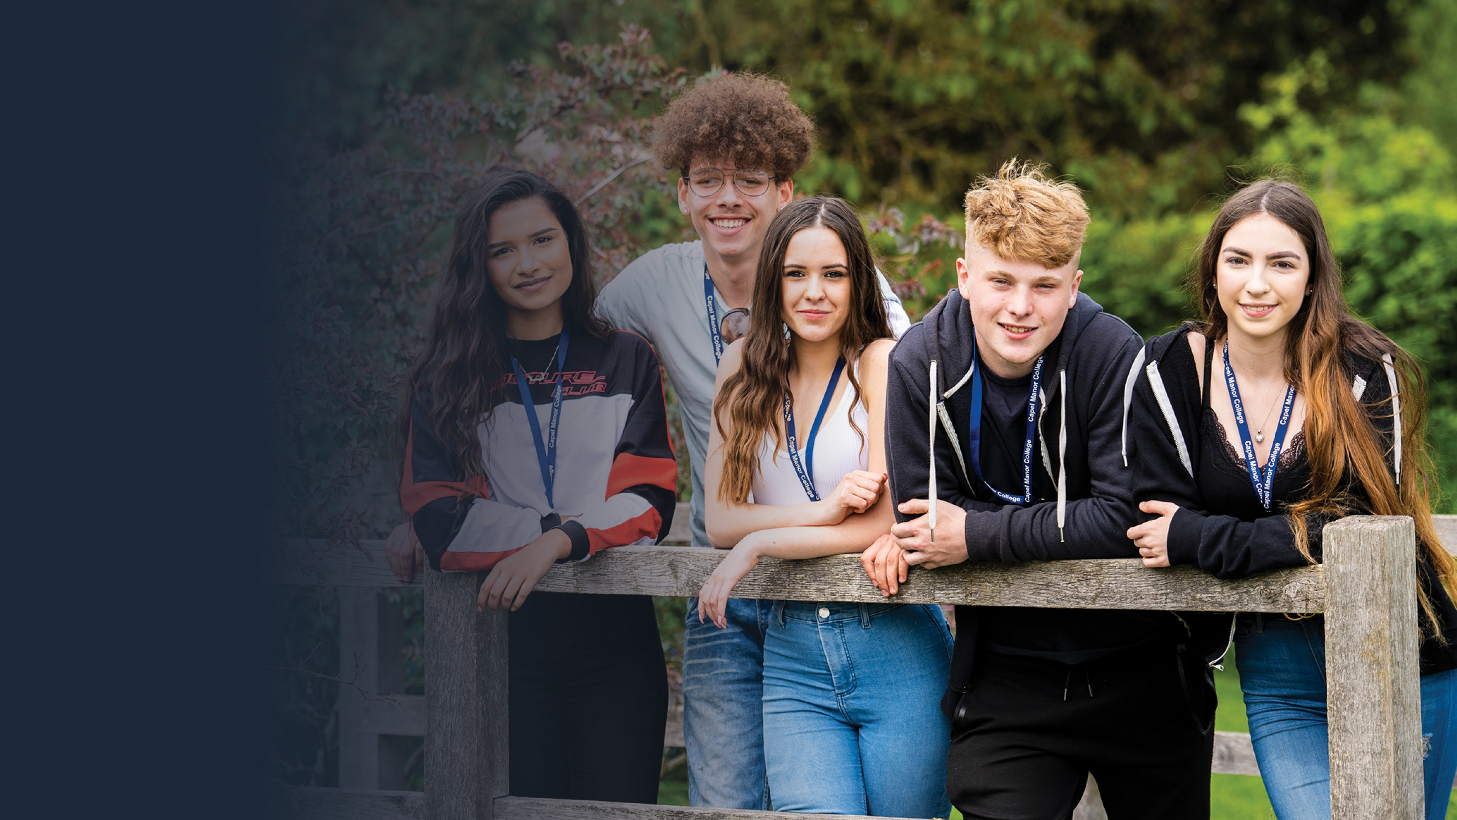
Keeping Safe
at
Capel Manor College

Slide 2
Keeping Safe at Capel Manor College
By the end of this session you should be able to:
Explain what Safeguarding is.
Describe the College’s Prevent Duty.
Know where to go if you have any safeguarding concerns.
In this session, we will talk about sensitive issues.
If you have any concerns, please speak to your Tutor or the Wellbeing Team.
London’s environmental college capel.ac.uk

Slide 3
What would you do?
You’ve noticed that a college friend has bruises on their arms. You ask how they got them but they are embarrassed and tell you it’s none of your business.
You’ve become friends with someone of the opposite sex in your class. You’ve been getting on well as friends but recently they have been hugging and touching you in a way that makes you feel uncomfortable.
London’s environmental college capel.ac.uk
Notes:
Please discuss these 2 questions with your class. You can ask students to write their answers down on a flip chart one by one, in groups, or ask them verbally to reply by putting their hand up.

Slide 4
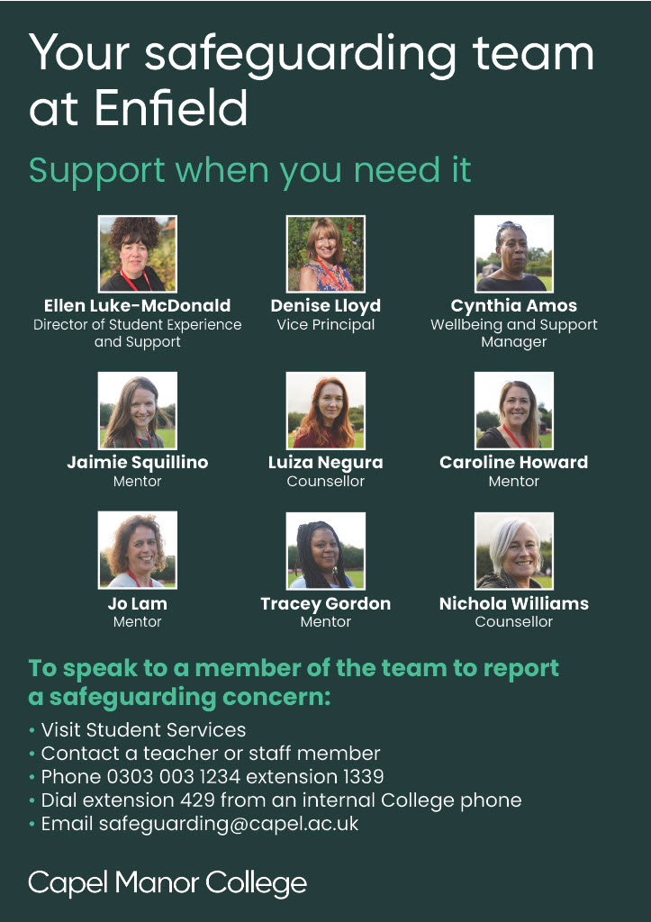
Visit Student Services
Contact a Teacher or Staff Member
Phone 0303 003 1234 extension 1339
Dial extension 429 from any internal College phone
Email: Safeguarding@capel.ac.uk
London’s environmental college capel.ac.uk
Notes:
All the above information is on Capel Moodle and on Poster’s throughout the College. Each Campus has a different poster depending on who is the Safeguarding Officer at that particular campus. Please make your students aware that the poster at their campus will have different safeguarding officers on however the contact information will be the same.

Slide 5
What would you do?
A college friend has told you that she is pregnant. She is only 16 and says that if she tells her parents they will throw her out of the house. She asks for your advice and help.
A college friend is in tears over a family incident that happened at home. You are worried about them but they refuse to tell you what is wrong because it is a private matter. They tell you they can’t face going to class but won’t go home either.
London’s environmental college capel.ac.uk
Notes:
Please discuss these 2 questions with your class. You can ask students to write their answers down on a flip chart one by one or in groups, or ask them verbally to reply by putting their hand up.

Slide 6
Why Safeguarding at Capel Manor College?
The law says that the Colleges have to make sure that all students know about the safeguarding arrangements they have in place.
Capel Manor College wants our students to live free of neglect and abuse. Helping our students understand Safeguarding ensures they are equipped with the knowledge they need to report and to challenge unsafe behavior.
London’s environmental college capel.ac.uk

Slide 7
What is Safeguarding?
London’s environmental college capel.ac.uk
Notes:
Please play this video to your class.

Slide 8
What is your definition of safeguarding?
Safeguarding is the action that is taken to promote the welfare of children and protect them from harm. Safeguarding means: protecting children from abuse and maltreatment. preventing harm to children's health or development. ensuring children grow up with the provision of safe and effective care.
London’s environmental college capel.ac.uk

Slide 9
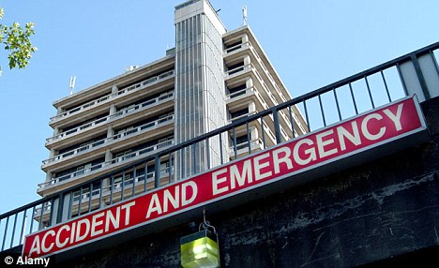
What is a Vulnerable Adult?
A vulnerable adult is someone who may:
Have a dependency upon others in the performance of basic physical functions;
Have severe impairment in the ability to communicate with others; or
Have an impairment in a their ability to protect themselves from assault, abuse or neglect.
London’s environmental college capel.ac.uk
Notes:
Please discuss this in class.

Slide 10
Divide the following into possible signs of Abuse and Neglect
There are 4 forms of abuse:
Physical abuse
Emotional abuse
Sexual abuse
Neglect
Injuries which occur to the body in places which are not normally exposed to falls or other accidents
The young person is sexually provocative or seductive with adults
Dirty skin, body smells, unwashed and uncombed hair
Negative statements about self
Clothing that is dirty, too big or small, or not right for different weather conditions
Bruises, bites, burns and fractures, for example, which do not have an accidental explanation
Highly aggressive or cruel to others
London’s environmental college capel.ac.uk

Slide 11
What is Abuse?
London’s environmental college capel.ac.uk
Notes:
Please watch the video

Slide 12
Answers: Physical abuse a. Injuries which occur to the body in places which are not normally exposed to falls or other accidents f. Bruises, bites, burns and fractures, for example, which do not have an accidental explanation Emotional abuse d. Negative statements about self g. Highly aggressive or cruel to others Sexual abuse b. The young person is sexually provocative or seductive with adults Neglect c. Dirty skin, body smells, unwashed and uncombed hair e. Clothing that is dirty, too big or small, or not right for different weather conditions
London’s environmental college capel.ac.uk
Notes:
Answers

Slide 13
What is Prevent?
Prevent is about safeguarding individuals from being drawn into terrorism, ensuring those vulnerable to extremist and terrorist narratives are given appropriate advice and support at an early stage. Prevent is no different to any other form of safeguarding from harm
London’s environmental college capel.ac.uk

Slide 14
The Prevent Duty, is a government requirement on Colleges and Schools.
Staff at Capel Manor College are legally required to protect students from the risk of radicalisation which may lead to extremism and terrorism.
The College’s approach to Prevent is primarily one of safeguarding the welfare of our students and staff. Protection from the risk of extremism and radicalisation forms part of this safeguarding duty. We also balance the duty against our commitment to freedom of speech and other key legislation.
The College helps to build student’ resilience to radicalisation by promoting Our Values.
London’s environmental college capel.ac.uk

Slide 15
Our values
Our students, staff and governors share common values that express who we are, how we behave and bring us together as a community.
We are:
Aspirational
We proactively and continuously seek the best from ourselves and each other through ambition, perseverance and resilience.
Responsible
We care about the environment, animals and people, promoting harmony, respect and sustainability.
Fair
We value individuals and our community, promoting diversity through inclusiveness, equality, openness and mutual respect.
Creative
We encourage passion, creativity, innovation and enterprise to enrich vocational and personal development.
Professional
We encourage behaviours and standards that inspire personal and professional achievement.
Listening
We listen to employers, our sectors and each other, and act on feedback.
London’s environmental college capel.ac.uk

Slide 16
Prevent - Exercise
Match the correct term to the appropriate definition:
Extremism
Terrorism
Radicalism
____________ challenges beliefs and traditions but does not normally lead to violence. People can challenge the values of a society but still stick to the law and attempt to bring about change through peaceful protests and other ways, e.g. Rosa Parkes
____________ is when people sometimes accept violence as a way of reaching their political goals. They do not necessarily carry out violence themselves.
____________ includes violent behaviours that start in the beliefs shared by a group of individuals. This includes the training, preparation and carrying out violent acts against members of the public.
London’s environmental college capel.ac.uk

Slide 17
Grooming
Question 1: What does it mean by grooming someone?
.
Answer 1: Grooming is when someone builds a relationship, trust and emotional connection with a child or young person so they can manipulate, exploit and abuse them. Children and young people who are groomed can be sexually abused, exploited or trafficked. Anybody can be a groomer, no matter their age, gender or race.
Question 2: Does grooming only take place online?
Answer 2: Children and young people can be groomed online or face-to-face, by a stranger or by someone they know - for example a family member, friend or professional.
London’s environmental college capel.ac.uk
Notes:
What does it mean by grooming someone?
Grooming is when someone builds a relationship, trust and emotional connection with a child or young person so they can manipulate, exploit and abuse them. Children and young people who are groomed can be sexually abused, exploited or trafficked. Anybody can be a groomer, no matter their age, gender or race.

Slide 18
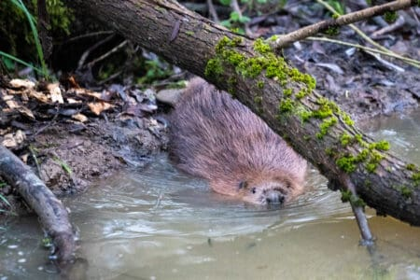
How does online grooming work?
“Let’s go private.” (leave the public chatroom and create a private chat or move to instant-messaging or phone texting)
“Where’s your computer in the house?” (to see if parents might be around)
“Who’s your favourite band? Designer? Film?” (questions like these tell the groomer more about you so they know what gifts to offer – e.g., concert tickets; Webcam, software, clothes, CDs)
“I know someone who can get you a modelling job.” (flattery, they figure, will get them everywhere)
“You seem sad. Tell me what’s bothering you.” (the sympathy angle))
“What’s your phone number?” (asking for personal info of any kind – usually happens at a later stage, after the target’s feeling comfortable with the groomer – but all online young people should not give out personal info online)
“If you don’t… [Do what I ask], I’ll… [tell your parents OR share your photos in a photo blog / Webcam directory / file-sharing network]“ (intimidation – used as the groomer learns more and more about the target)
London’s environmental college capel.ac.uk

Slide 19
Making threats? DON’T DO IT!
Making a threat of violence, whether you mean it or not, is an act that can land you under Police investigation. It doesn't matter if you say it, text it, write it, snap it or post it on social media, students who make threats can face serious consequences. Even if it was meant to be a joke.
London’s environmental college capel.ac.uk

Slide 20
Making a threat? DON’T DO IT
Capel Manor College has zero tolerance for students that make threats, these will be met with disciplinary action or suspension during Police investigations which could ultimately lead to expulsion from the college.
London’s environmental college capel.ac.uk

Slide 21
Indecent images and taking images/videos without consent
Sexting is when people share a sexual message and/or a naked or semi-naked image, video or text message with another person. It's also known as nude image sharing.
Children and young people may consent to sending a nude image of themselves. They can also be forced or coerced into sharing images by their peers or adults online.
If a child or young person originally shares the image consensually, they have no control over how other people might use it.
If the image is shared around peer groups it may lead to bullying and isolation. Perpetrators of abuse may circulate a nude image more widely and use this to blackmail a child and/or groom them for further sexual abuse.
It's a criminal offence to create or share explicit images of a child, even if the person doing it is a child.
If you are under 18, it is against the law to: take, have or distribute a sexual photo; this includes a selfie, even if it is of yourself.
London’s environmental college capel.ac.uk
Notes:
It's not a crime to send intimate images or videos of yourself privately to another person if you're both consenting adults. It's a crime to show intimate images or videos, send them to another person, upload them to a website, or threaten to do this, without consent of the person in the image. If you are under 18, it is against the law to: take, have or distribute a sexual photo; this includes a selfie.

Slide 22
Please remember, Capel Manor College’s Safeguarding and Wellbeing Team are here for you.
If you should need any support or guidance please do not hesitate to contact us:
Visit Student Services
Contact a Teacher or Staff Member
Phone 0303 003 1234 extension 1339
Dial extension 429 from any internal College phone
Email: Safeguarding@capel.ac.uk
London’s environmental college capel.ac.uk
Notes:
It's not a crime to send intimate images or videos of yourself privately to another person if you're both consenting adults. It's a crime to show intimate images or videos, send them to another person, upload them to a website, or threaten to do this, without consent of the person in the image. If you are under 18, it is against the law to: take, have or distribute a sexual photo; this includes a selfie.

Slide 23
Visit capel.ac.uk to browse courses and apply online

