Slide 1




Slide 2
Equality and Diversity in the UK:
Protected Characteristics

Slide 3
Key Points
Equality means that we ensure everybody has an equal opportunity, and is not treated differently or discriminated against because of their characteristics. ​
​
Diversity is about taking account of the differences between people and groups of people, and placing a positive value on those differences. ​
​
Placing respect and kindness in the centre of your outlook, recognising that we all have different experiences and situations that have made us who we are today. ​
​
When we start to appreciate each other, we really being to learn and grow​
Discrimination – treating someone differently because of a characteristic or perceived characteristic.
Harassment - persistent unwanted contact or behaviour towards a person – deemed as harassment if the recipient views it as such
Prejudice – attitudes and beliefs about certain groups
Abuse - causing harm through direct action or neglect.
Notes:
Discuss as a whole class

Slide 4
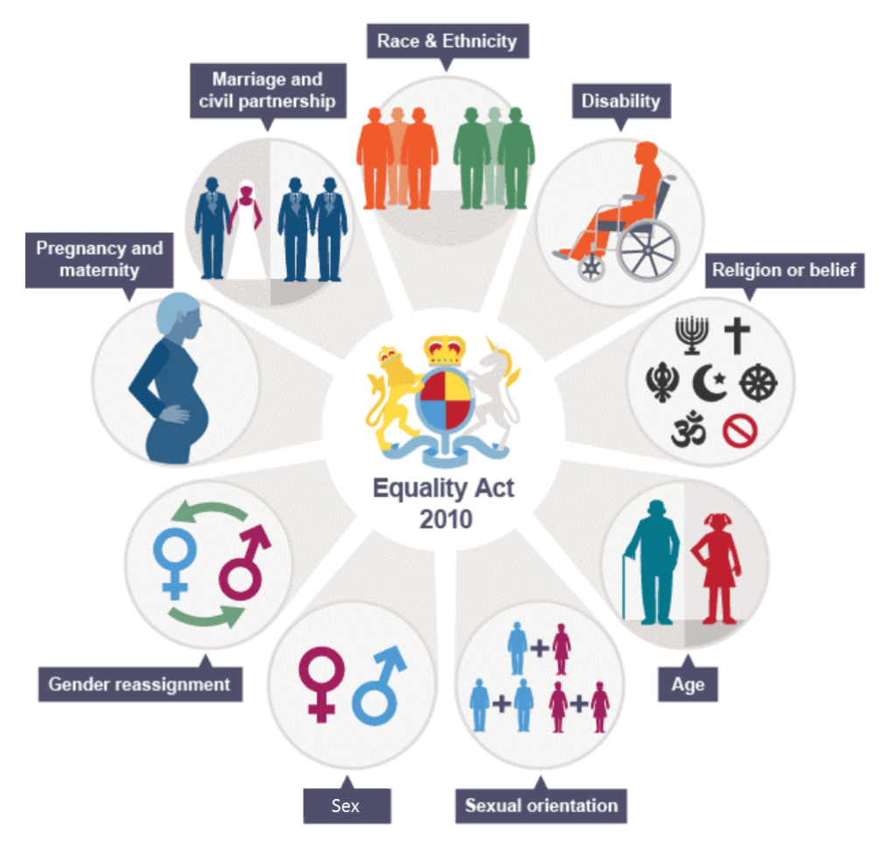
What are the protected characteristics?
Discussion points:
Why do you think these characteristics are protected?
What might they be protected from?
Think about which ones might apply to you if you are applying for a job.

Slide 5
The Equality Act lists 9 protected characteristics which it is illegal to discriminate on the basis of:
A characteristic is a feature belonging to a person that identifies them.
The Equality Act 2010 places upon all organisations three
duties these are:
  To eliminate unlawful discrimination, harassment and victimisation.
  To advance equality of opportunity.
  To foster good relations.
Remember: It is illegal to discriminate against an individual because of their protected characteristic.

Slide 6
Hidden and Visible Characteristics
Decide which characteristics below are hidden, and which are visible. Place them in the correct columns. Be aware that some can be both, place these in the middle.
Pregnancy and maternity
Race and ethnicity
Age
Sex
Religion or belief
Sexual orientation
Gender reassignment
Disability
Marriage or civil partnership
Hidden | Visible

Slide 7
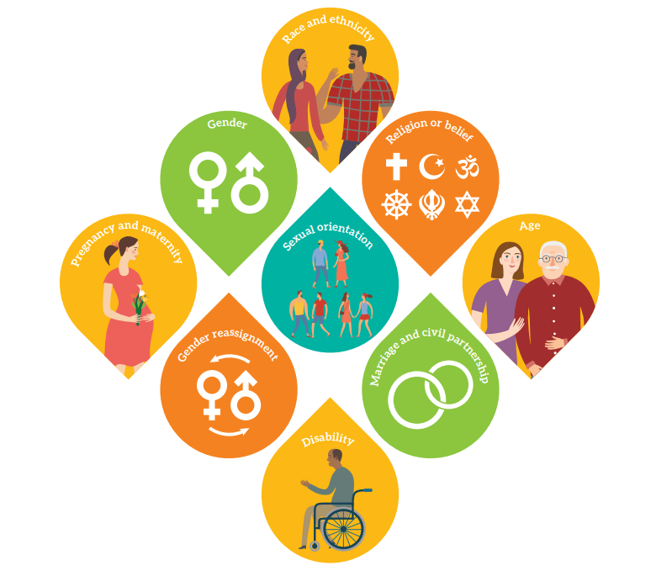
Age
The Equality Act 2010 says that you must not be discriminated against because:
you are (or are not) a certain age or in a certain age group
someone thinks you are (or are not) a specific age or age group, this is known as discrimination by perception
you are connected to someone of a specific age or age group, this is known as discrimination by association
Age groups can be quite wide (for example, ‘people under 50’ or 'under 18s'). They can also be quite specific (for example, ‘people in their mid-40s’). Terms such as ‘young person’ and ‘youthful’ or ‘elderly’ and ‘pensioner’ can also indicate an age group.
Example:
You are 22 and you find you are not eligible to be promoted because your employer has a policy that only workers with a post graduate qualification (such as a Masters) can be promoted. Although this applies to everyone it disadvantages people of your age because they are less likely to have that qualification

Slide 8
Disability
A person has a disability if she or he has a physical or mental impairment
which has a substantial and long-term adverse effect on that person's ability to
carry out normal day-to-day activities.
Although the regulation provides a definition of disability, the issue is more complex than the Act initially clarifies.
While some impairments are immediate and identifiable, it can be difficult to work out if some disabilities qualify.
For example, is autism a protected characteristic? In this instance yes, it fits the criteria as it’s a mental impairment. It’s the same for other issues such as dyslexia and depression.
However, the level of support or adjustments an affected employee needs depends on where they sit on the spectrum.
Under the legislation, workplaces and public areas must make reasonable adjustments to remove barriers caused by a disability.
Examples:
Terminating employment because someone has taken time off for an illness related to their disability.

Slide 9

Gender Reassignment
The process of transitioning from one gender to another.
This is when you are treated differently because you are transsexual.
The treatment could be a one-off action or as a result of a rule or policy. It doesn’t have to be intentional to be unlawful.
There are some circumstances when being treated differently due to gender reassignment is lawful, explained below.
Examples:
A transsexual woman is having a drink in a pub with friends, the landlord keeps calling her ‘Sir’ and ‘he’ when serving drinks, despite her complaining about it.
A local health authority decides that it will not fund breast implants. As a result the health authority refuses to provide this treatment for a woman undergoing gender reassignment even though she considers it essential to make her look more feminine. The same policy is applied to all women but puts transsexuals at a greater disadvantage. The health authority may be able to justify its policy if it can prove that it has legitimate reasons.

Slide 10

Marriage and civil partnership
Marriage is a union between a man and a woman or between a same-sex couple.
Same-sex couples can also have their relationships legally recognised as 'civil partnerships’.
Civil partners must not be treated less favourably than married couples (except where permitted by the Equality Act).
People do not have this characteristic if they are:
single
living with someone as a couple neither married nor civil partners
engaged to be married but not married
divorced or a person whose civil partnership has been dissolved
Examples:
A woman works night shifts in a distribution warehouse but is dismissed when she gets married because her employer thinks a married woman should be at home in the evening.

Slide 11
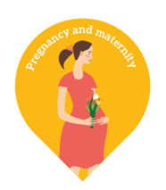
Pregnancy and Maternity
Pregnancy is the condition of being pregnant or expecting a baby. Maternity refers to
the period after the birth, and is linked to maternity leave in the employment context.
In the non-work context, protection against maternity discrimination is for 26 weeks
after giving birth, and this includes treating a woman unfavourably because she is breastfeeding.
The Act defines two types of pregnancy and maternity discrimination:
Unfavourable treatment: This is putting people at a disadvantage because of pregnancy or maternity.
Victimisation: This involves treating someone unfairly because they’ve made or supported an allegation (or complaint) of discrimination.
Example:
Taking into account pregnancy-related illness during an employee’s appraisal or probation.

Slide 12

It refers to a group of people defined by their race, colour, and nationality (including citizenship)
ethnic or national origins.
In the Equality Act, race can mean your colour, or your nationality (including your citizenship). It can also mean your ethnic or national origins, which may not be the same as your current nationality. For example, you may have Chinese national origins and be living in Britain with a British passport.
Race also covers ethnic and racial groups. This means a group of people who all share the same protected characteristic of ethnicity or race.
Example:
A Somalian asylum seeker tries to open a bank account but the bank states that in order to be eligible you need to have been resident in the UK for 12 months and have a permanent address. The Somalian man is not able to open a bank account. The bank would need to prove that its policy was necessary for business reasons (such as to prevent fraud) and that there was no practical alternative.
Race

Slide 13

Religion and belief
Religion refers to any religion, including a lack of religion. Belief refers to any religious or
philosophical belief and includes a lack of belief. Generally, a belief should affect your life
choices or the way you live for it to be included in the definition.
Examples of religion or belief discrimination in the workplace include:
Refusing to hire an individual or a particular group of people because of their religion or philosophical beliefs.
Dismissing a member of staff because of their belief or religion.
A form of indirect discrimination could be enforcing inconvenient working hours. For example, setting a meeting at 3 pm on Fridays when you know some of your employees go to the mosque.

Slide 14

Sex
The Equality Act 2010 says you must not be discriminated against because:
you are (or are not) a particular sex (meaning being a man or woman)
someone thinks you are the opposite sex (this is known as discrimination by perception)
you are connected to someone of a particular sex (this is known as discrimination by association)
In the Equality Act, sex can mean either male or female, or a group of people like men or boys, or women or girls.
Examples:
A nightclub offers free entry to women but charges men to get in.
An employer decides to change shift patterns for staff so that they finish at 5pm instead of 3pm. Female employees with caring responsibilities could be at a disadvantage if the new shift pattern means they cannot collect their children from school or childcare.

Slide 15

Sexual Orientation
Whether a person's sexual attraction is towards their own sex, the opposite sex or to both sexes.
The Equality Act 2010 says you must not be discriminated against because:
you are heterosexual, gay, lesbian or bisexual
someone thinks you have a particular sexual orientation (this is known as discrimination by perception)
you are connected to someone who has a particular sexual orientation (this is known as discrimination by association)
In the Equality Act, sexual orientation includes how you choose to express your sexual orientation, such as through your appearance or the places you visit.
Examples:
At a job interview, a woman makes a reference to her girlfriend. The employer decides not to offer her the job, even though she is the best candidate they have interviewed.
A hotel owner refuses to provide a double bedroom to two men.

Slide 16
Discussion Questions
Can you think of some more examples of discrimination against the protected characteristics?
What might you do if you experience or witness discrimination against a protected characteristic?
Do you think the Equality Act is necessary?
If so, why? If not, why?

Slide 17





Visit capel.ac.uk to browse courses and apply online

