Slide 1
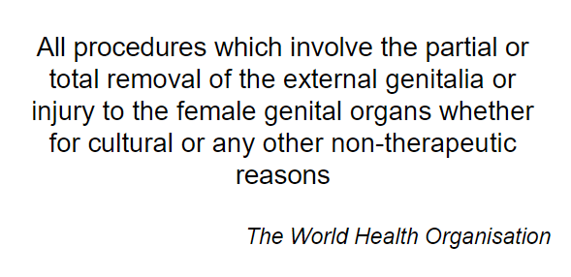
What is Female Genital Mutilation (FGM)?

Slide 2
Please watch this information video. While watching, think of any arguments for and against FGM
https://www.youtube.com/watch?v=kzBNTtR7toE

Slide 3
Ideas for group discussions

Slide 4
Types of FGM

Slide 5
Health Consequences

Slide 6
Long Term

Slide 7
Who is at risk?

Slide 10
How is FGM carried out?

Slide 11
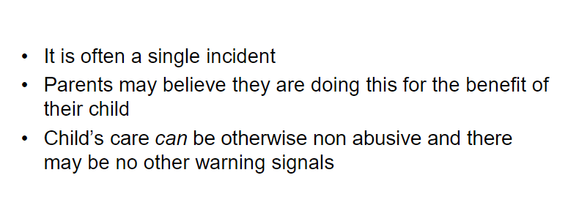
FGM Is Child Abuse

Slide 12
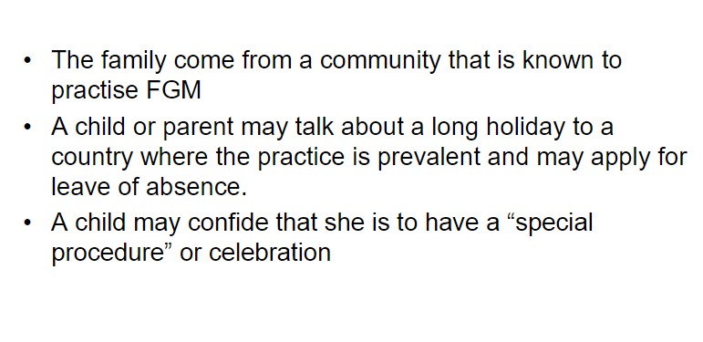
Indications that FGM may be about to take place

Slide 13
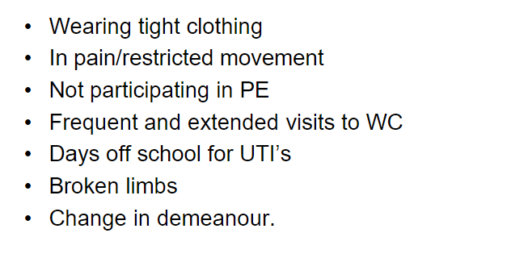
Indications that FGM has been carried out

Slide 15
How can you help?
Keep FGM on your Radar, be alert to signs.
Talk to a trusted adult or member of staff if you have concerns.
Report any concerns. Child protection is everyone's responsibility.
Be aware that school holidays (particularly summer) are a time when it is known that girls are taken out of the country to undergo FGM.

Slide 16
Female Genital Mutilation
FGM is a serious crime and can be fatal.
The survivors of FGM are serving a life sentence

Slide 17
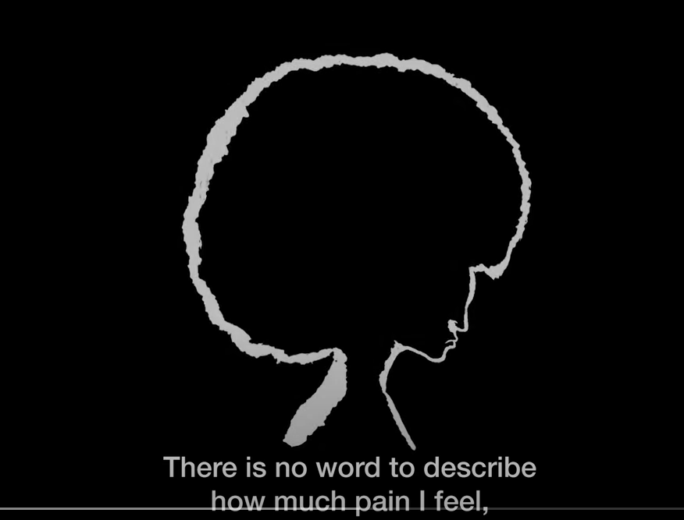
Please watch this video – Raising our voices FGM
https://www.youtube.com/watch?v=cZ_9bybCQWM&t=216s

Slide 18
Signposting for further advice and support
NSPCC National charity working in child protection and the prevention of cruelty to children. www.nspcc.org.uk
ChildLine - Children and young people can contact ChildLine about any problem, big or small, whether they are feeling worried, scared, stressed or just want to talk to someone, they offer information and
support. www.childline.org.uk
Free 24-hour helpline which doesn’t show up on your bill: 0800 1111
Women’s Aid - Works to end violence against women and children. www.womensaid.org.uk 24-hour free helpline: 0800 2000 247
Sexual violence legal advice line: 020 7251 8887

